Slide 1
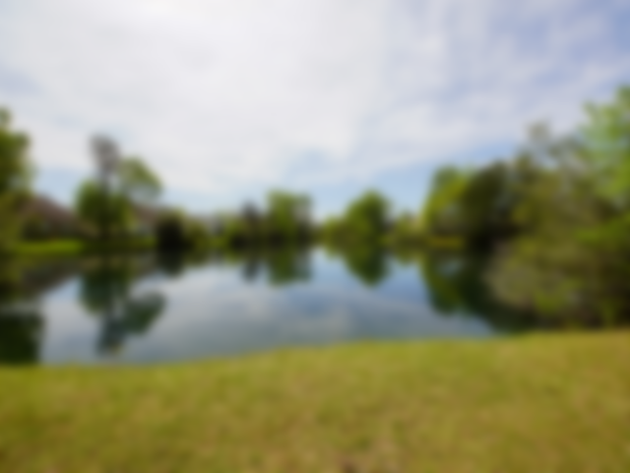
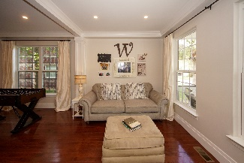
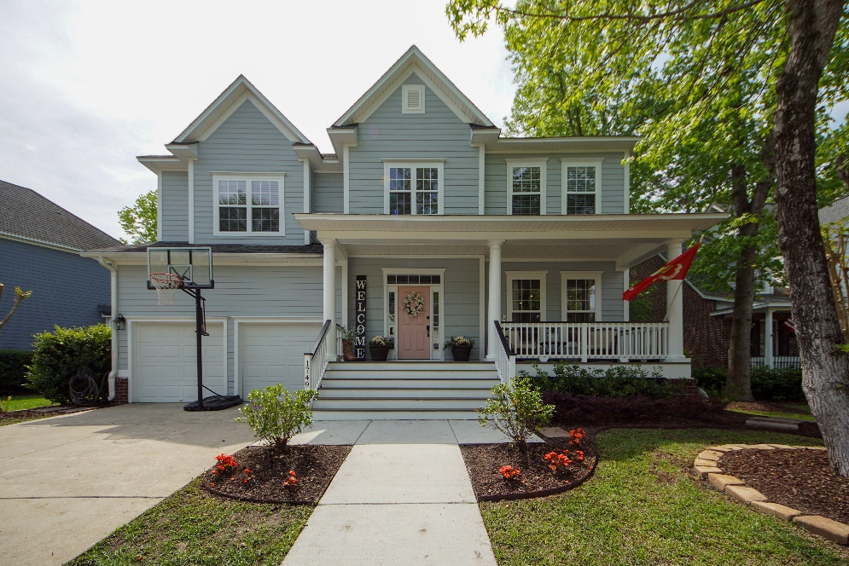
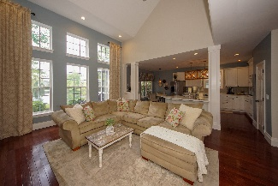
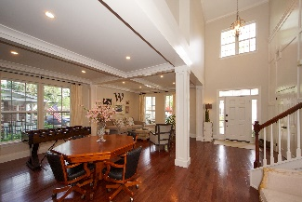
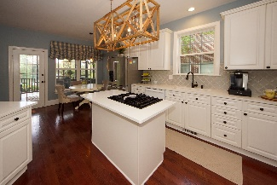
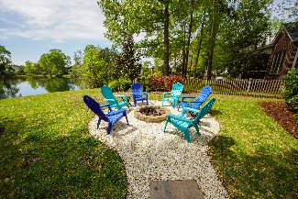
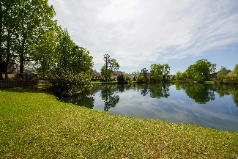
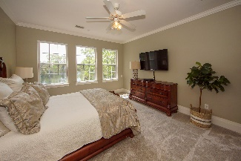
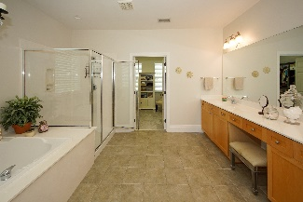
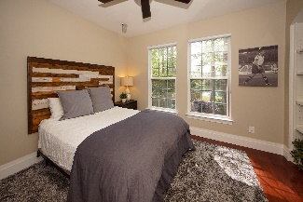
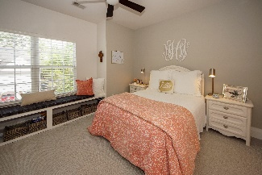
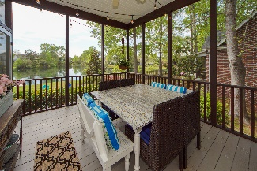
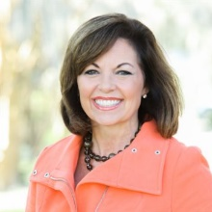

Price Reduction in Park West
1749 James Basford Place Mount Pleasant, SC 29466 | MLS# 20006131 | $599,000
Stunning 4 bedroom, 3.5 bath home with spectacular views of the pond! This home has great curb appeal with mature landscaping, tons of upgrades and is truly move-in ready. As you enter the 2-story foyer, you are welcomed with a large dining room and living room separated by architectural columns, crown molding, chair railing and designer lighting. Custom trim has been added throughout the home. The views of the pond are breathtaking from the foyer, kitchen, family room, study, and master bedroom. The kitchen has been upgraded with new quartz countertops, backsplash, island with gas cooktop, double ovens, under mount sink, and designer lighting over the island and breakfast table. The kitchen opens to a 2-story family room with built-ins, LED recessed lights, ceiling fan, surround sound, and a 2-sided fireplace with gas logs. The first floor media/study with French doors, built in shelves, shares the 2-sided fireplace. The main level also has a powder room, spacious laundry and a 2-car garage. The screen porch is off the kitchen and steps down to a spacious patio and nearby fire pit making it the perfect spot to entertain and enjoy the peaceful wildlife and pond. The master suite features amazing pond views from the triple windows, crown molding, ceiling fan, Hunter Douglas shades, and built-in shelves. The master bath is equipped with, dual vanities, recessed lights, linen closet, glass enclosed shower, and an oversized jetted soaking tub and leads into a huge closet updated with a shelving system. There are 3 additional upstairs bedrooms, hall linen closet, 2 full bathrooms with ceramic tile floor, and hall desk area with shiplap. Park West amenities include 2 pools, a clubhouse, play area, six-lighted tennis courts, and miles of trails for walking and biking. A $1800 Lender Credit is available and will be applied towards the buyer's closing costs and pre-paids if the buyer chooses to use the seller's preferred lender. This credit is in addition to any negotiated seller concessions.
Debbie Rogers (843) 990-2915
deborah.rogers@carolinaone.com
www.DebbieRogersSellsCharleston
Carolina One Real Estate | 2713 Highway 17 North | Mt. Pleasant, SC 29466

