Slide 1
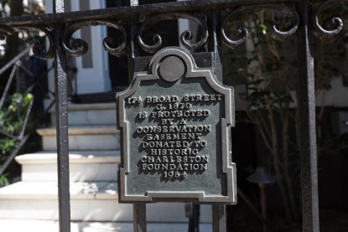
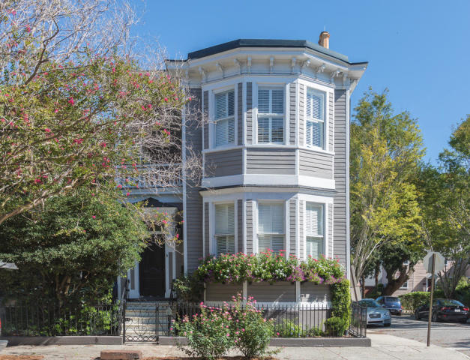
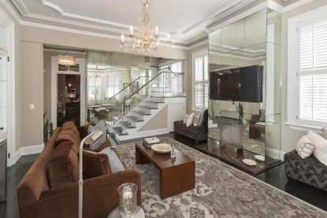
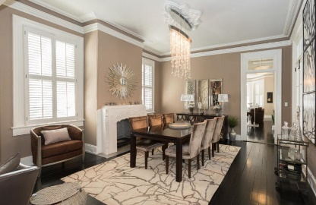
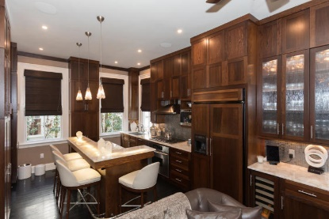
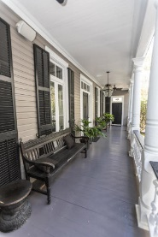
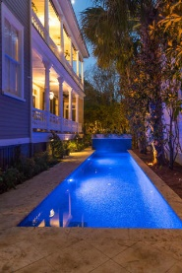
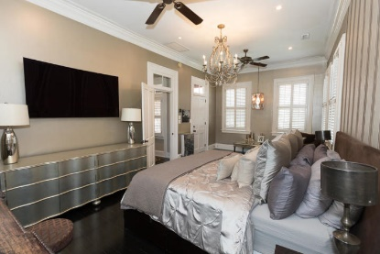


Harleston Village Open House & Luncheon
Tuesday, October 9th 11-2
174 Broad Street
Charleston, SC 29401 · MLS# 18025884 · $2,400,000
Absolutely gorgeous historical down town home on Broad. Completely renovated 4 bedroom 4.5 bathroom by Cook Bonner Construction. Original hardwoods, moldings, and plantation shutters through out. Beautiful onyx counter tops in kitchen with lighted under counter island. Jerusalem wenge wood cabinets to ceiling. Built in KitchenAid refrigerator and dishwasher. Custom backspalsh. 6 burner high profile stove with outside vented hood. 4 fireplaces total. 2 with ethanol burners. Huge porch with ceiling fans off the dining and living rooms overlooking lighted pool. Guest suite down stairs with Toto Washlet. Upstairs are 3 additional bedrooms including the master. All are en suites. Front bedroom has huge window seat with trundle, fireplace, and built ins. Huge balcony off master bedroom with sun shades. His and hers walk in closets. Master bath has limestone floor to ceiling with radiant heat flooring. Separate extended length tub and seamless glass walk in shower with 4 Kohler shower heads and body sprays. Water closet with Toto washlet. Marble counter vanity with back lit mirror with built in TV. There is an outdoor kitchen in the beautifully landscaped yard with Wolf grill, green egg, sink, refrigerator, ice make and plenty of storage. Rocks by pool are a mosquito control system. Waterfall at head of the pool has color changing lights. Home has custom lighting through out. Lightning suppression system and home security. Off street parking for 2 cars with security gate. Absolute luxury!!
Michael Dew
O 843-769-5100
M 843-870-7000
michaeledew@gmail.com
www.michaeldewrealestate.com
AgentOwned Charleston Group
902 Savannah Hwy
Charleston, SC 29407
Real Estate ● Mortgage
Insurance ● Business Brokerage

