Slide 1
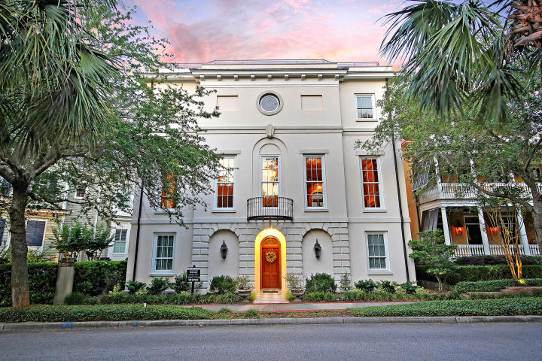

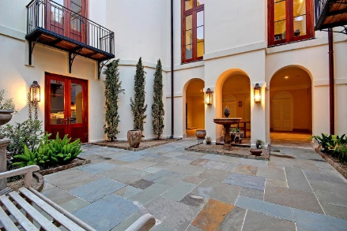
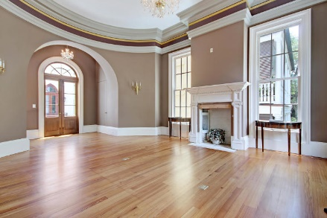
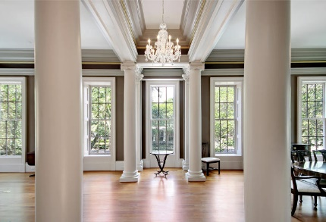
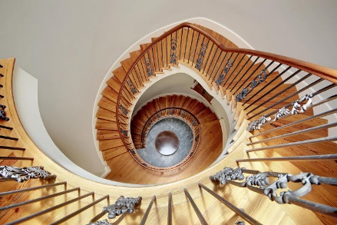
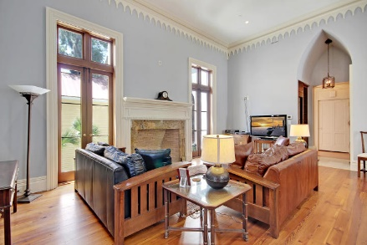
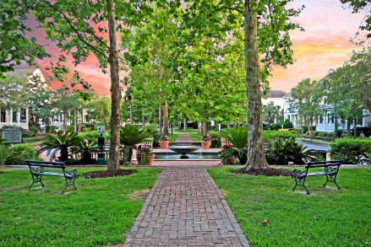
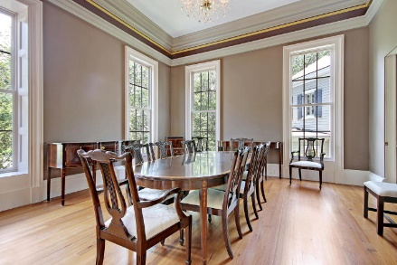
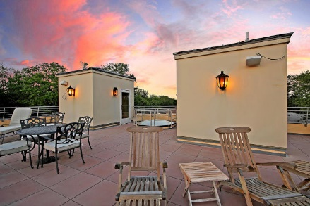
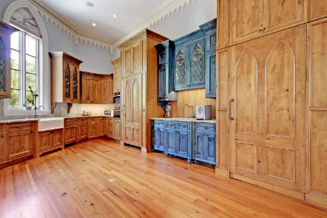
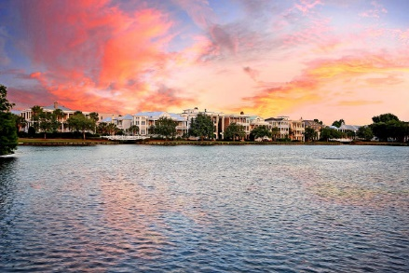
$225K Price Drop!
Open House
Thursday, Oct 24, 4:30-7:00
Price Reduced!
174 N Shelmore Boulevard I'On ~ Mount Pleasant, SC 29464 ~ MLS# 19024848 ~ $1,770,000
This unique home in Mount Pleasant's ION neighborhood is a one of a kind gem. The grandeur of this unique home cannot be surpassed. Walk in the door to discover details such as intricate moldings, arched doorways, atrium style sky lights, custom iron work, oversized columns, and gorgeous high end fixtures. The kitchen is straight out of a design magazine! The custom cabinetry features gorgeous Gothic details with hidden refrigerator and pantry. The oven range and hood is a showstopper and every chefs dream. The master bedroom overlooks the courtyard below with functioning French doors to allow the fresh air in. Travel from floor to floor of this amazing home via elevator or the beautiful spiral staircase, flooded with light from the skylight above. Arrive on the top floor to the rooftop deck and prop your feet up after a long day while watching the sun set over beautiful ION.
Additional features include:
First floor features a master with easy accessibility.
Gorgeous stone courtyard with covered patio, plumbed for outdoor kitchen.
Large garage with room for several cars.
Gorgeous chandeliers, moldings, and fireplace in the grand ballroom.
Living room features functional doors, open to the courtyard below.
High end appliances and fixtures in the custom, one of a kind kitchen.
Book your showing today!
True Edwards true@trueedwards.com 843-442-6253

