Slide 1
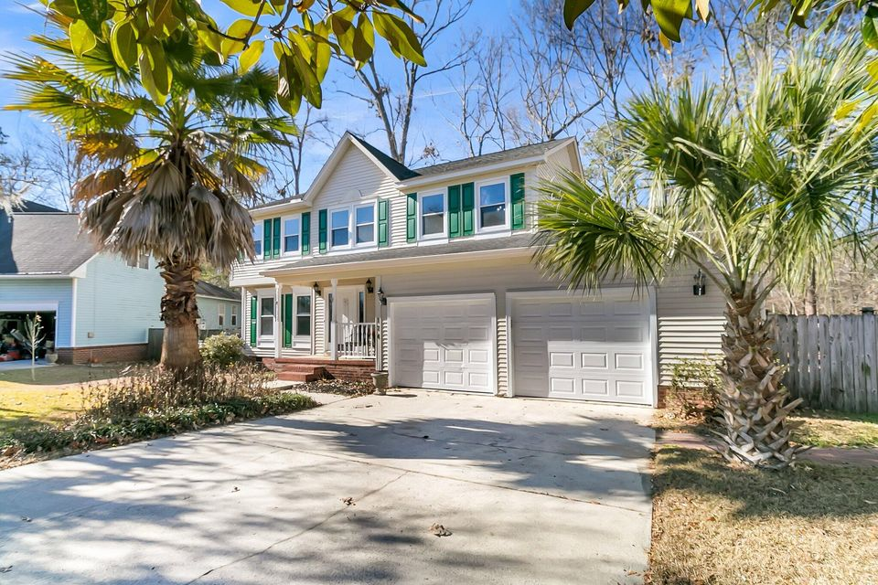
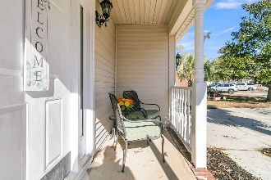
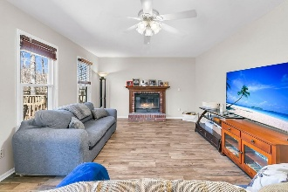
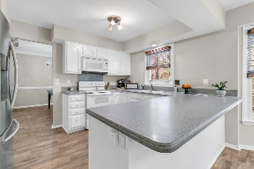
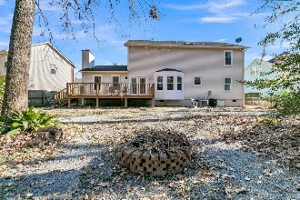
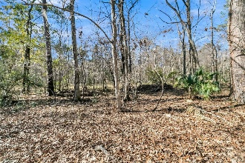


***PRICE REDUCTION***
$15,000 Agent Bonus
with ratified contract by 4/15/18
174 Winding Rock Rd
Crowfield Plantation
Goose Creek, SC 29445
MLS# 25002012
$395,000
$12,100 Under
Recent Appraised Value
Welcome to 174 Winding Rock Rd, a stunning 4-bedroom, 2.5-bath residence nestled in the highly sought-after Crowfield Plantation community. Boasting 2,408 square feet of beautifully updated living space, this home seamlessly blends charm with everyday comfort, offering an opportunity to live in amazing community. . Discover a freshly painted interior complemented by newly refinished kitchen cabinets and smooth ceilings, creating a bright and welcoming atmosphere. Brand-new flooring flows throughout, adding a touch of sophistication to every room. The upstairs features four spacious bedrooms, including a luxurious primary suite with a spa-inspired ensuite.
The main level offers remarkable versatility, with a flex space perfect for a home office or playroom, and a centrally heated and cooled bonus room off the kitchen - ideal as a workshop, hobby space, or cozy retreat. The heart of the home, the family room, invites you to entertain or relax, with French doors leading to a generous deck. Here, you'll enjoy serene views of the fenced backyard, bordered by a tranquil wooded buffer. With direct access to Crowfield Plantation's 10 miles of paved walking and biking trails, this home is a haven for residents. As part of Crowfield Plantation, you'll have access to a wealth of amenities, including a championship golf course, resort-style pools, tennis courts, playgrounds, and scenic fishing ponds. This vibrant community truly offers something for everyone. outdoor enthusiasts.
Schedule your tour today!
William R Everett, Jr
(843) 693-8539– C (843) 576-2701 – O
bill@theeverettgroup.net
RE/MAX Southern Shores
9209 University Blvd, Charleston, SC 29406

