Slide 1
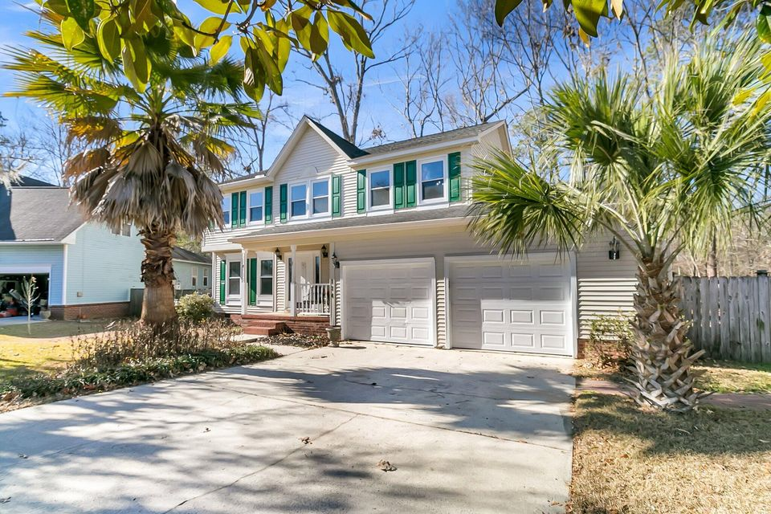
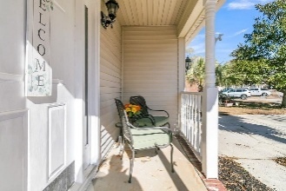
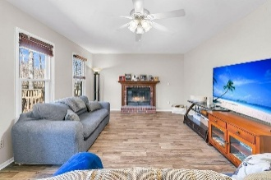
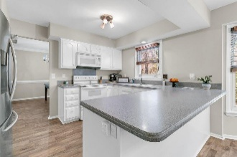
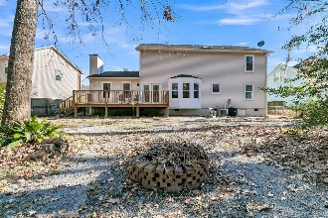
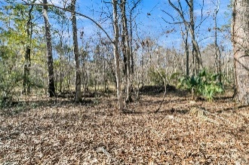


Dream Home Now Within Reach! Discover Your Perfect Space At A New Price!
$15,000 Agent Bonus
with ratified contract by 4/15/18
174 Winding Rock Rd
Crowfield Plantation
Goose Creek, SC 29445
MLS# 25002012
Reduced to $375,000
$12,100 Under
Recent Appraised Value
Upgrades and improvements to home
■ Termite bond in place
■ All new flooring throughout main living area and bedrooms
■ Smooth and freshly painted ceilings through entire home
■ New paint done throughout home
■ Cabinets redone in kitchen
■ New (less than 1 month) Stainless steel appliances in kitchen
■ Leaf Fitter gutter protection system installed with 50 year warranty, purchased in 2021
■ New duct work and crawl space under home in 2022
■ Split HVAC Unit upstairs 2020 and bottom floor 2022 as well as, all new ductwork
Schedule your tour today!
William R Everett, Jr
(843) 693-8539– C (843) 576-2701 – O
bill@theeverettgroup.net
RE/MAX Southern Shores
9209 University Blvd, Charleston, SC 29406

