Slide 1

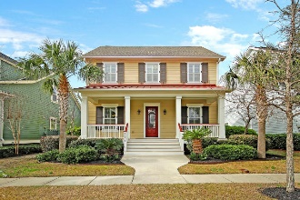

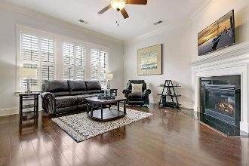
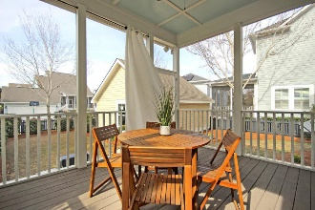
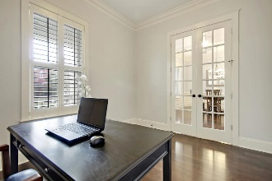
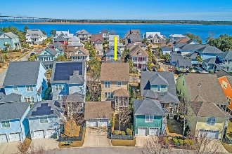
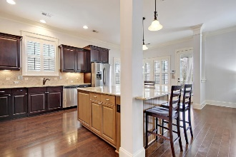
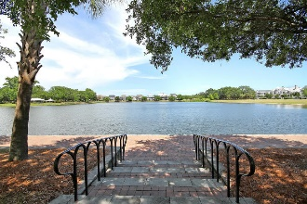
Great Downtown Investment Opportunity
Price Reduced!
1751 Providence Street Daniel Island, SC 29492 ~ MLS# 19004628 ~ $672,000
Pristine custom home on desirable Daniel Island, a short drive from historic downtown Charleston, great beaches and the airport. Whether you are looking to purchase your first home or your last, this beautiful Daniel Island home has something to offer everyone! Every detail was thought of in the design of this custom home. Walk in the door to discover pristine hardwood flooring and an open flowing floor plan. You immediately notice the 10' ceilings, beautiful molding and trim work, plantation shutters, and lovely French doors into the first floor office. Wander into the custom gourmet kitchen where every cook will fall in love the oversized island and stainless steel appliances. The island has seating for 5 and is the perfect place for entertaining!
There is a breakfast area and a formal dining room. The front porch and screened in back porch overlooking the fenced in yard are perfect for year round enjoyment. This home is located in desirable Mitchell's Wharf/Smythe Park neighborhood on Daniel Island just steps away from the Wando River where you won't want to miss the show stopping sunrises and sunsets! Community Amenities include: miles of walking/biking trails, tennis, pools, multiple playgrounds, community boat dock, shops, restaurants and the Volvo Tennis Center -- a great venue for concerts and sporting events.
Buyer pays a one-time neighborhood enhancement fee of .5% of the sales price to Daniel Island Community Fund at closing. Daniel Island Resale Addendum will be required to offer purchase. Daniel Island Resale Addendum, Property Disclosure, and Community Fund Disclosure are attached.
Additional Features:
Book your viewing today!
Large front porch with gas lanterns.
Fenced backyard and large screened back porch
Separate dining room with wainscoting
State of the art security system
Energy efficient heating system
Gas fireplace with granite surround
New hardwood flooring and new carpet on second floor
Fresh paint throughout
Three spacious bedrooms plus bonus loft area
Second floor laundry room with front loading machines
Paige Rhodes 843-830-3281 paige@mattoneillteam.com
Ben Laaper 843-642-3546
ben@mattoneillteam.com

