Slide 1
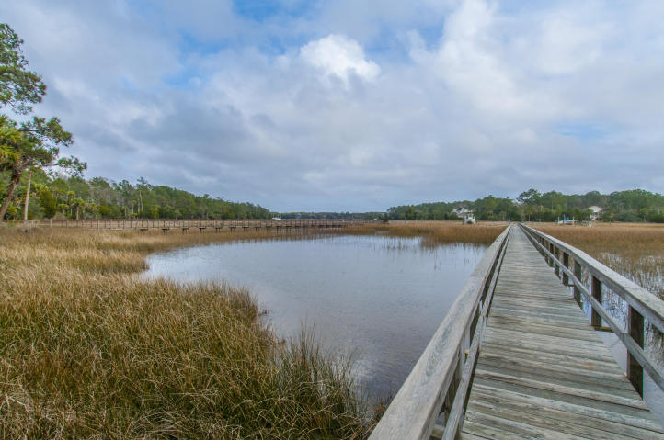
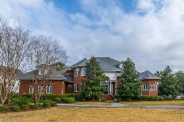
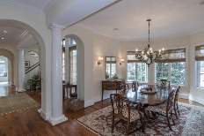
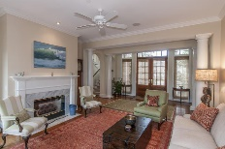
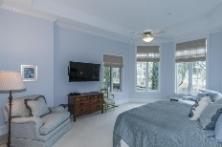
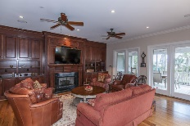
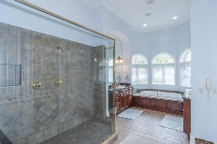
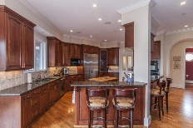
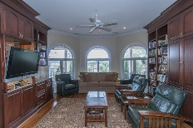
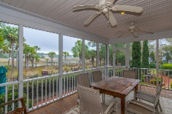
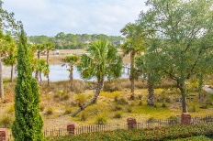
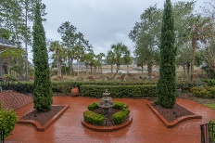
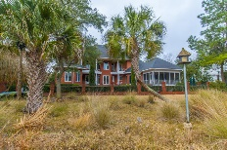
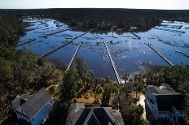
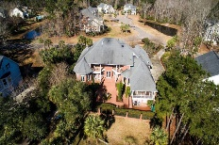
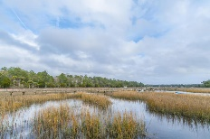


1752 Greenspoint Court
Dunes West ~ Mount Pleasant, SC 29466 ~ MLS# 16003260 ~ $1,600,000
Just Listed! Stately Executive Waterfront in Home Dunes West!
Welcome to your stately waterfront home on beautiful Wagner Creek! This custom executive home provides water views from most every room. This home has been carefully designed and was awarded the Prism Award for Building in 2002. It boasts just under 5000 square feet of beautifully appointed trim, custom built ins and detail. This home has a shared dock walkway but its own boat lift and floater with two feet of water at low tide. From Wagner Creek it's only a short ride to the Wando River then onto the Charleston Harbor and ocean. From the moment you step into this home you have expansive views out back through the formal living room. You will feel the spaciousness of the floor plan which offers plenty of room to entertain - both indoors and out. The open kitchen features a brand new subzero refrigerator, new Miele dishwasher, and disposal. The cherry kitchen cabinetry is expansive with loads of room for storage and the raised granite bar provides plenty of casual seating. The family room flows right off the kitchen and the centerpiece of the room is a stunning wall of cherry built-in cabinetry with fireplace. The back of the home is filled with windows and doors which flood the room with light and allow for easy access to the adjoining screened porch and covered patio. Also off the kitchen you will find the formal dining room, half bath, and large laundry/utility room. On the opposite side of the downstairs is the master suite featuring a 12' tray ceiling, his and her closets, bay window seating area, and spacious master bath. The oversized custom tiled master shower has dual showerheads. His and her vanities, a large garden tub and the same cherry cabinetry as in the kitchen complete the space. Next door to the master is the perfect office space complete with custom built in cabinets. Upstairs get ready to relax in the finely appointed media room/office/or library. You choose how to use it, but enjoy the elegant cherry built ins on both sides and the water views from the back. This space also has a built in mini fridge and wet bar. Four additional bedrooms complete the upstairs as well as 2 baths. The 5th room on the end also has built in desk and would be great as a craft or multi-purpose space. Two of the bedrooms also open onto upstairs balconies that overlook the backyard and the water. As special as the interior is, the beauty doesn't stop there. The back yard is an exquisite combination of hardscape and lush landscape. All of it is fenced in between brick pillars and iron pickets. It's your own piece of paradise! All the foilage make it extremely private as well. Come see for yourself the best of low country living!
Melodie Smith
(843) 408-5067 M
melodie.smith@carolinaone.com
www.melodiesmithrealestate.com

