Slide 1
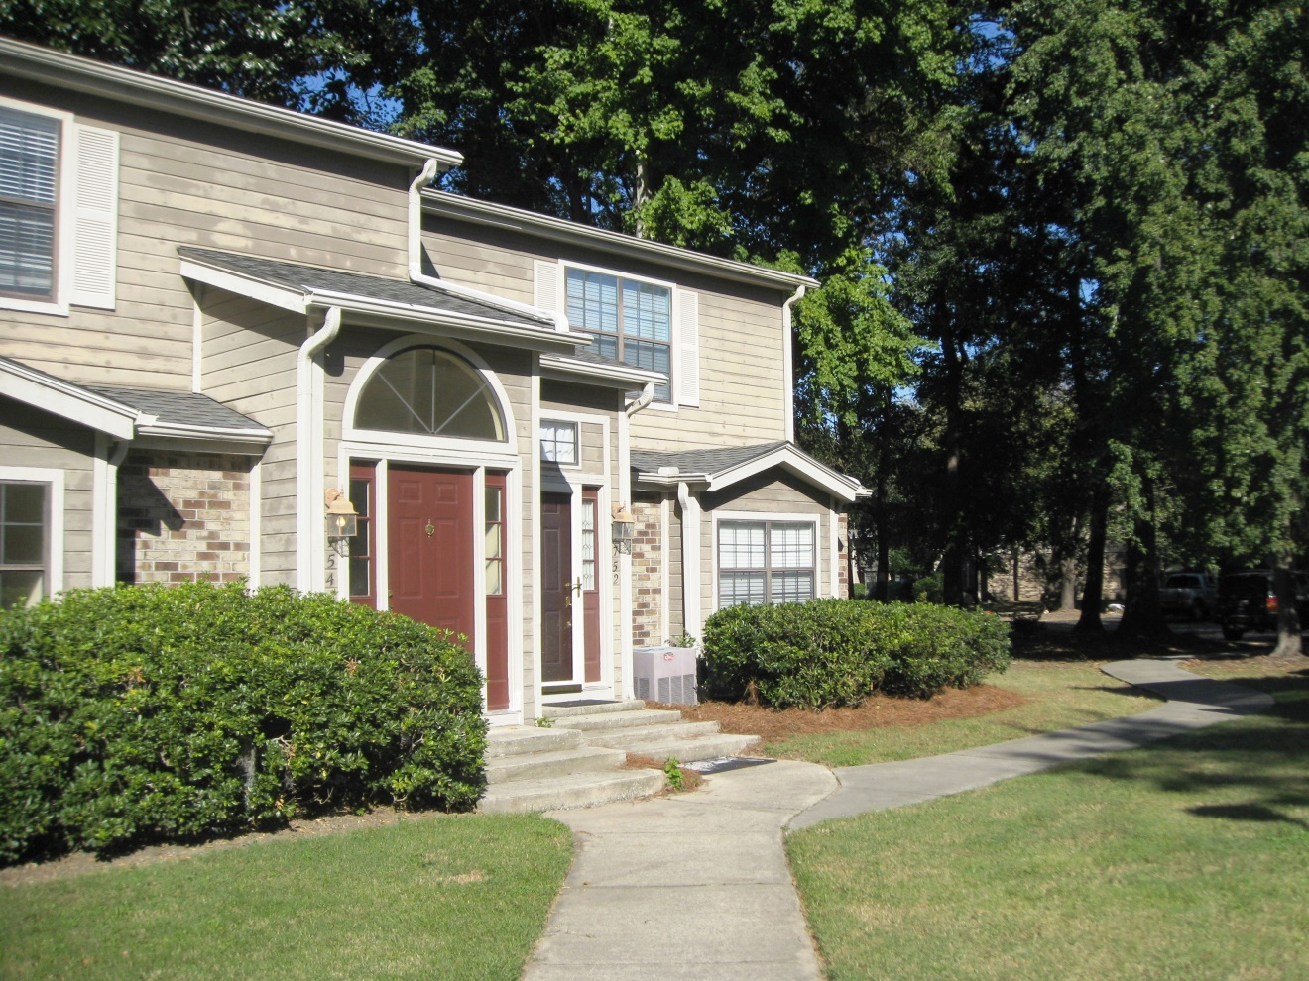
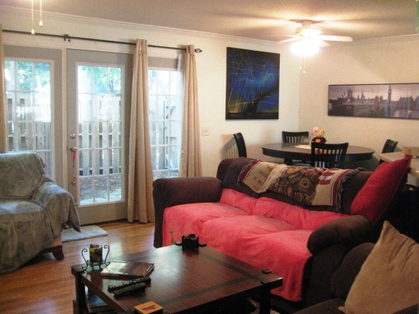
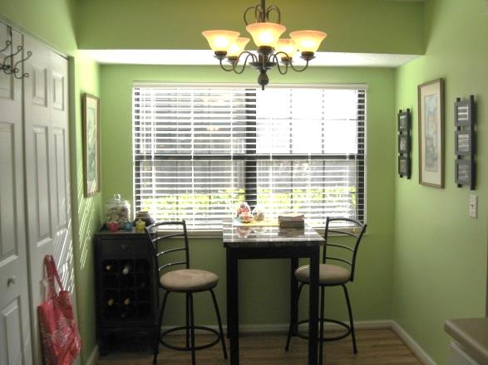
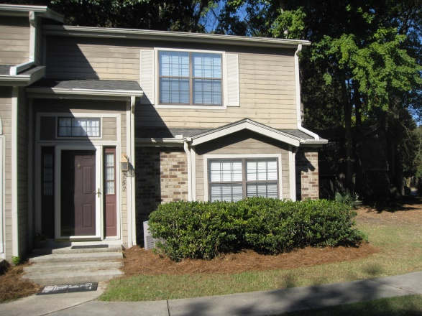


Great Value in Mount Pleasant
1752 Parc Vue Ave
Montclair
Mt Pleasant, SC
MLS# 14028261
$159,900
2 Bedrooms
2½ Baths
1,206 sq ft
MONTCLAIR! Convenient & affordable Mt Pleasant living! Located across from Towne Centre, restaurants, movies & just few miles from beaches & downtown Charleston. Lovely end unit with tranquil wooded yard! In last 2 years owner has: added privacy fence, replaced glass sliding doors to patio with French Doors, new high pile carpet & padding, Pergo floors downstairs, new glass shower door, some new light fixtures, fresh paint & wireless thermostat.
Unit has large bedrooms, plenty of closet space, ceiling fans, open floor plan, new roof in 2012,new chimney approx. 8 years ago, patio, Community pools, club house, fitness centers, tennis courts, walking trails & boat storage. Monthly fee covers; water, sewer, termite bond, monthly pest control, sanitation services, amenities, on-site Manager, building maintenance (roof, siding, gutters) landscaping and exterior building insurance, Flood Insurance.
Jeanne Weekley
843-442-3364 {M}
jeanne.weekley07@comcast.net
ERA Wilder Realty, 125-F Wappoo Creek, Charleston, SC 29412

