Slide 1
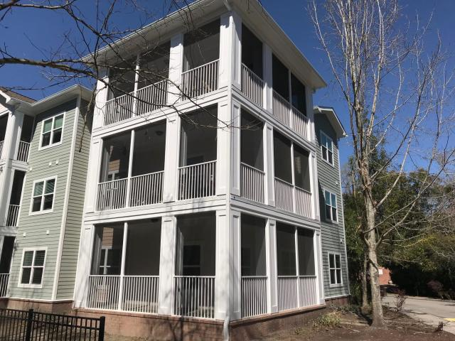
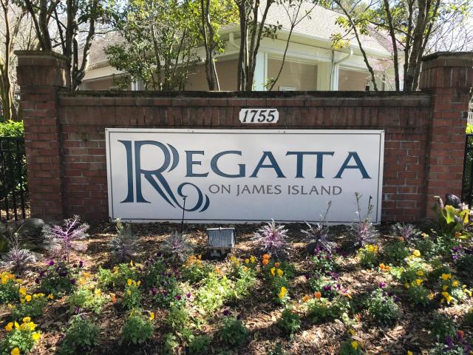
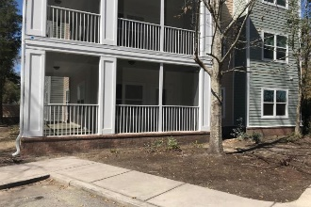
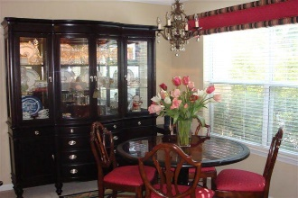
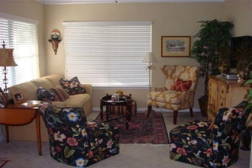
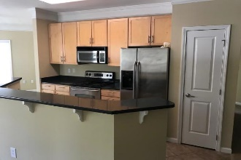
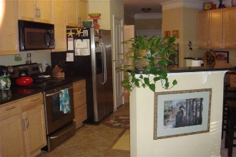
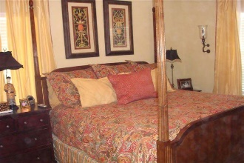
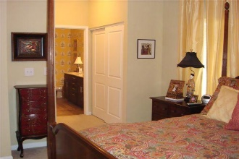
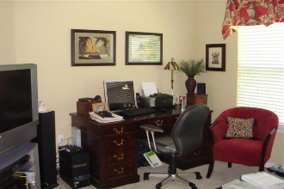
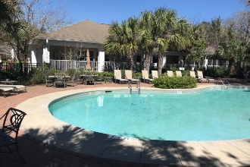

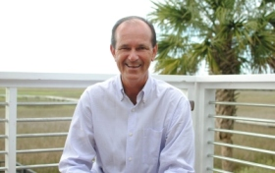
1755 Central Park Rd Road 4102
Regatta On James Island · Charleston, SC 29412
MLS# 19006569 · $240,000
Motivated Seller
$550,000
Beautiful 3 bedroom unit with tons of upgrades,, 10 Minutes to downtown Enjoy this first floor condo, Including New siding, New wind resistant windows, Washer , Dryer, Fridge, included in the sale. Very nice large screen porch off the living room, Move in ready, First Floor Unit I minute walk to Clubhouse and Pool. Very well cared for. Large bedrooms large closets in every room. Experience James Island living without the need for Yardwork or outside maintenance. Its a must see to appreciate.
VERY MOTIVATED SELLER!!!
Nick Collins
Office - (843) 266-5000
Mobile - (843) 224-8771
ncollins@carolinaone.com
www.nickacollins.com
Carolina One Real Estate | 2713 Highway 17 North | Mt. Pleasant, SC 29466

