Slide 1
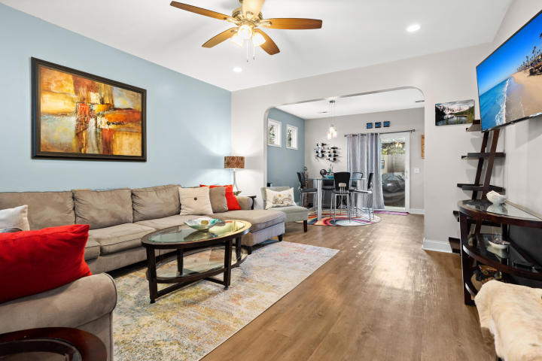
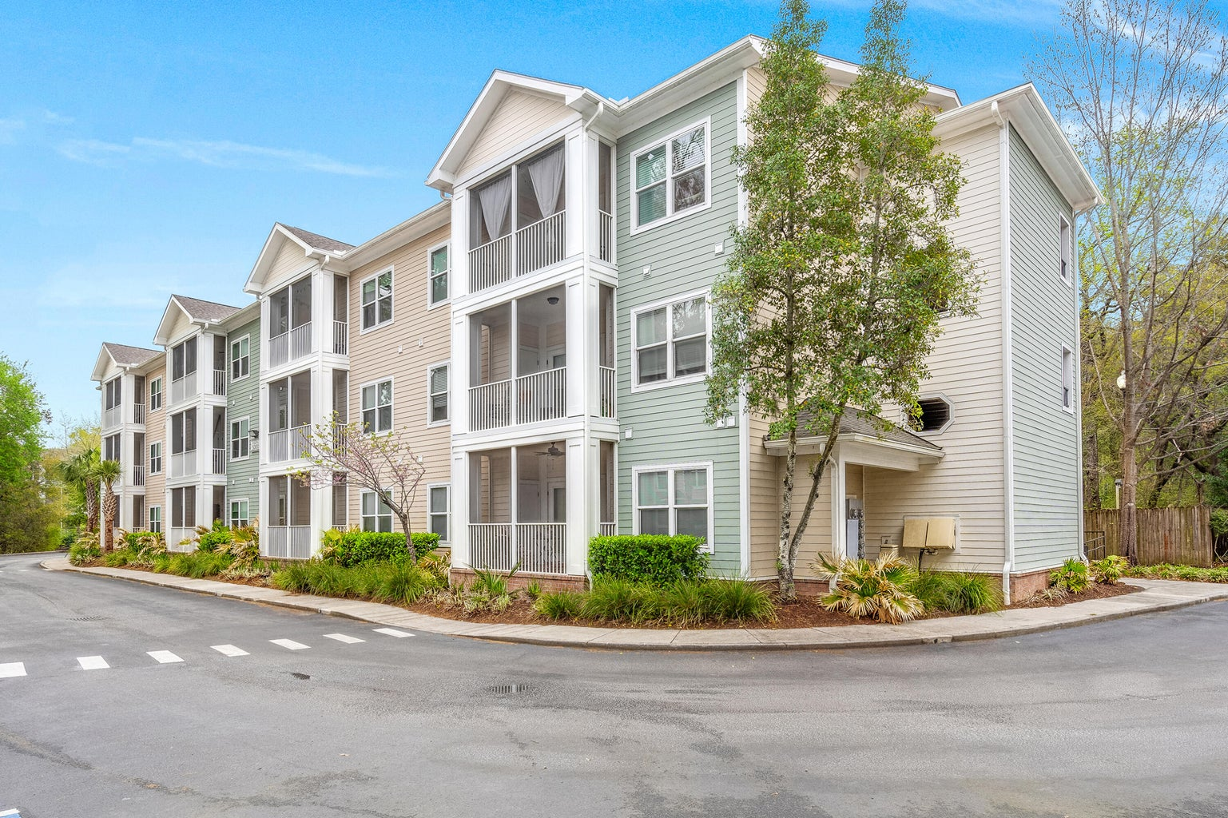
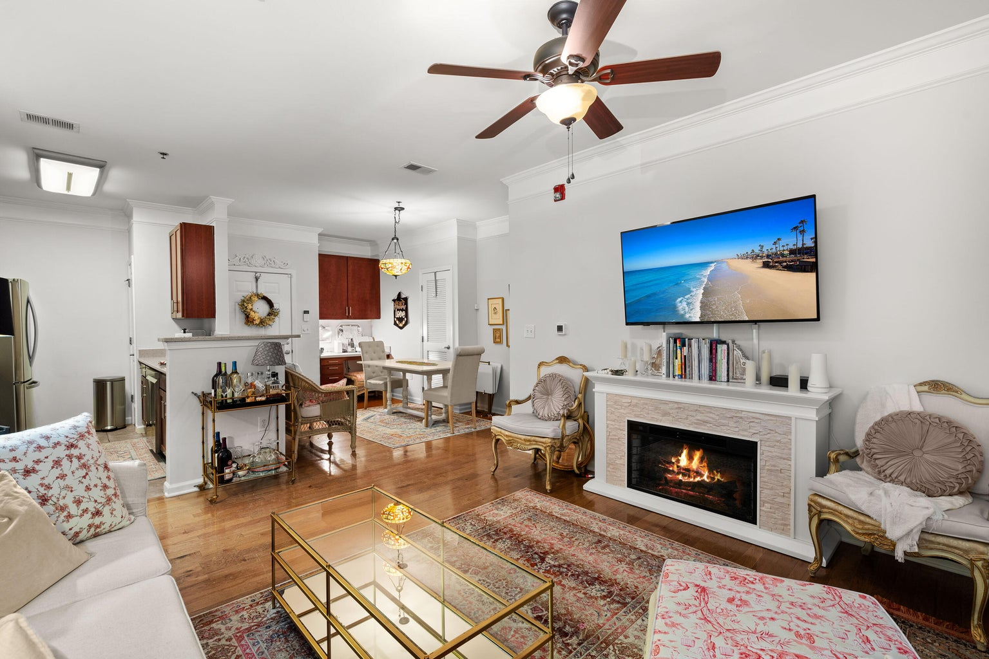
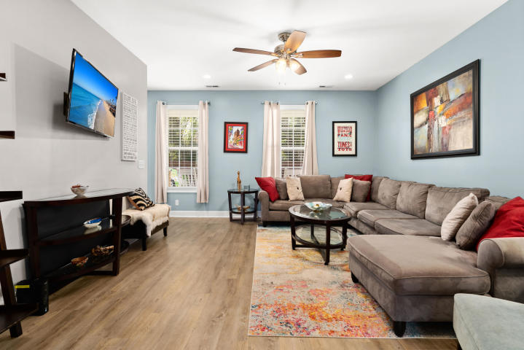
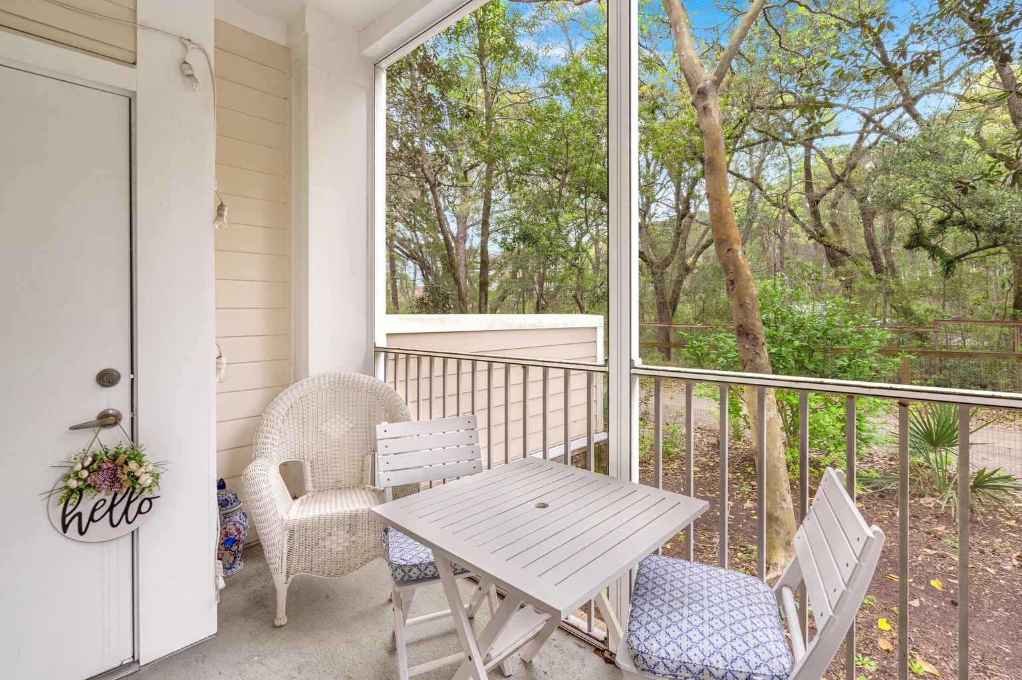
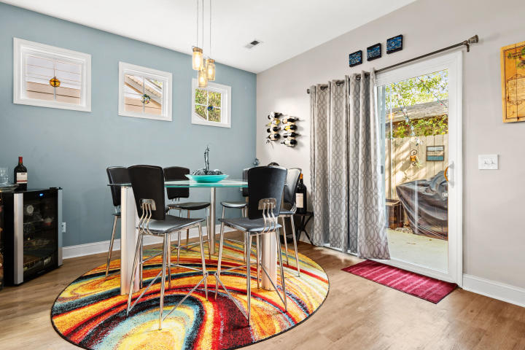
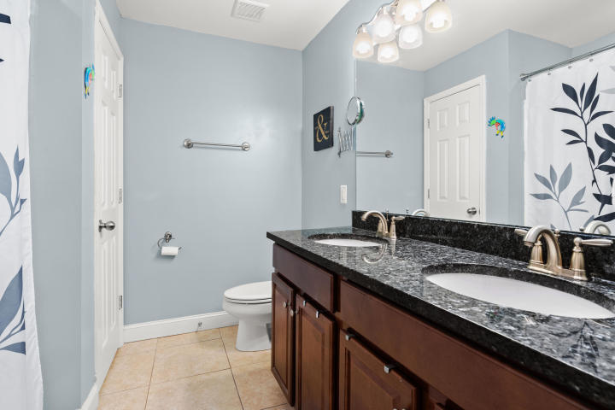
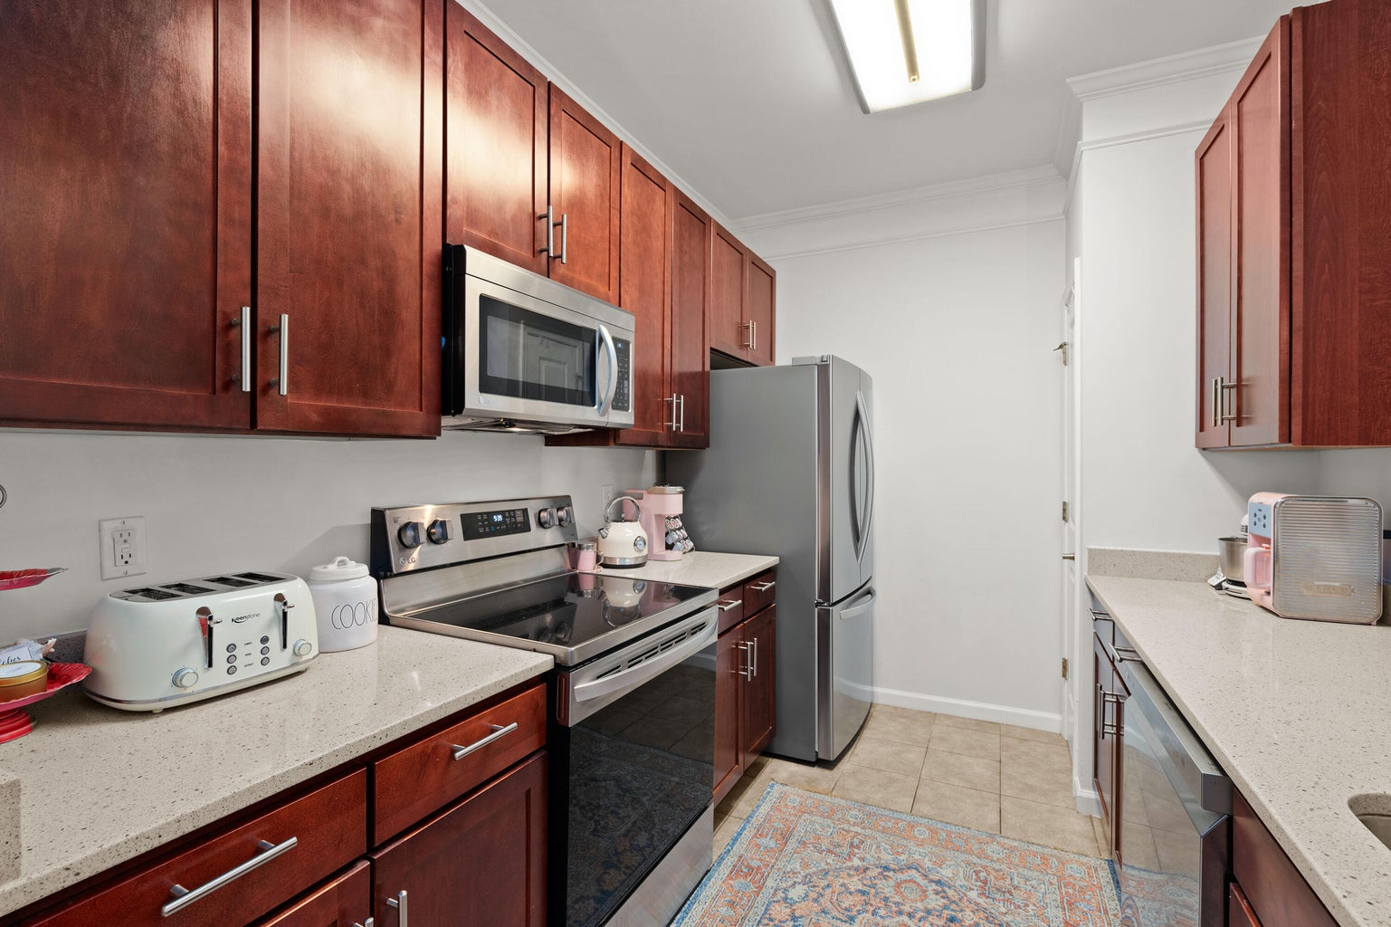
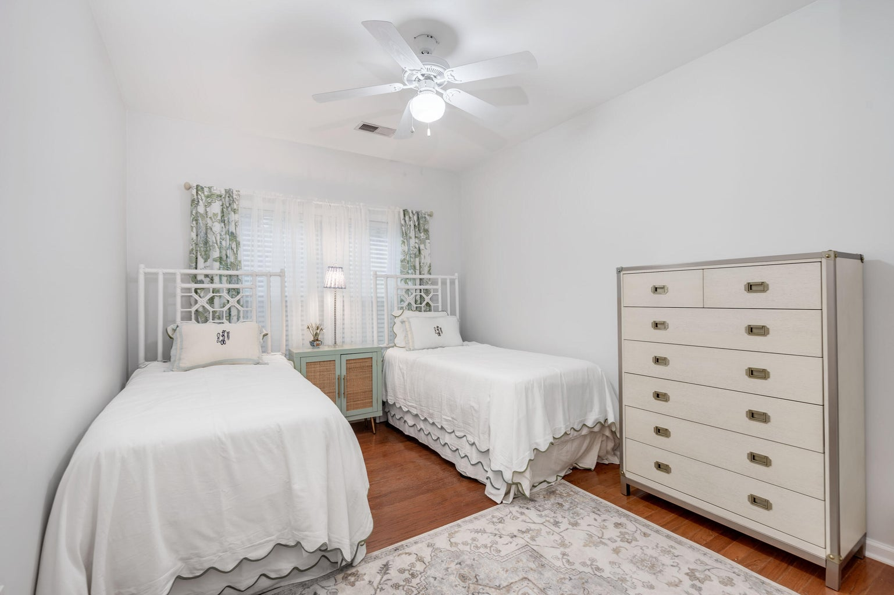
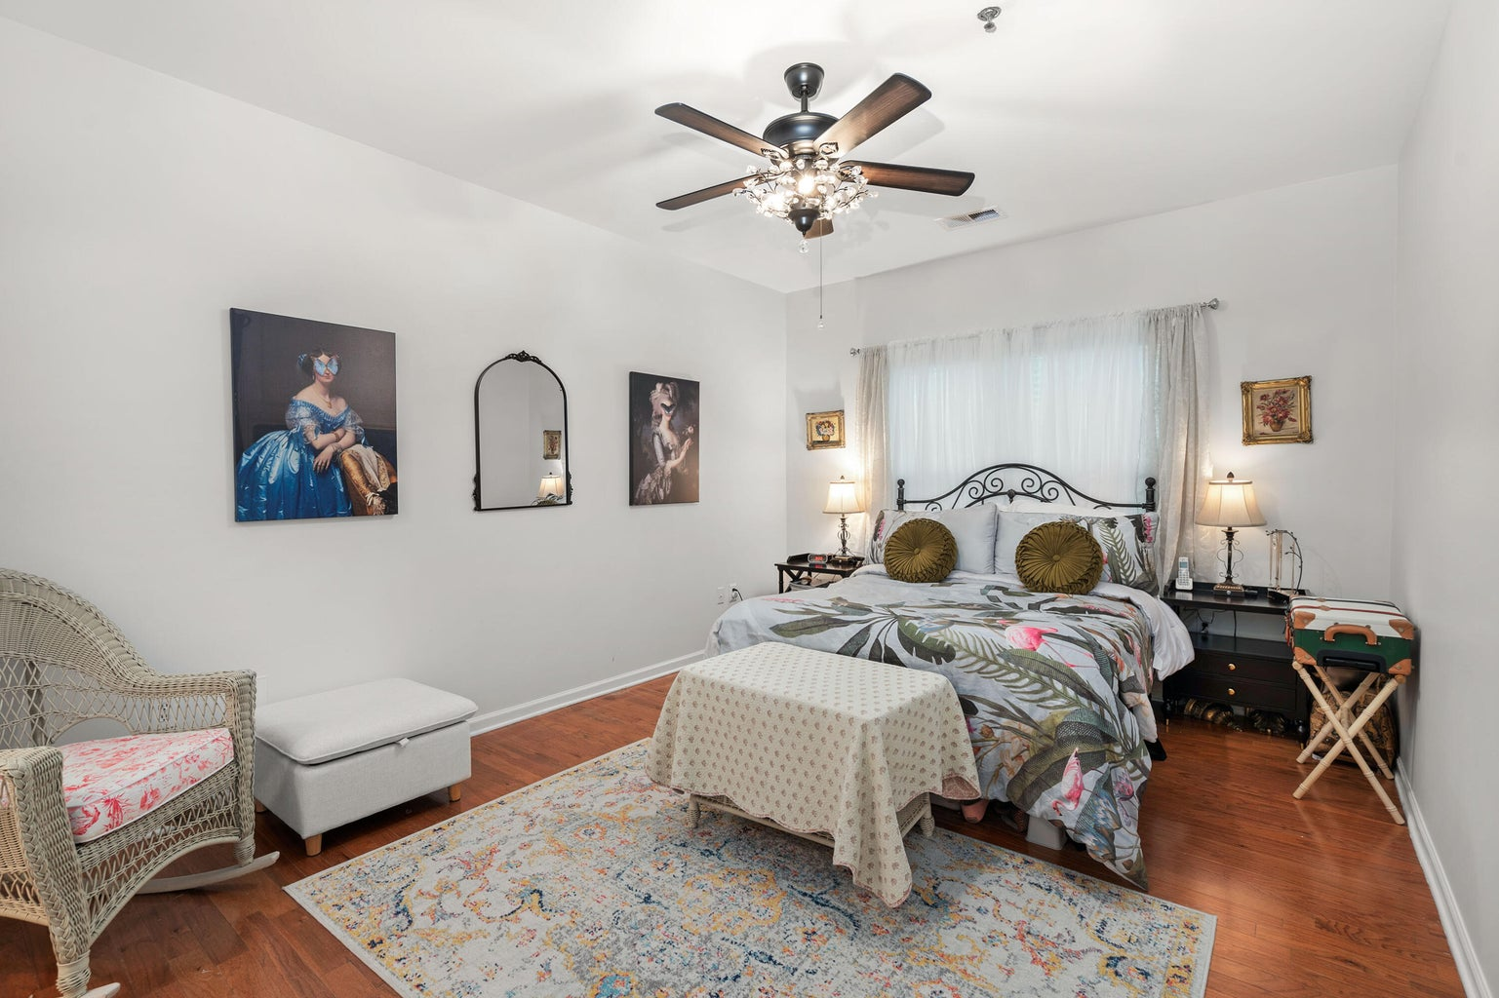
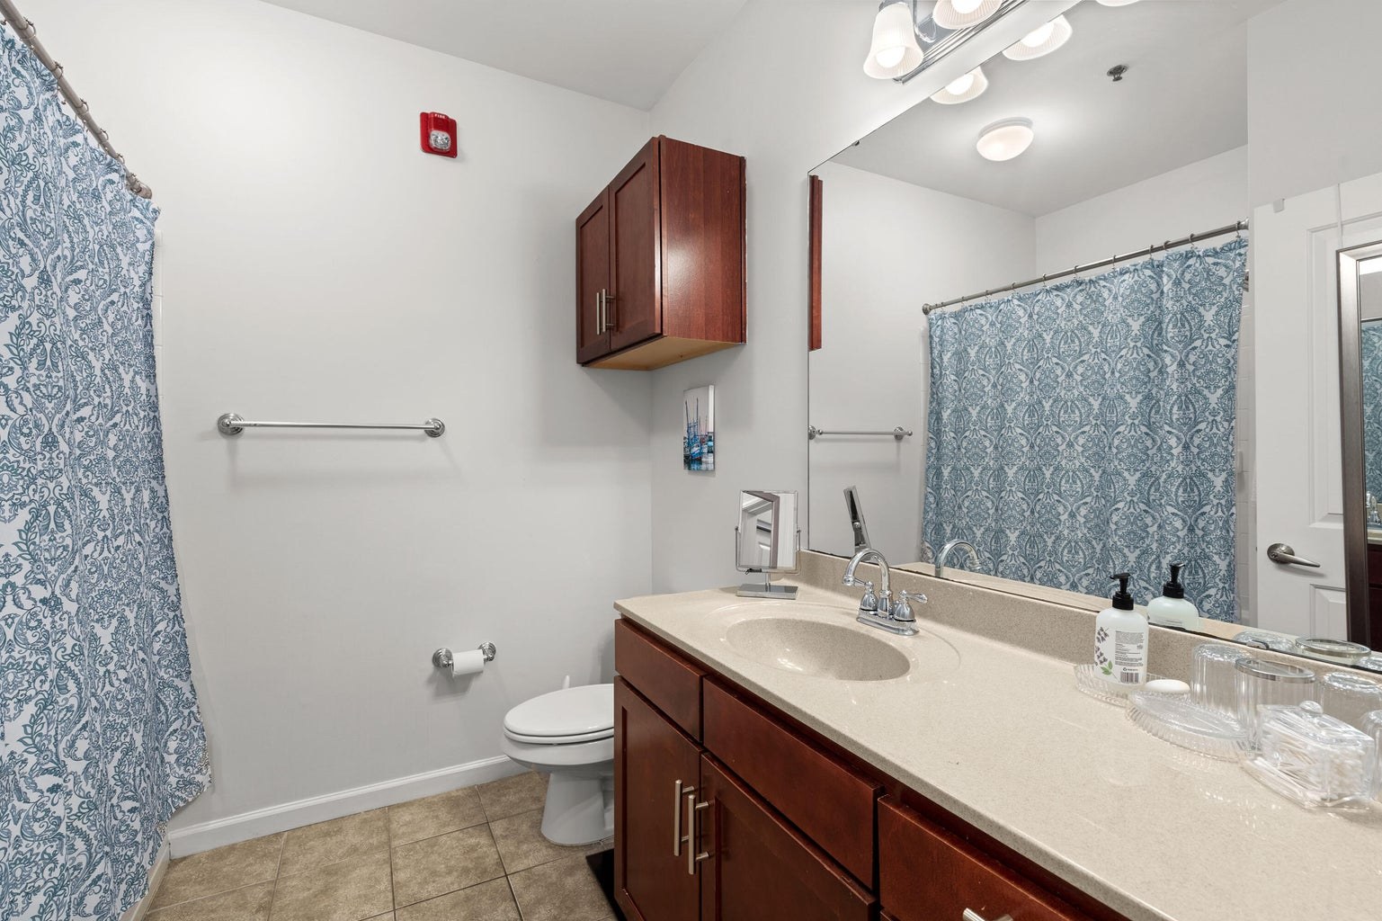

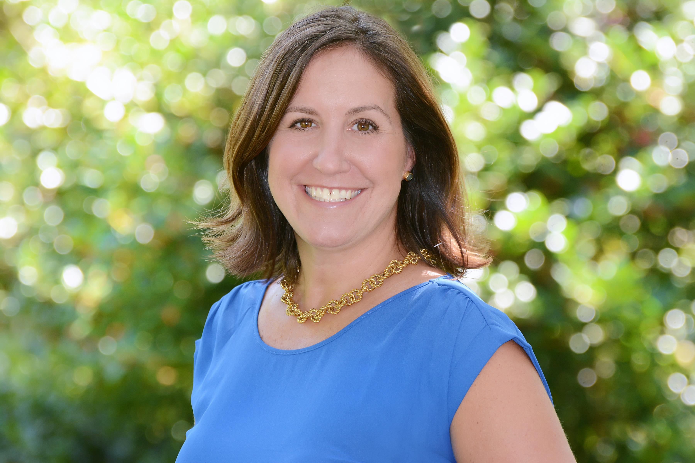
Gorgeous 2/2 Condo 5 Mins from Downtown!!!
1755 Central Park Road 5108
Regatta On James Island · Charleston, SC 29412 · MLS# 23025714 · $355,000
Gorgeous first floor condo in desirable Regatta on James Island. Unbelievable location that is just minutes from downtown and about 10 minutes to Folly Beach. The Regatta is like a private oasis teaming with amenities. The unit has engineered hardwoods throughout. The condo was freshly painted two years ago and new appliances were installed. Roof 2021, HVAC 2019. The balcony is private with no neighbors in sight. Easy to see!
Keller Williams Realty Charleston West Ashley
1180 Sam Rittenberg Ste 300
Charleston, SC 29407
Amy Z. Powers
(843) 534-3523
amy@amyzonarich.com
liveandlovecharleston.kw.com

