Slide 1
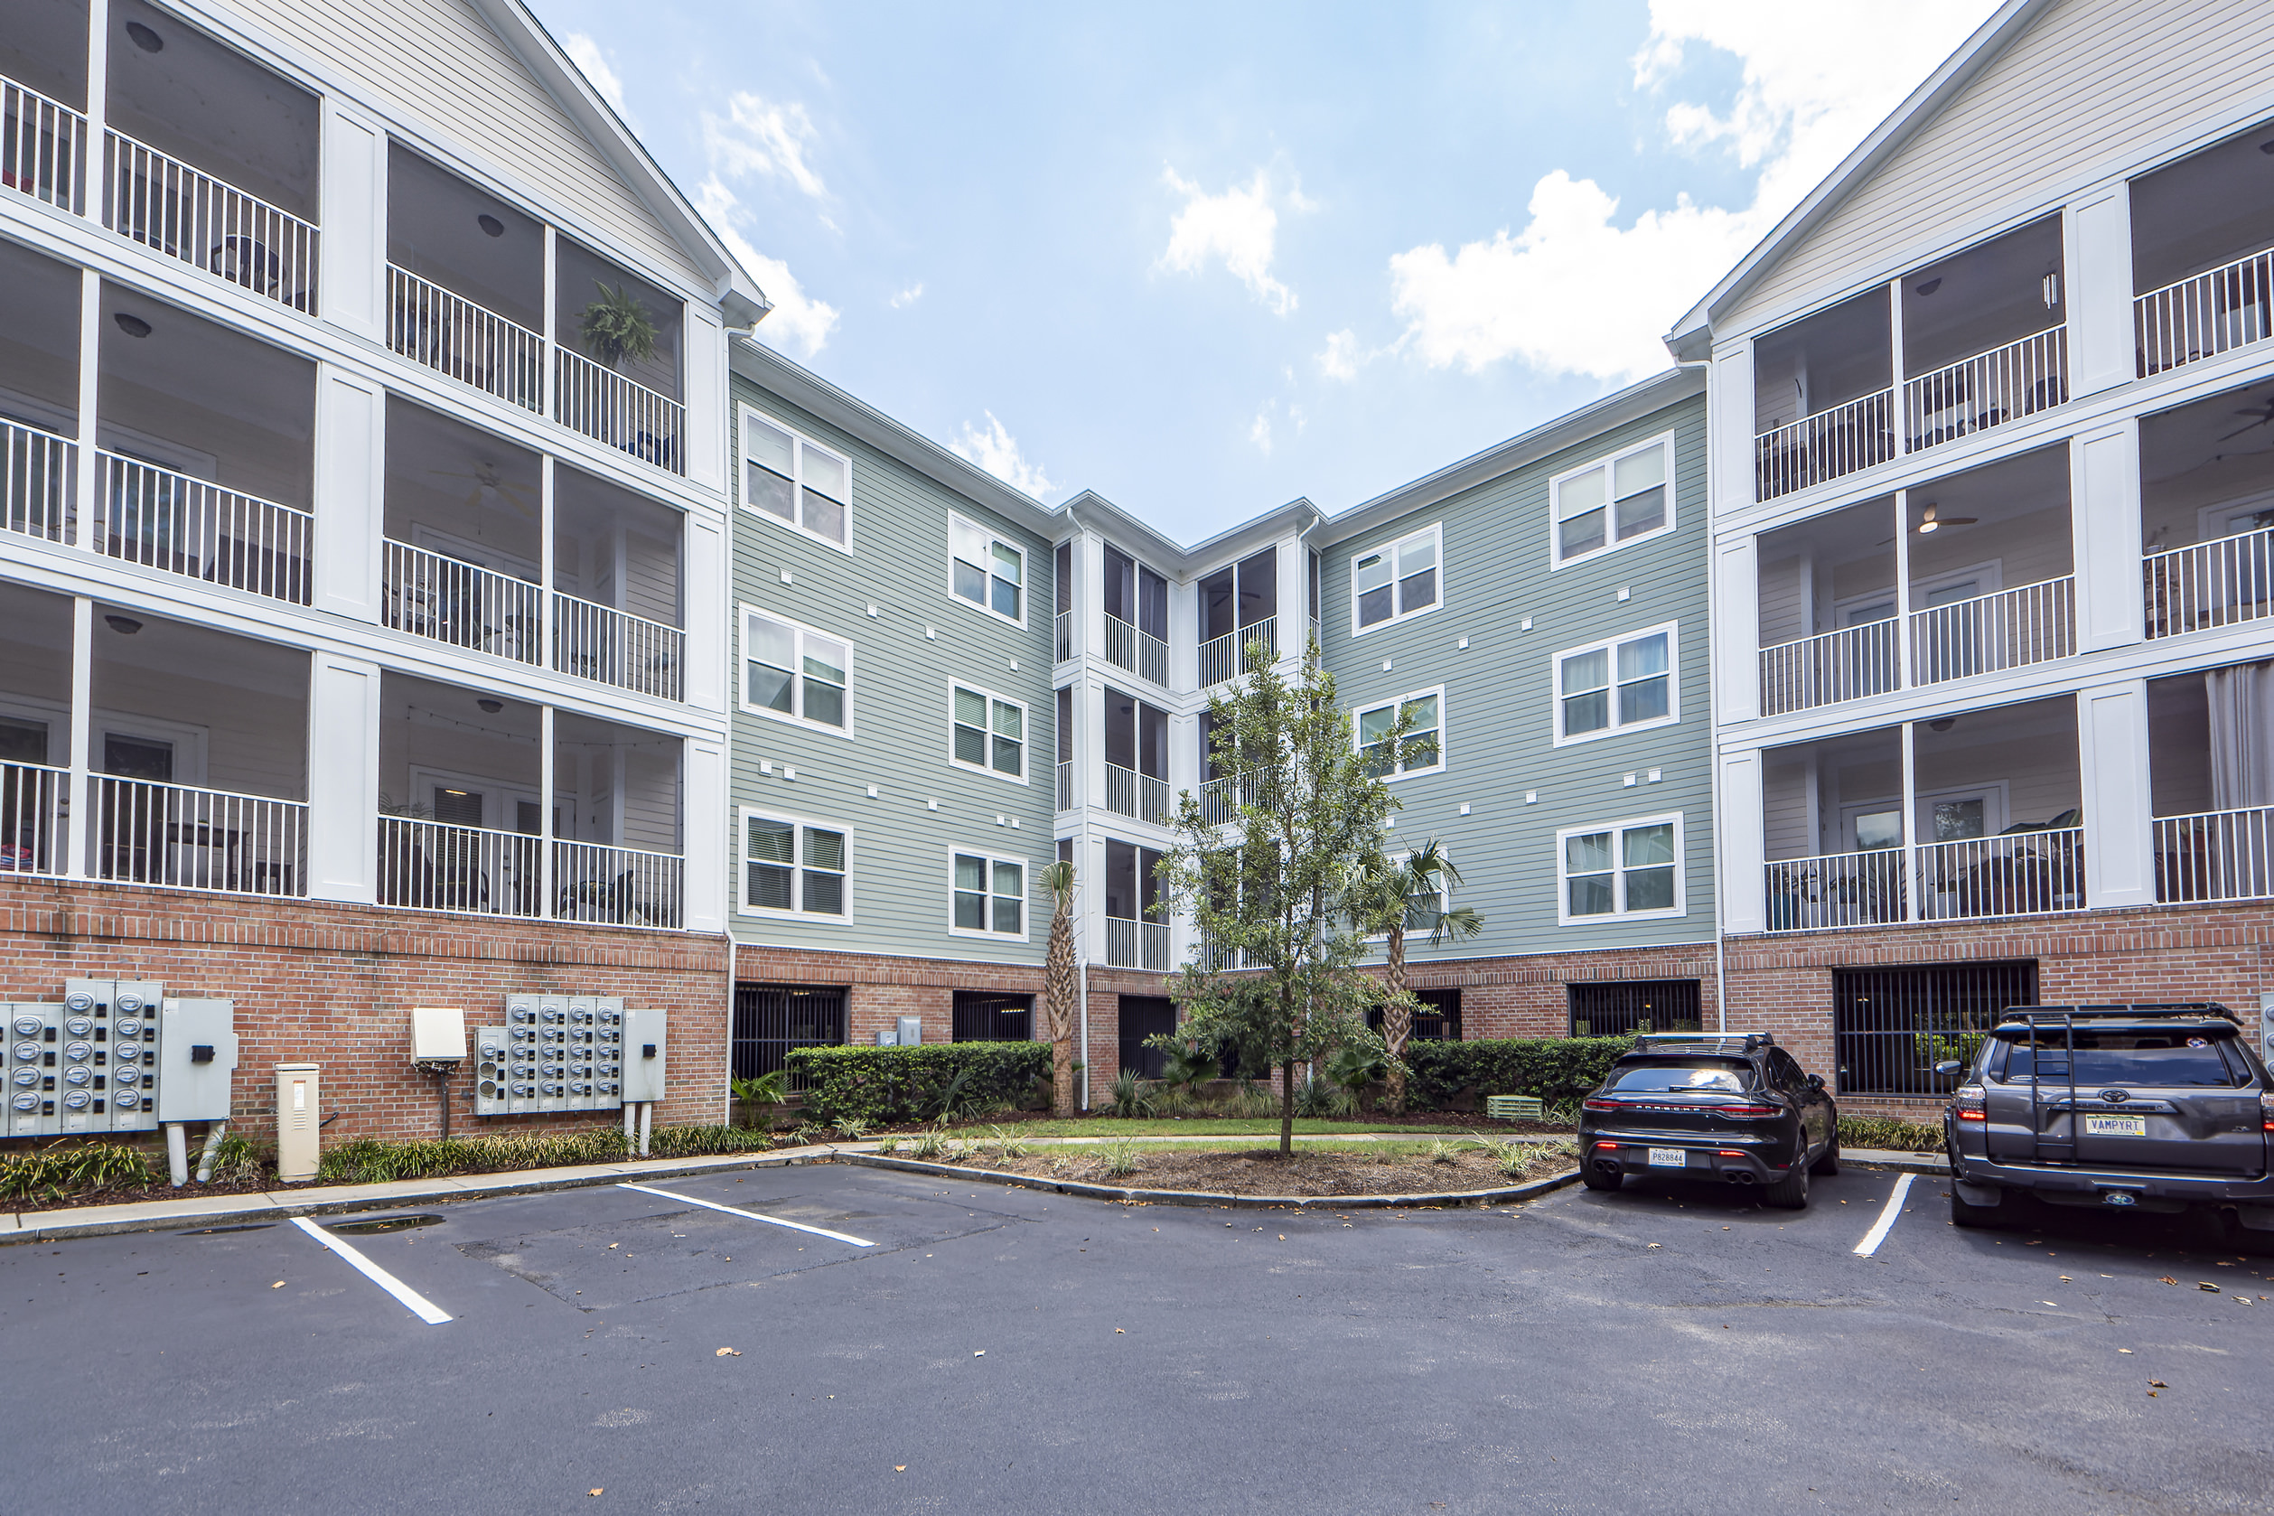
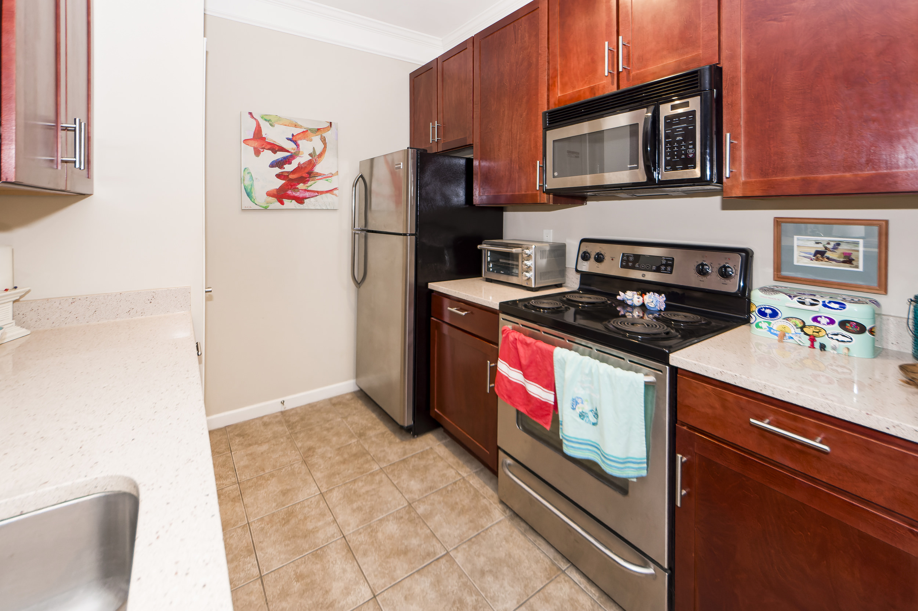
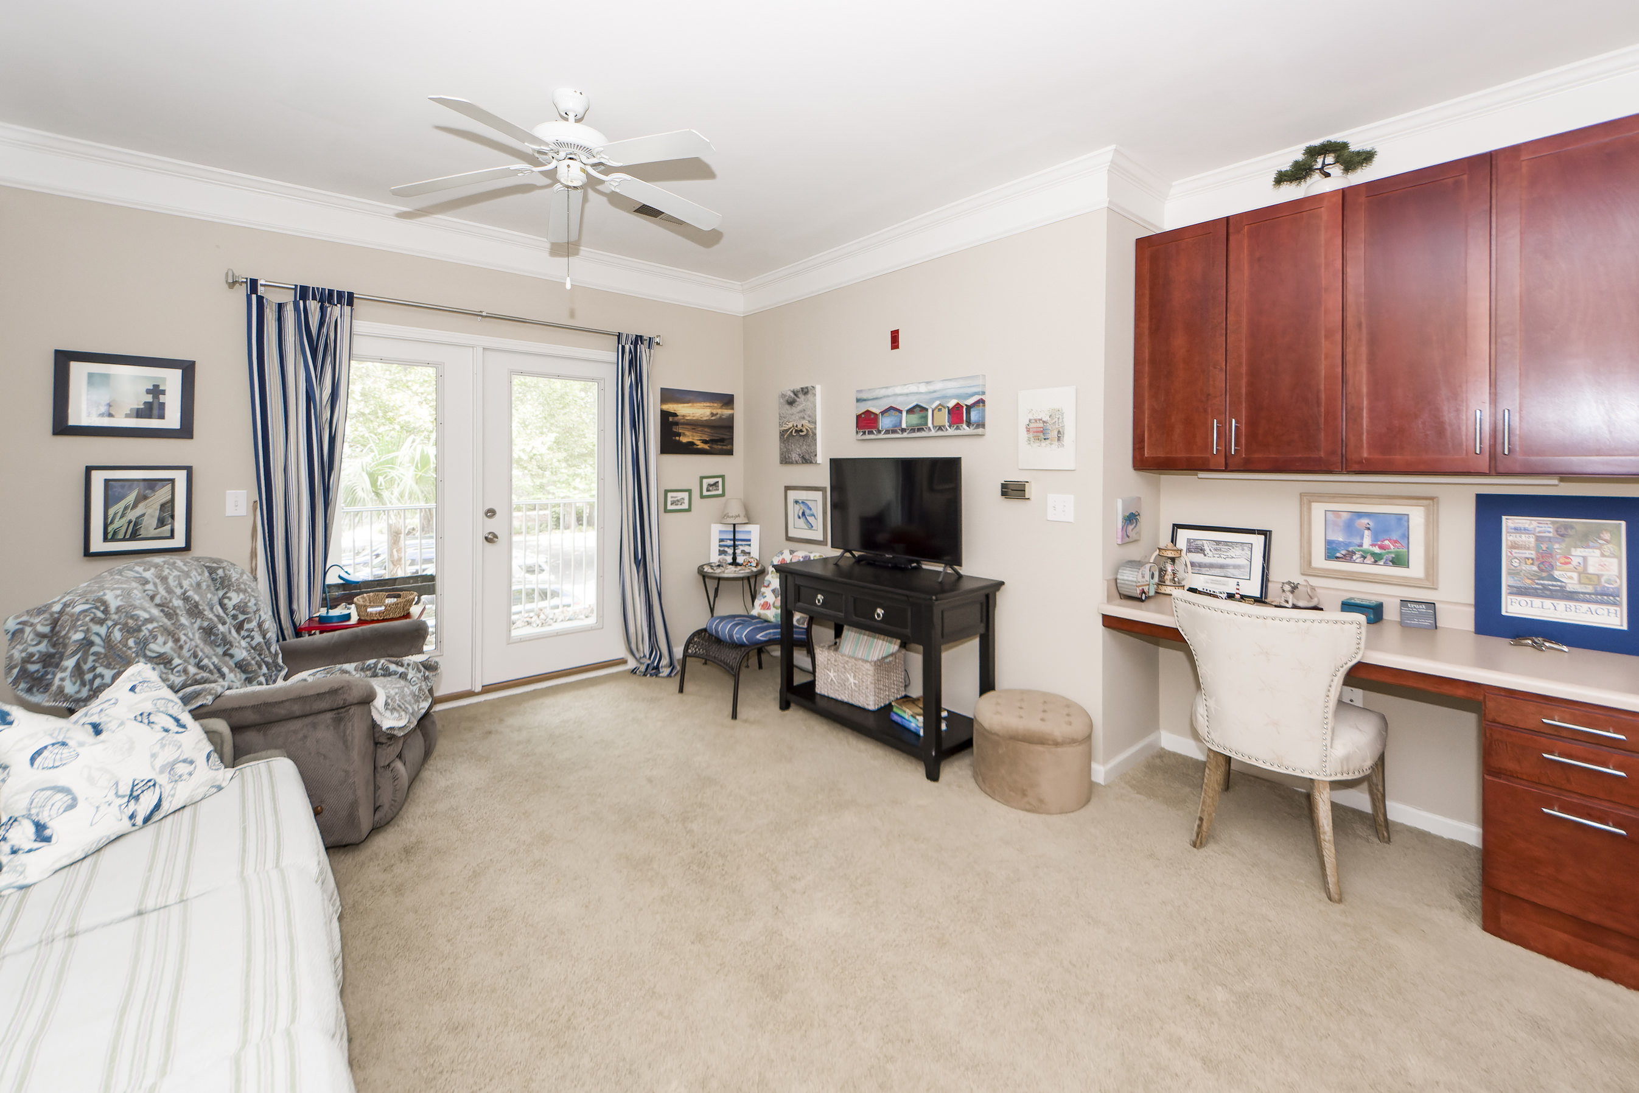
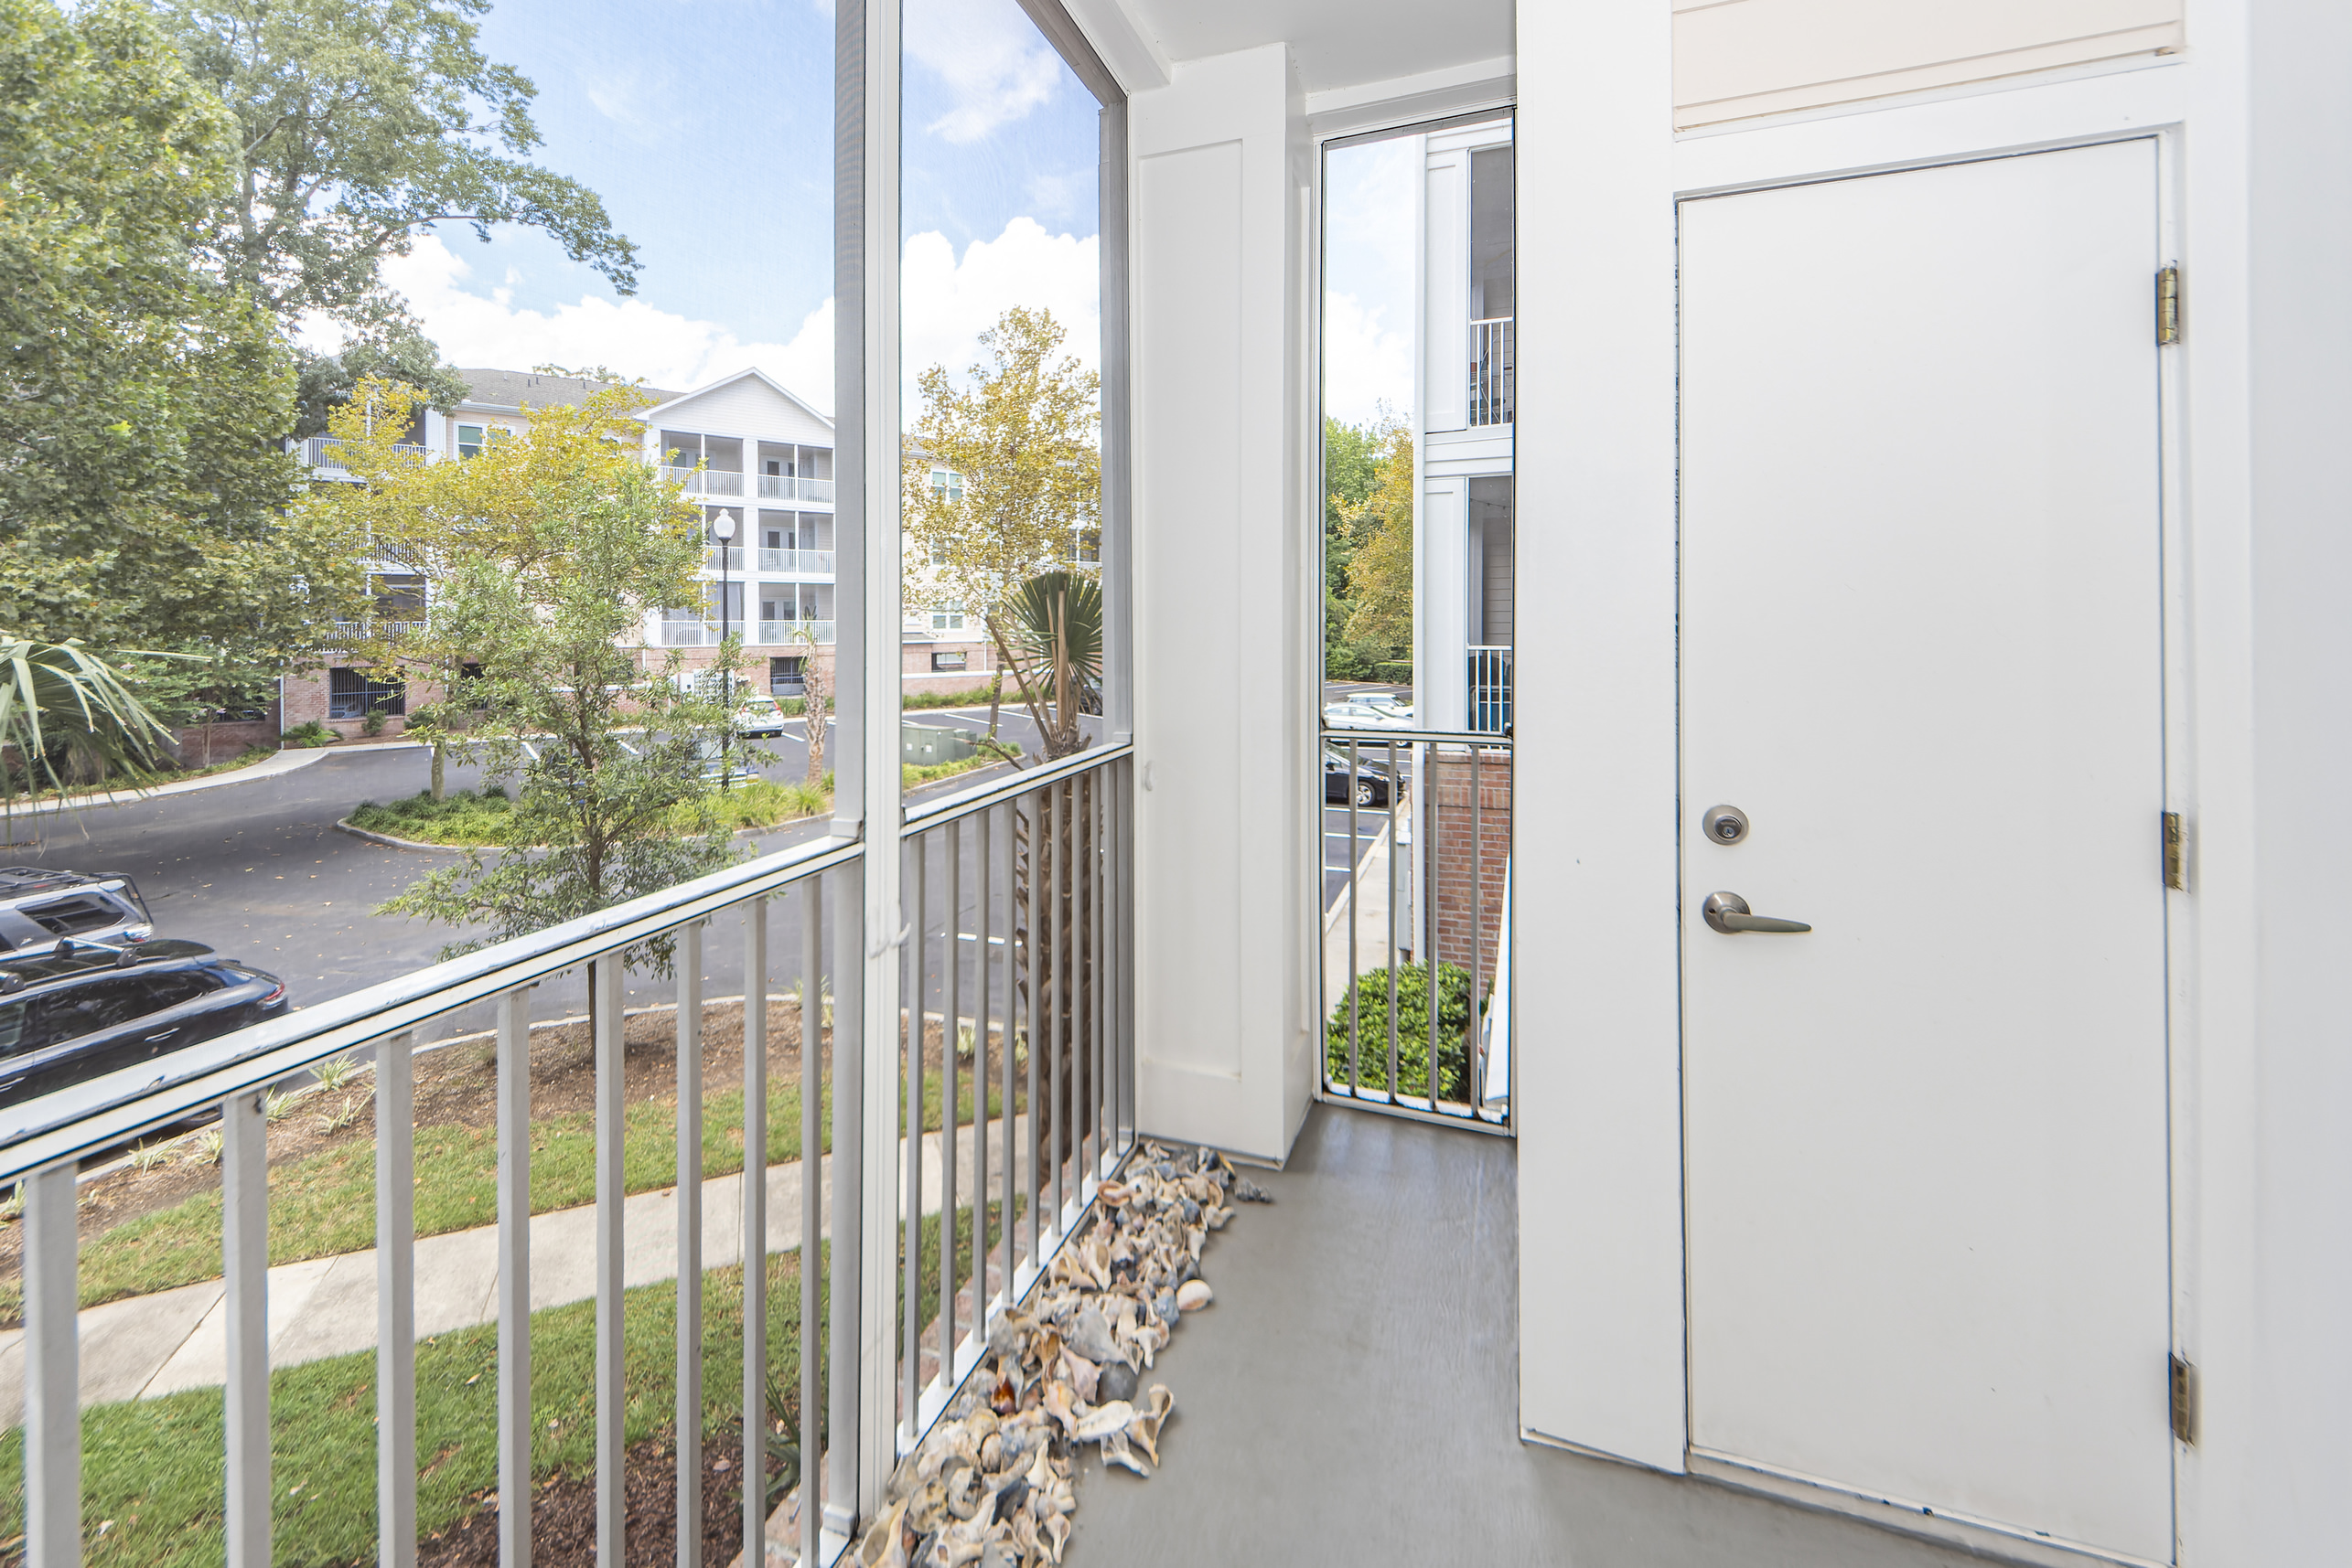
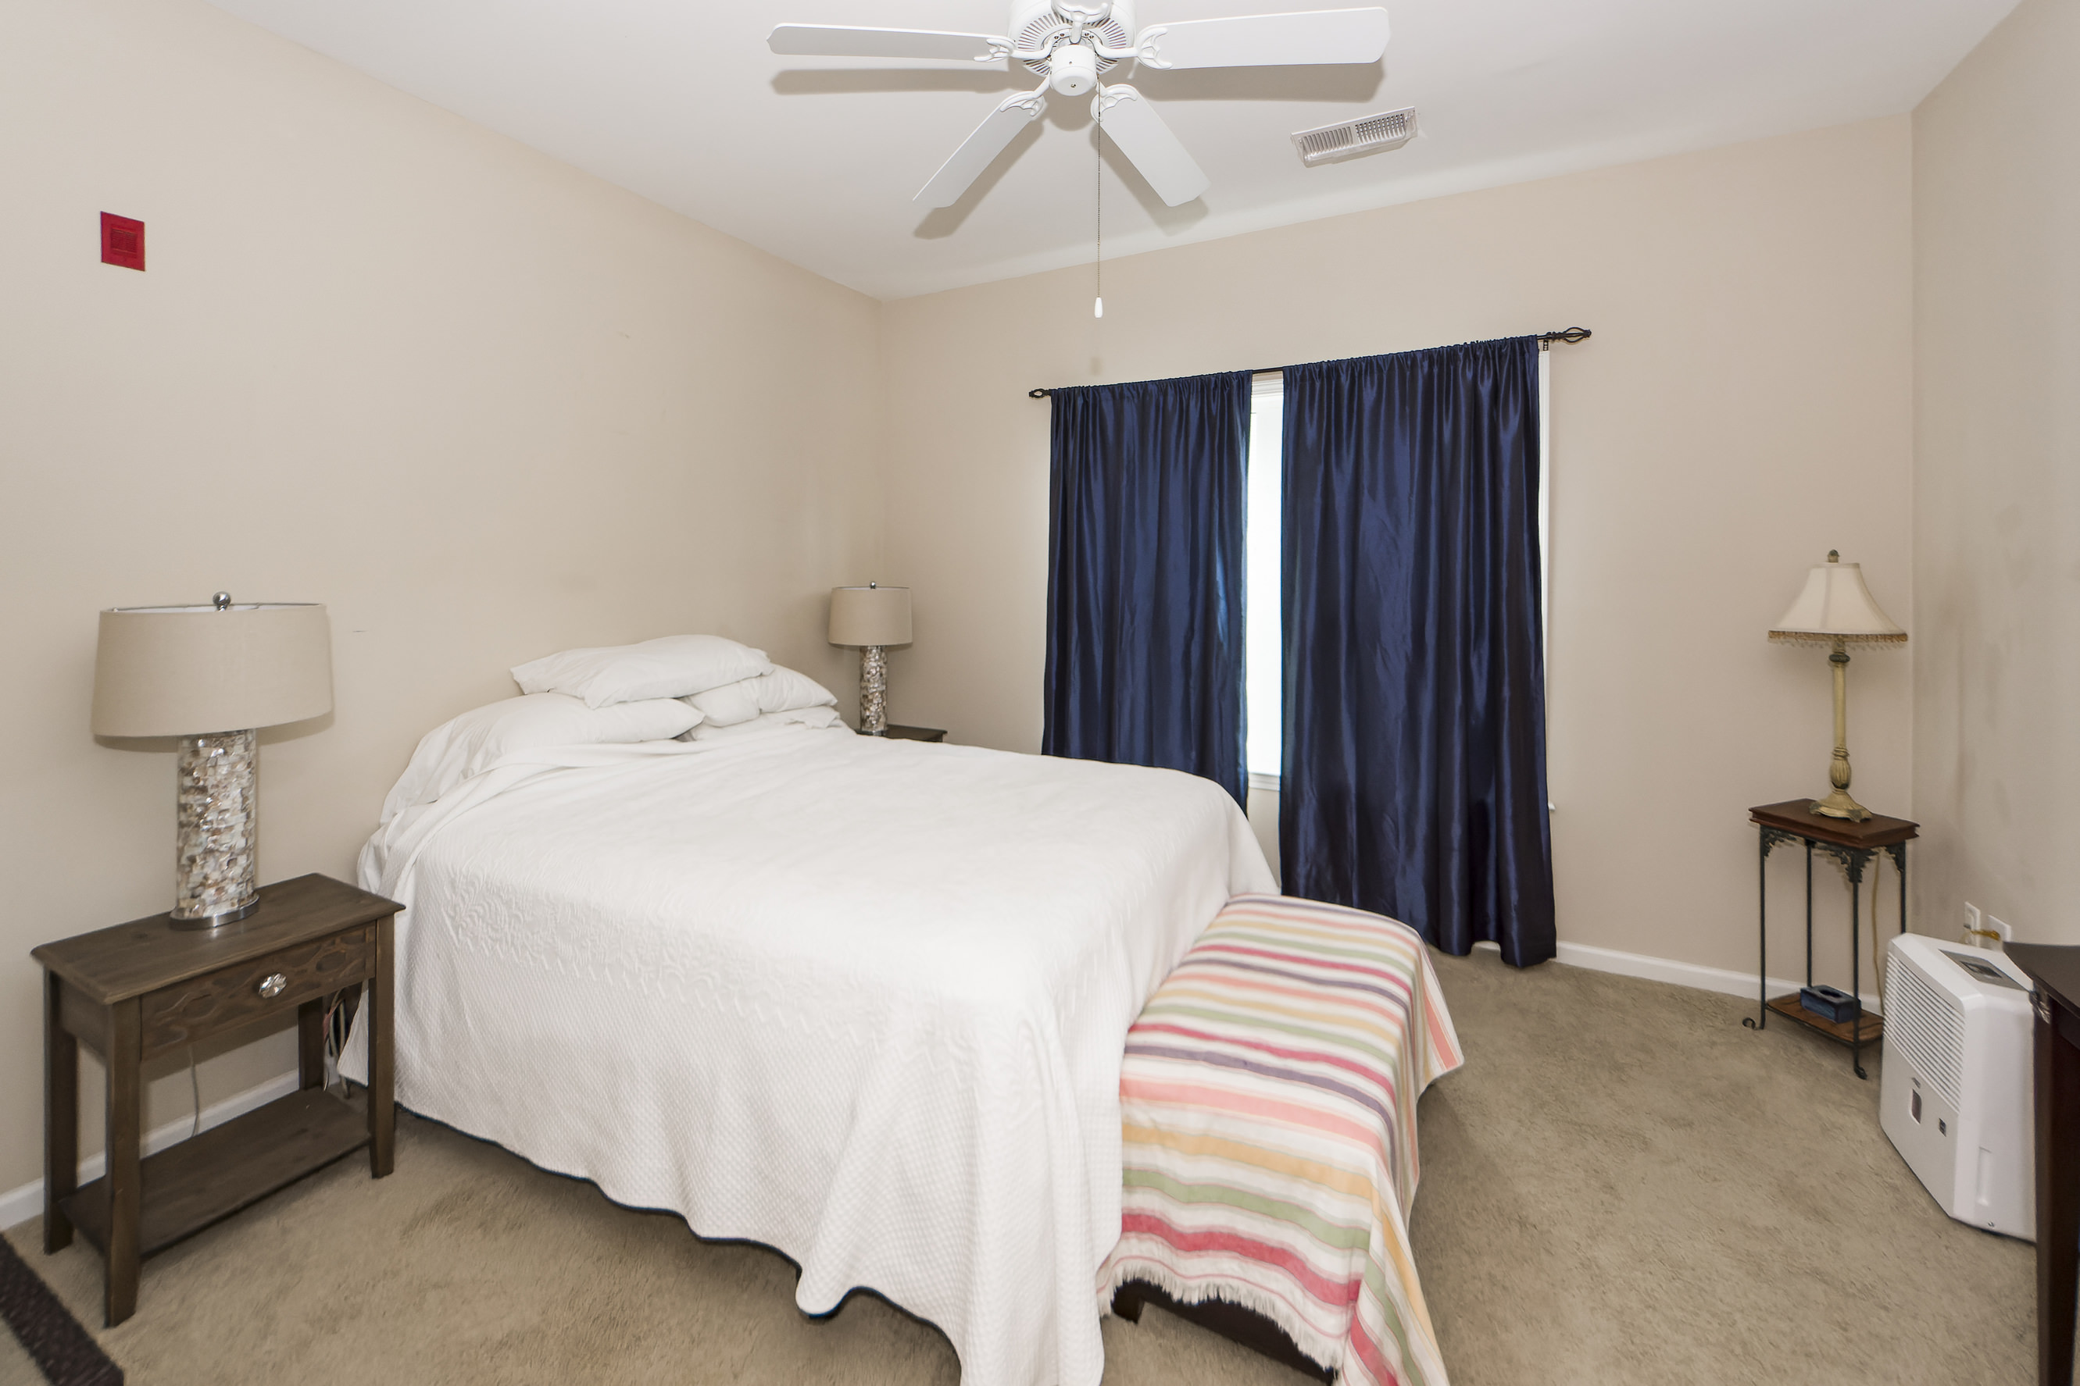
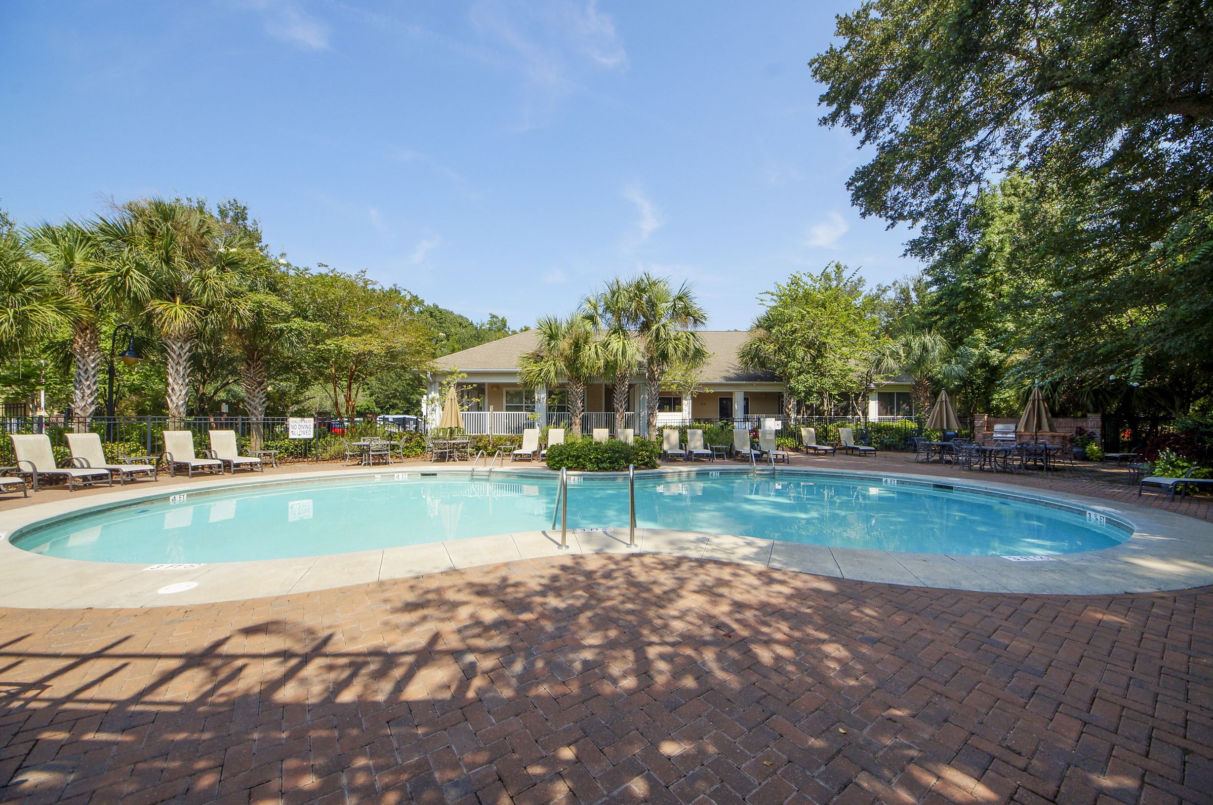


1755 Central Park Road #7110 Regatta On James Island Charleston, SC 29412 MLS# 23018748 $267,500
A gated upscale community, Regatta is located just minutes from downtown and convenient to MUSC, Folly Beach, James Island County Park and shopping. This first floor unit is in an elevator building and comes with a reserved, deeded parking space on the ground level, as well as an additional storage room off the breezeway. The kitchen features quartz counter tops, tile floor, stainless steel appliances and upgraded cabinets. Regatta amenities include a pool, clubhouse, workout room, grilling station and a dog park. Having undergone a major renovation just a couple of years ago, all units at Regatta have new hurricane resistant windows and patio doors, along with all new Hardiplank siding.
Come see this today. It won't last long.
Take a Virtual Tour!
Steven Ginsberg
(843) 860-7782 | sginsberg1@gmail.com
www.steveginsberg.com
NorthGroup Real Estate LLC | 2408 Madison Dr; Unit 202 | North Myrtle Beach, SC 29582

