Slide 1
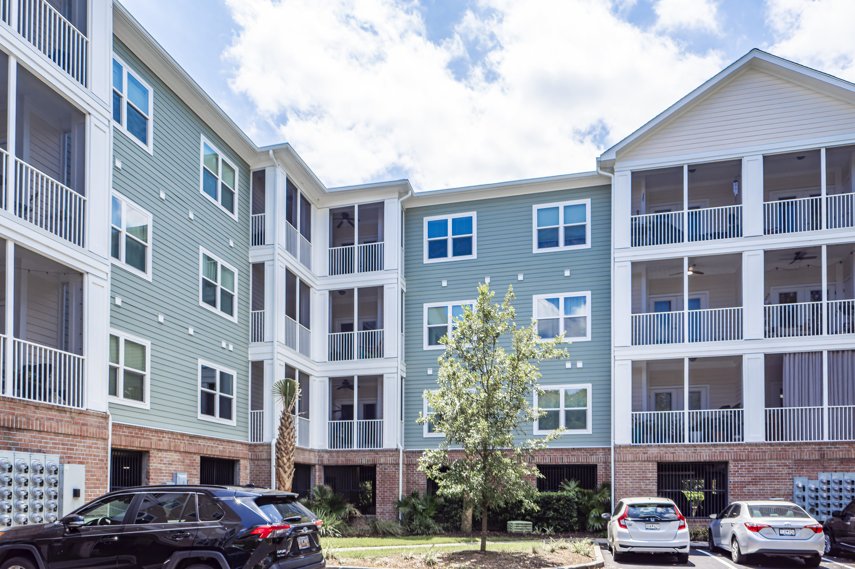
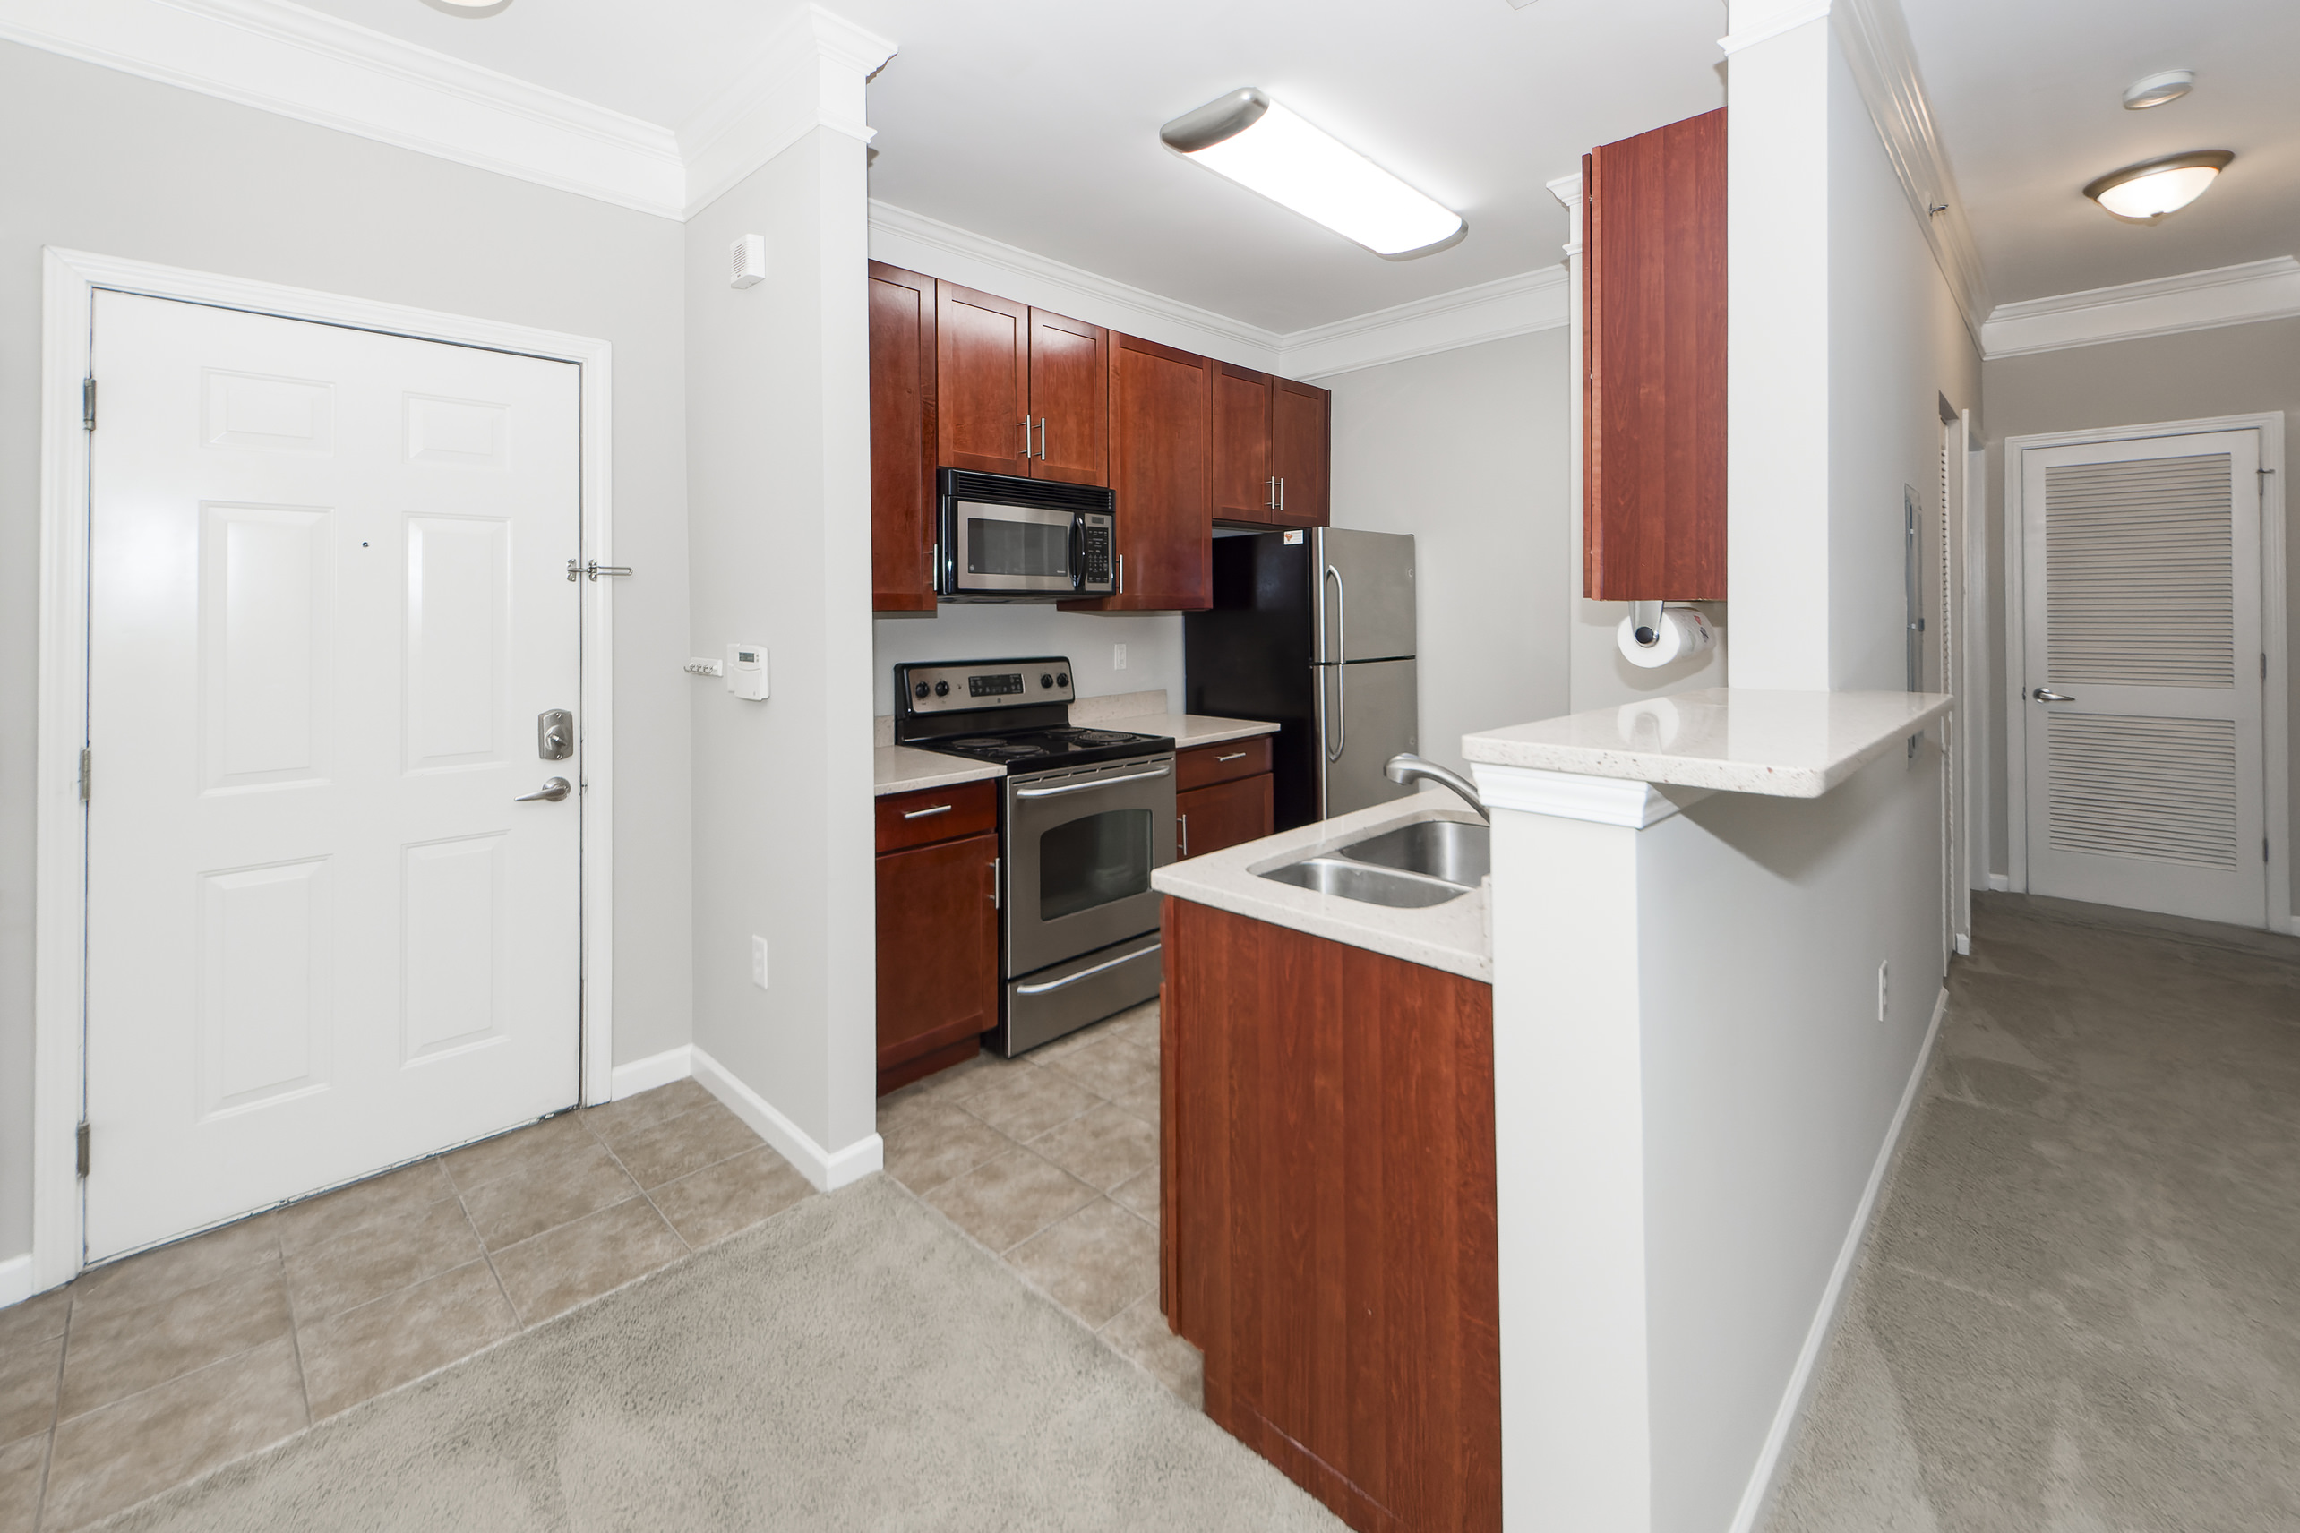
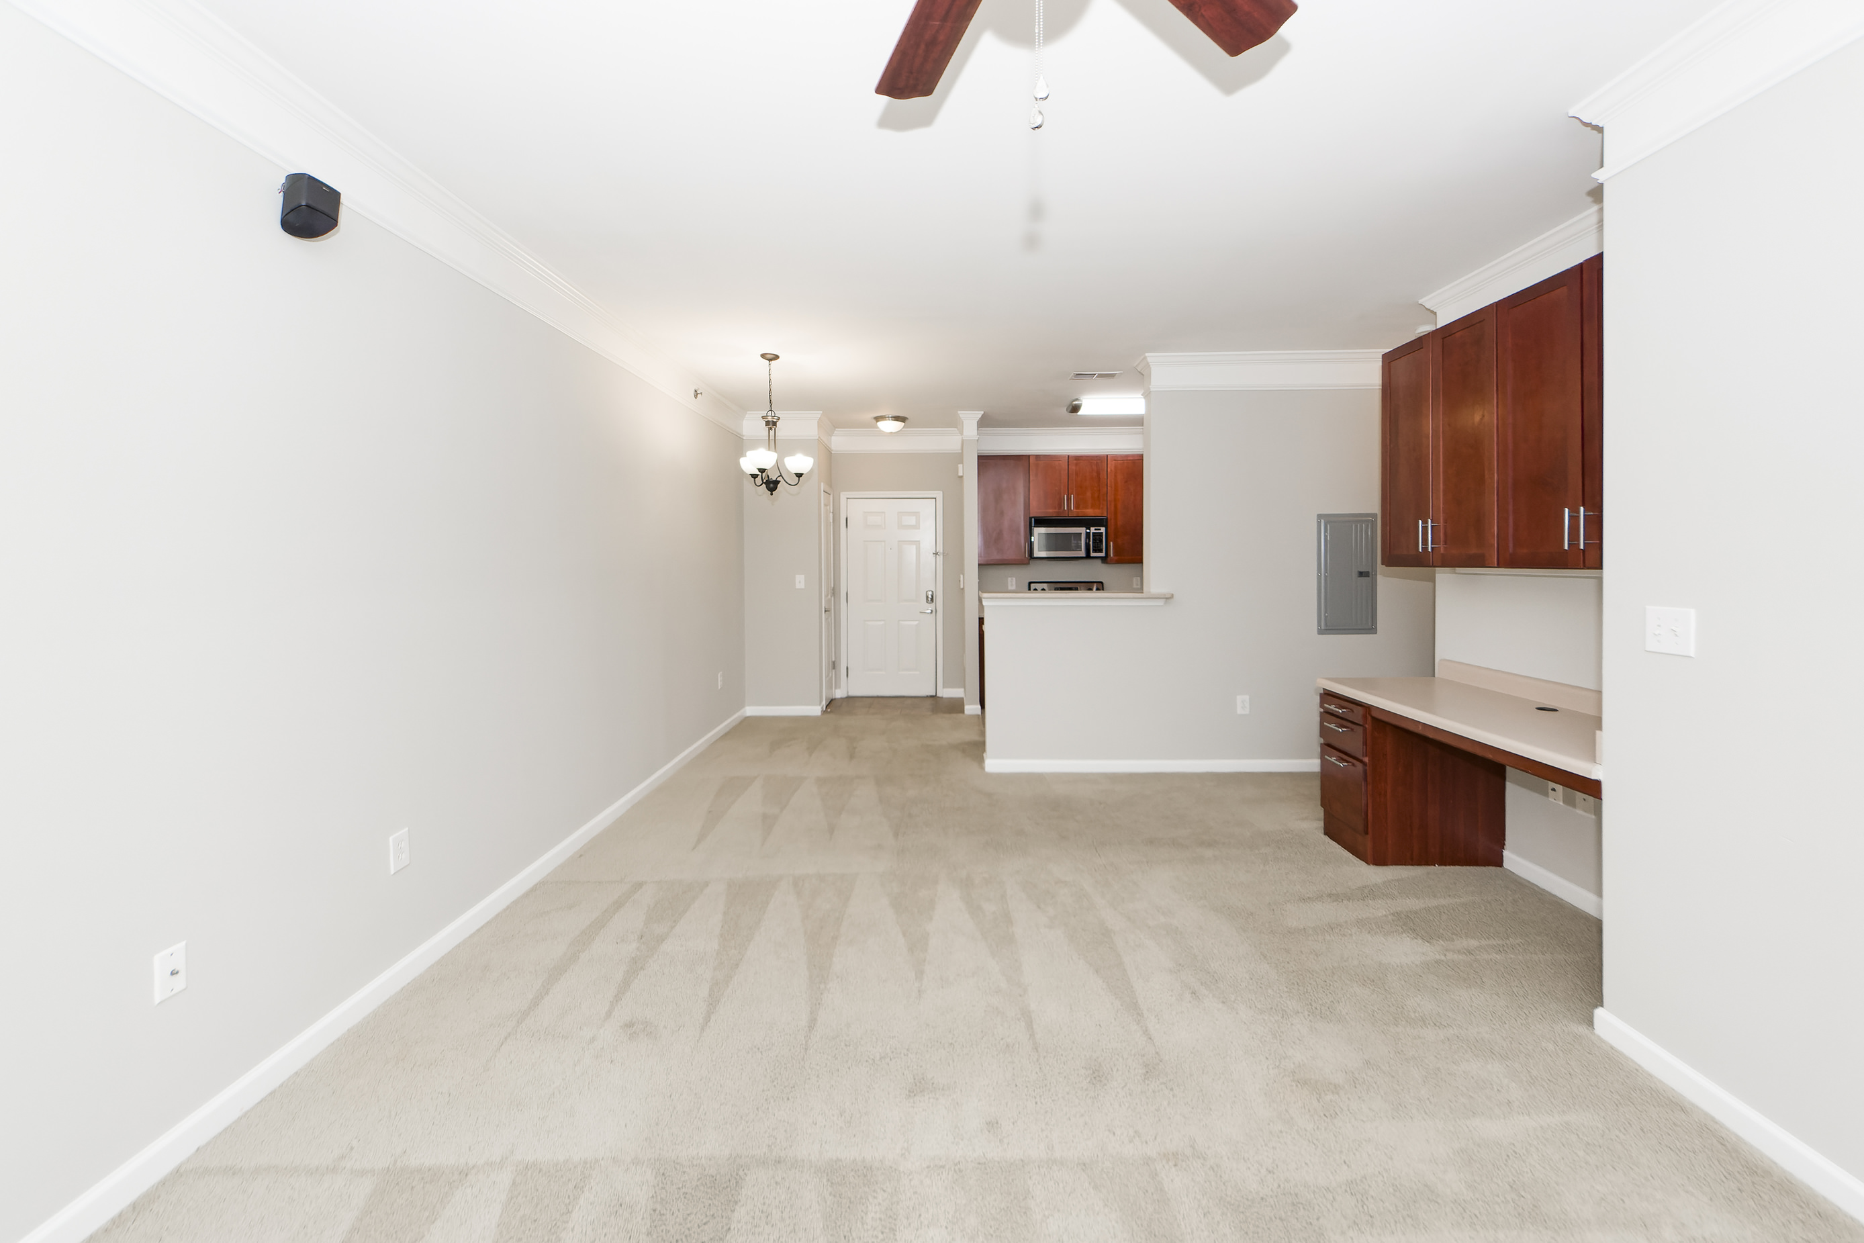
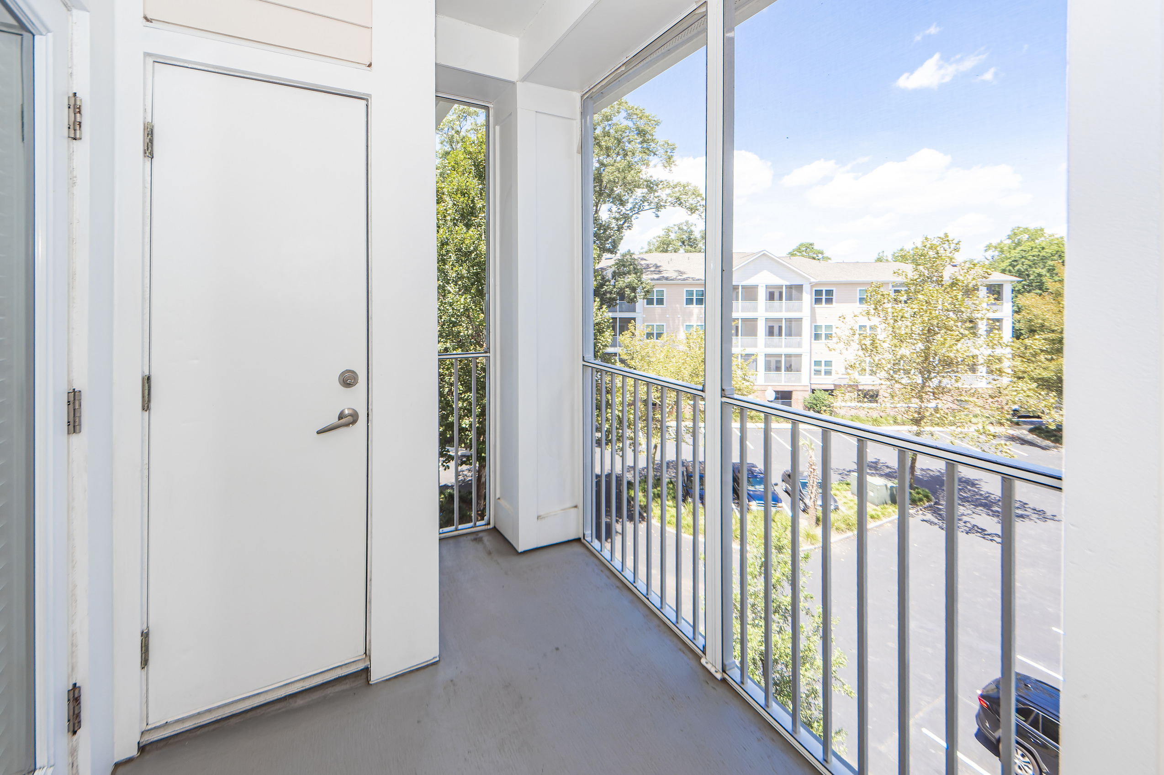
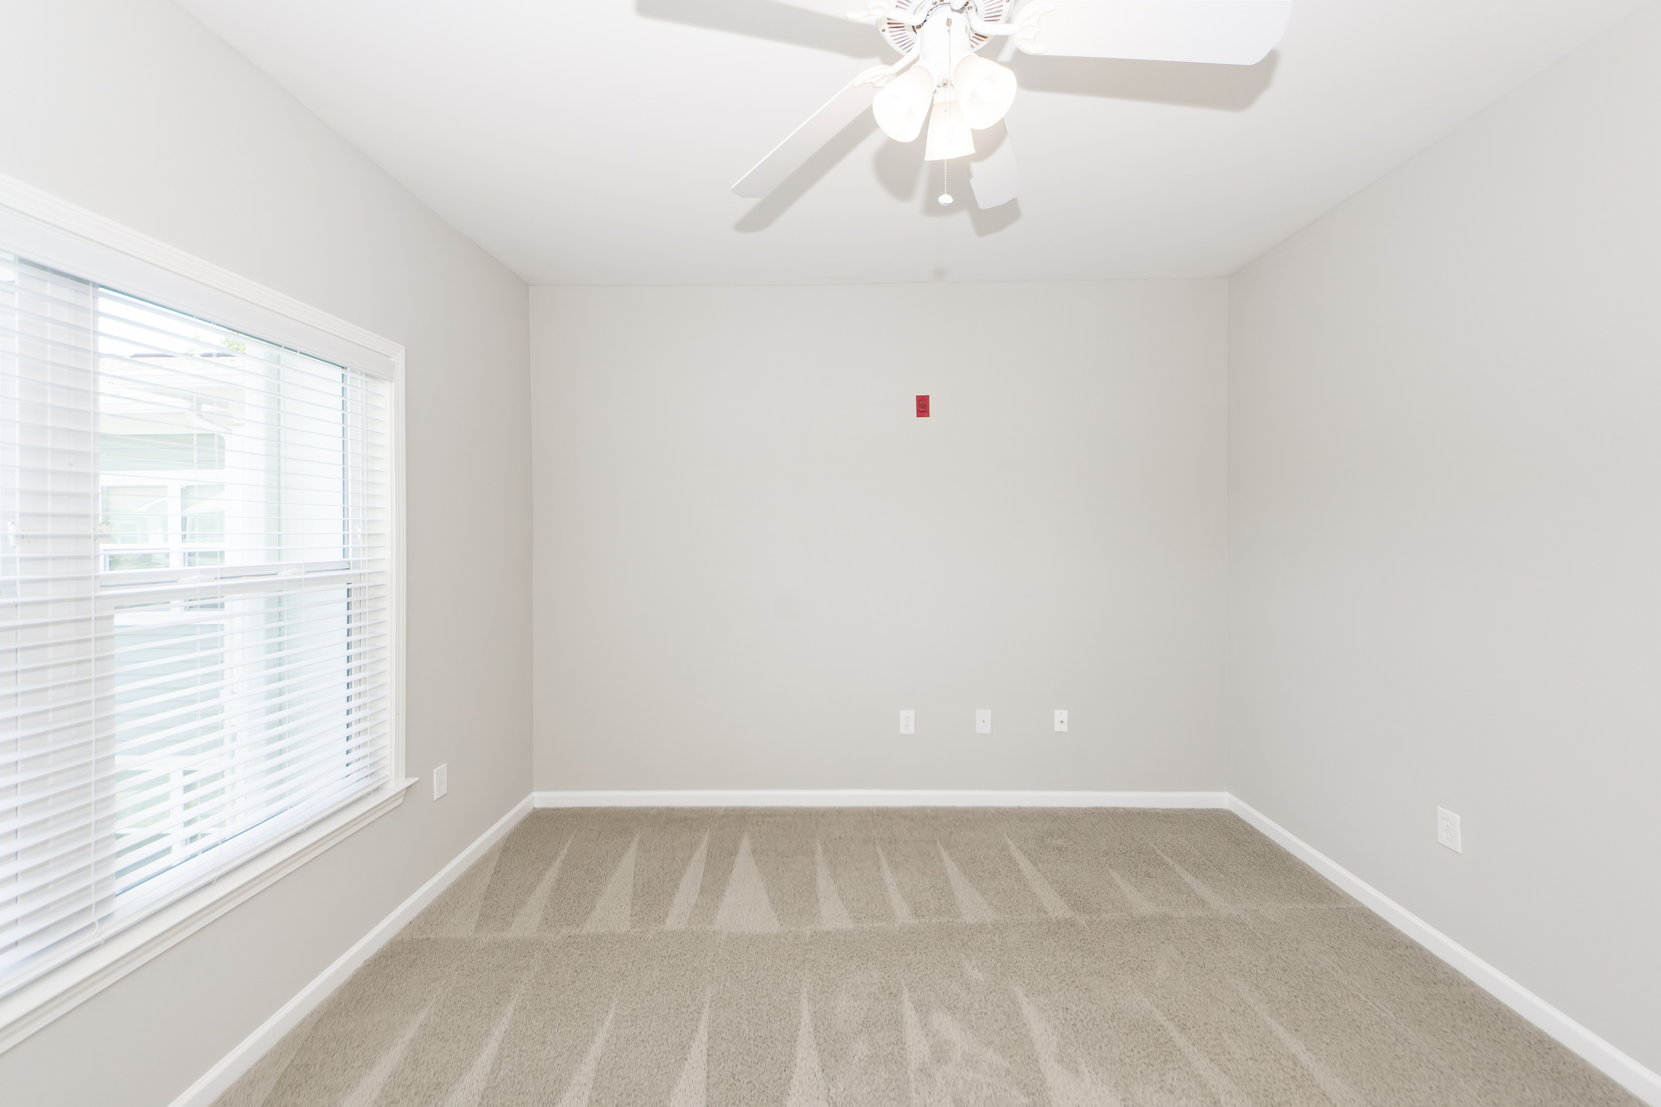
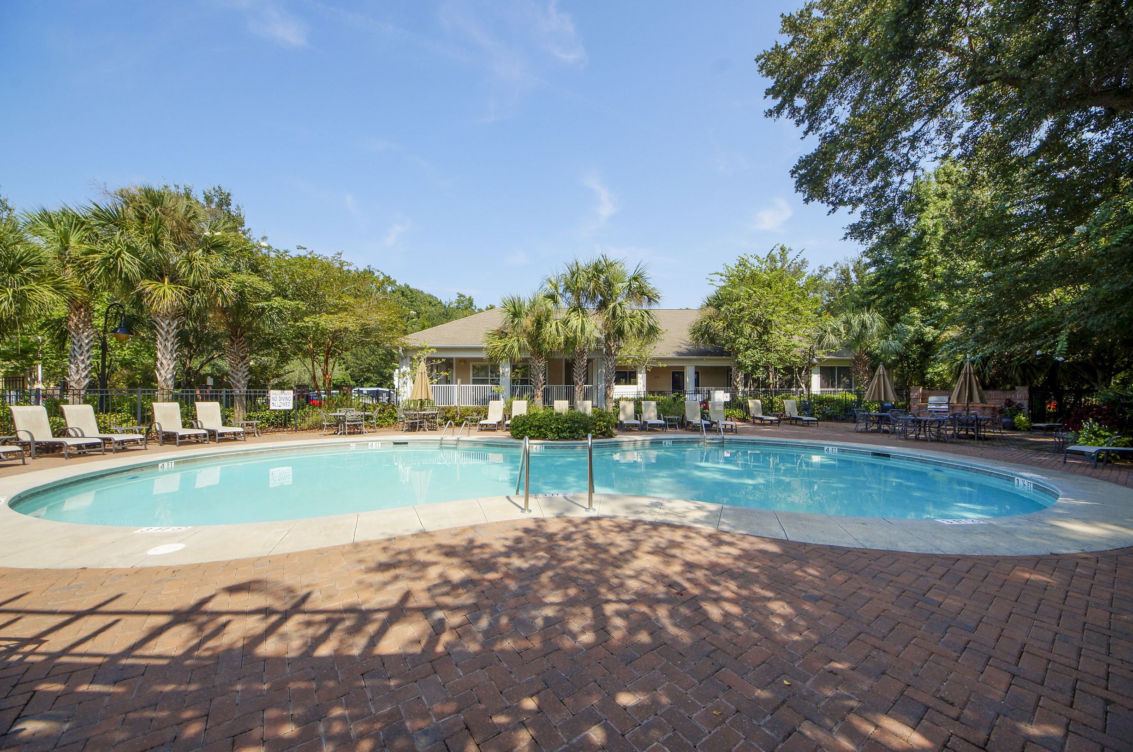


1755 Central Park Road #7308
Regatta On James Island
Charleston, SC 29412
MLS# 23017389
$265,000
A gated upscale community, Regatta is located just minutes from downtown and convenient to MUSC, Folly Beach, James Island County Park and shopping. This third floor unit is in an elevator building and comes with a reserved, deeded parking space. The kitchen features quartz counter tops, tile floor, stainless steel appliances and upgraded cabinets. Regatta amenities include a pool, clubhouse, workout room, grilling station and a dog park. Having undergone a major renovation just a couple of years ago, all units at Regatta have new hurricane resistant windows and patio doors, along with all new Hardiplank siding. Come see this today. It won't last long.
Steven Ginsberg
(843) 860-7782 | sginsberg1@gmail.com
www.steveginsberg.com
NorthGroup Real Estate LLC | 2408 Madison Dr; Unit 202 | North Myrtle Beach, SC 29582

