Slide 1
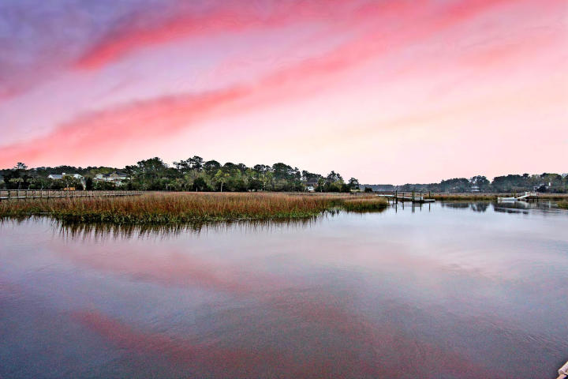
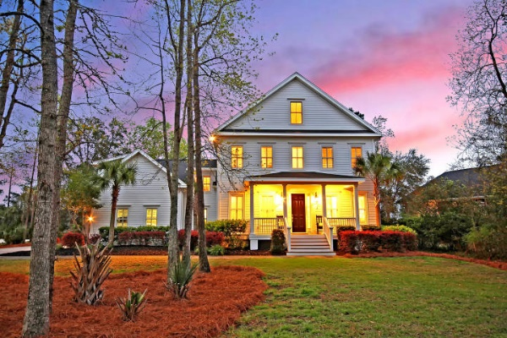
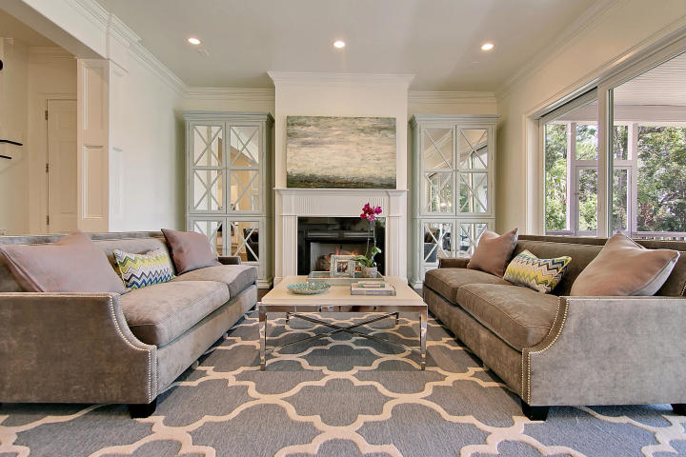
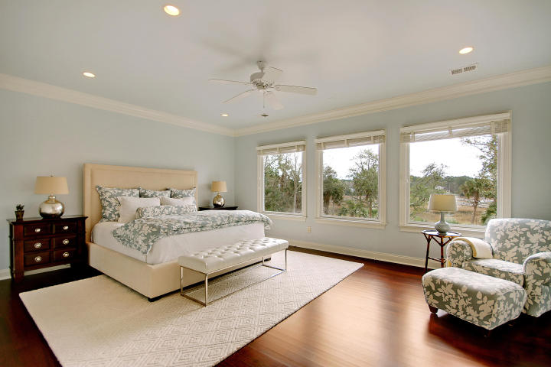
Price Reduced in Dunes West! New A/C Units With Nest Controllers PLUS a 10 Year Warranty
Deep-water Dock On Wagner Creek
Just Minutes From The Wando River
Price Reduced!
1756 Greenspoint Court Dunes West ~ Mount Pleasant, SC 29466 ~ MLS# 19008630 ~ $999,000
Deep-Water Dock on Wagner Creek, just minutes from the Wando River, with a Whole-House renovation in 2016, this incredible home is located in the Gated, Golf-Course community of Dunes West. Enjoy the views of the water from the enormous screened-in back porch. Inside are high ceilings, gorgeous hardwood floors, crown molding, a granite kitchen with breakfast bar and center island and an open concept floor plan. The owner's retreat boasts two incredible walk-in closets, a luxurious master bath and breathtaking views of the creek. The top level is massive and can serve as a media/game room and the FROG is another great space with an office and a full bath. Enjoy boating and fishing from your back yard. Enjoy golf and world-class community pool and walking trails. This home will amaze you!
Nate Gainey nate@mattoneillteam.com 843-513-2038

