Slide 1
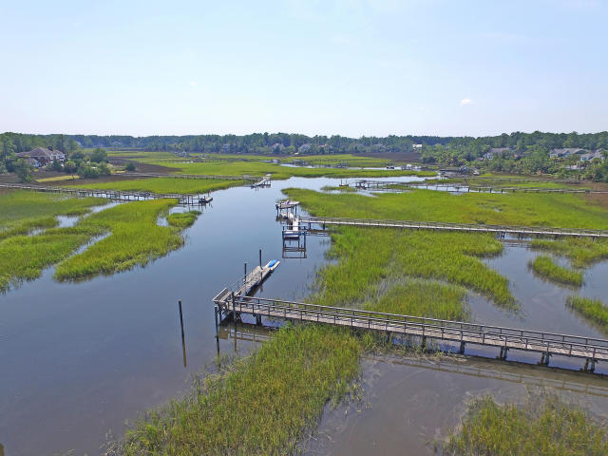
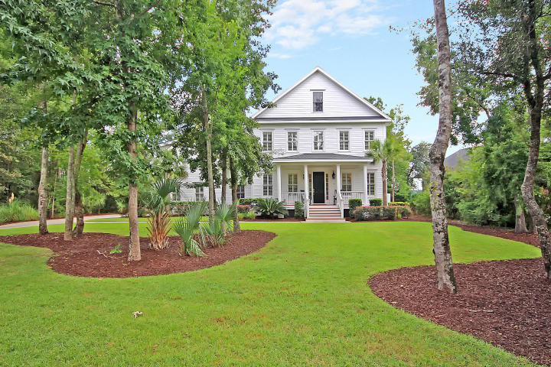
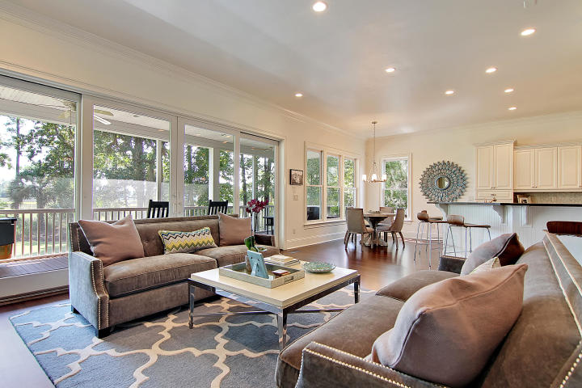
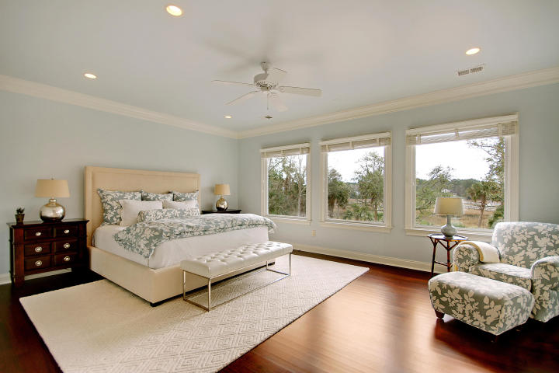
Price Reduced in Dunes West!
New A/C Units With Nest Controllers PLUS a 10 Year Warranty
Deep-water Dock On Wagner Creek
Just Minutes From The Wando River
1756 Greenspoint Court
Dunes West ~ Mount Pleasant, SC 29466 ~ MLS# 18003693 ~ $1,090,000
Enjoy the views of the water from the enormous screened-in back porch. Enjoy boating and fishing from your back yard. Enjoy golf and world-class community pool and walking trails.
Nate Gainey nate@mattoneillteam.com 843-513-2038

