Slide 1
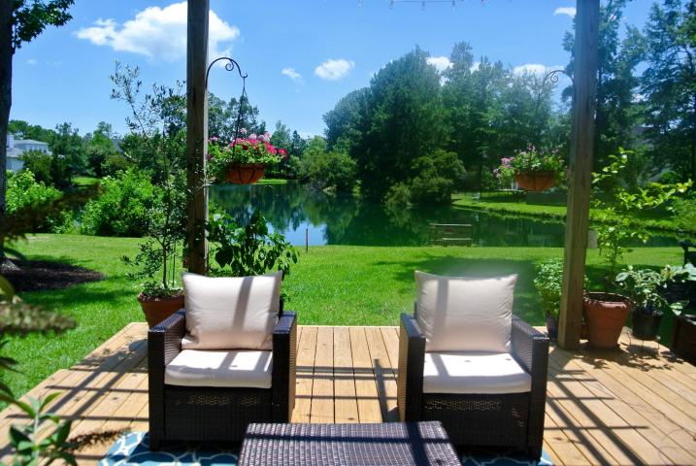
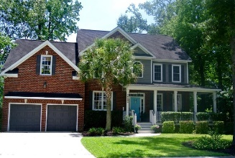
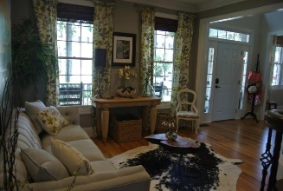
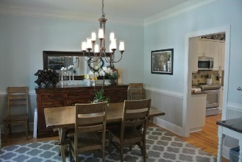
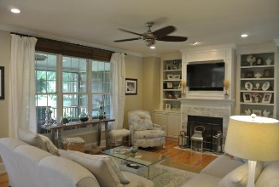
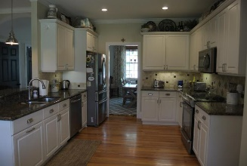
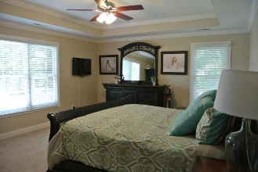
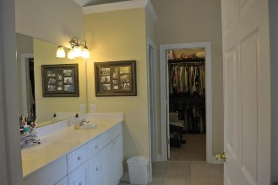
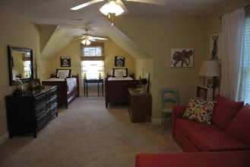
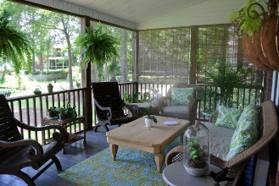
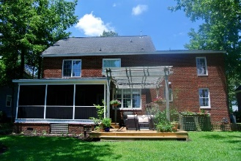

Just Reduced Over $5,000!
1757 James Basford Place
Park West ~ Mount Pleasant
MLS# 16019063 ~ $544,000
Just Reduced to $538,000
Beautiful custom built brick home with STUNNING POND VIEWS. Fresh exterior paint and newly sodded yard lend to gorgeous curb appeal of this 5 bedroom home. The full-width, partial wrap around, front porch welcomes you into a 2-story foyer with custom seeded glass chandelier. The foyer opens into a formal dining room with bead board wainscoting, chair rail and upgraded crown molding. The formal living room also has upgraded crown molding and plenty of natural light. The kitchen features a tile back splash, new LED recessed lighting, white cabinet, built-in microwave, stainless steel appliances with a gas connection in place should the new owner want a gas stove. There is also bar seating in addition to an eat-in kitchen area overlooking the new deck with pergola and beautiful pond views. The kitchen is opens to a large family room with ceiling fan, fireplace with gas logs, built-in shelves and cabinets, new LED recessed lighting, large windows and access to the screen porch. The screen porch leads to the new deck with a pergola. The backyard has new sod and irrigation system. This main level also has a large bedroom and full bathroom. Upstairs the large master suite features double tray ceiling, large window overlooking the pond ceiling fan, and walk-in closet with custom closet system The master bath includes ceramic tile floor, dual vanity, shower with separate soaking tub, and more pond views. On the second floor there are 2 more large bedrooms with upgraded crown molding, one with a walk -in closet. The hall bath as large vanity, and separate shower area. The huge frog makes a great playroom or guest retreat. There is also the 5th bedroom currently being used as a home office.. Other features included an oversized 2-car garage with overhead storage, and 4 zone lawn irrigation system, new Train HVAC system, Rennai tank less hot water heater, . Park West amenities include 2 pools, a clubhouse, play area, six-lighted tennis courts, and miles of trails for walking and biking. It is a short trip by bike or golf cart to stores, gyms, offices, restaurants, and the award winning schools that are located in Park West. The Mt. Pleasant rec. center and sports complex are also located in the neighborhood! Beaches and beautiful downtown Charleston are only a short drive away.
Sona Laudenslager
O - (843) 491-1445
M - (843) 270-9600
sona@lifetreelending.com
LifeTree Real Estate, LLC
3094 Hwy 17 North
Mt. Pleasant, SC 29466
www.lifetreerealestate.com

