Slide 1
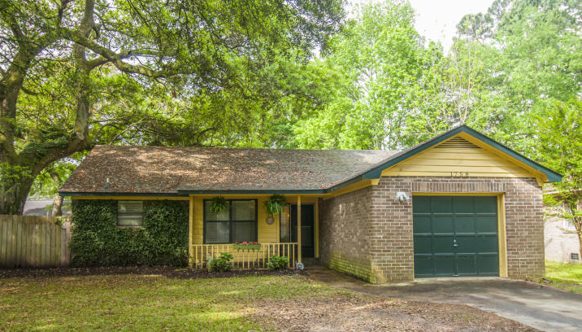
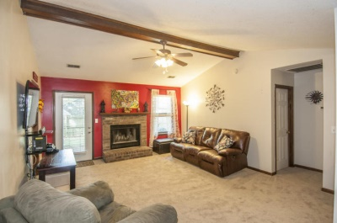
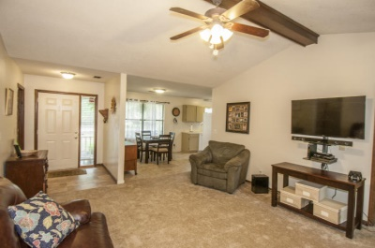
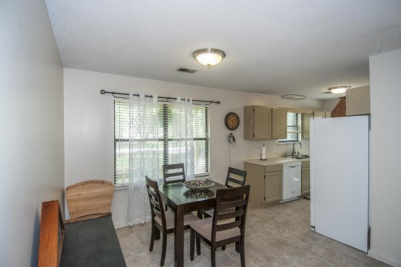
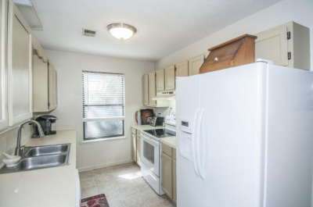
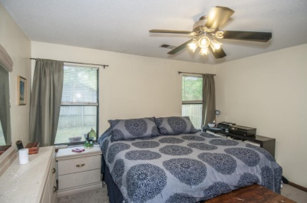
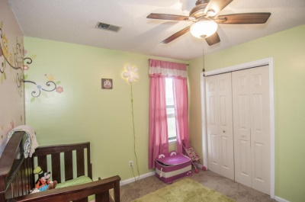
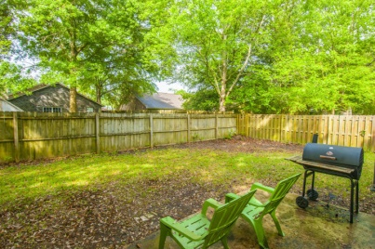
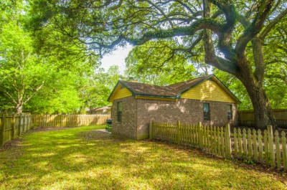


West Ashley Gem
1758 Dogwood Road
Double Oaks – Charleston - MLS# 15010021 - $150,000
This 3 bedroom, 2 bath home boasts brand new carpet as well as new flooring in the kitchen, foyer and master bathroom. Split floorplan. The backyard has plenty of space for outdoor activities whether that be grilling out or room for kids to play. There is also a great space in the backyard that could be used as a dog enclosure (dog run). House was just professionally cleaned and pressure washed!
Del Shaffer
843.408.6821
dshaffer@carolinaoneplus.com

