Slide 1
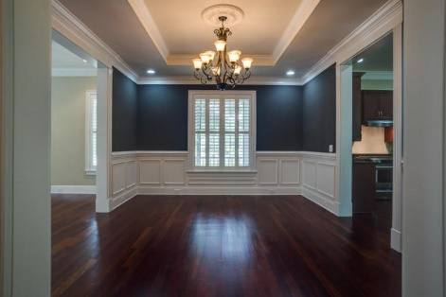
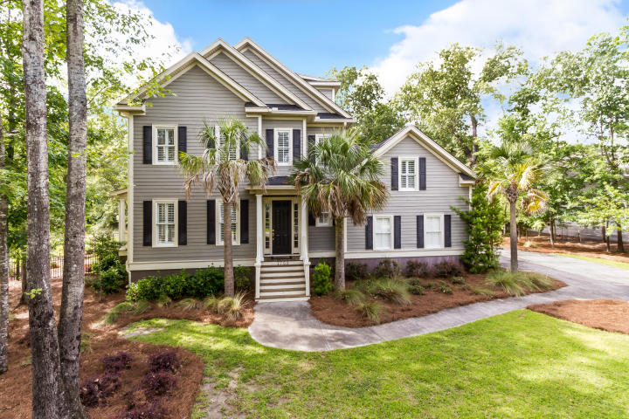
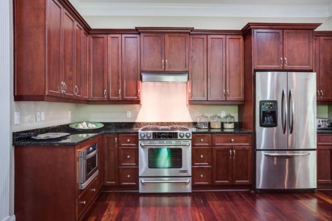
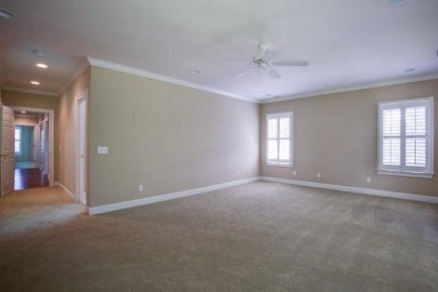
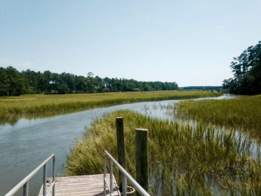
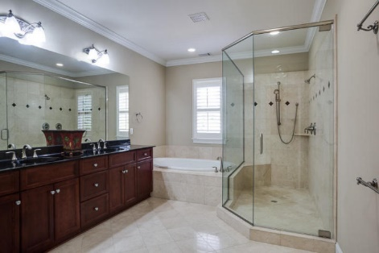
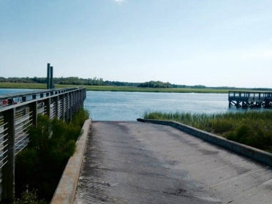
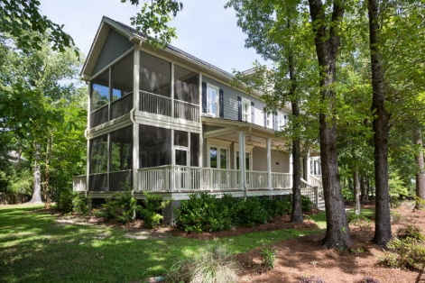
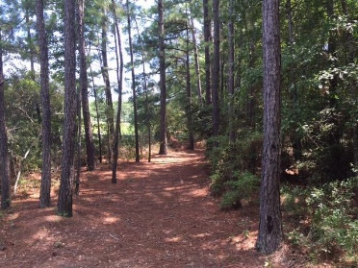
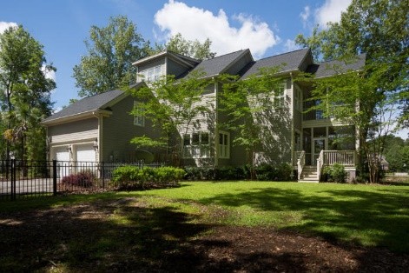
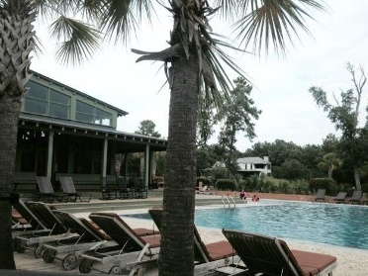


1759 Greenspoint Court Dunes West | Mount Pleasant, SC 29466 | MLS# 15013994 | $774,900
Beautiful Custom Built Home w/Large Lot
In the highly sought after private & gated community of Dunes West, this home offers 5 bedrooms, 4 full baths, 2 half baths and sits on over 1/2 acre of protected woodlands. If you need space, this is the place!
Brazilian cherry hardwood flooring
10-ft ceilings
Well-appointed gourmet kitchen with 42-inch cabinets, walk-in pantry, granite countertops and stainless steel appliances
Abundant natural light
Family room is wired for surround sound and has a gas fireplace
Formal living & dining rooms
MBR includes 2 walk-in closets, a screened porch, and a fully appointed master bath with marble floors, an oversized shower, jetted tub, and double vanities.
FROG and 3rd floor can be used as oversized bedrooms or fabulous office space or media/bonus room.
Outside includes a fully fenced backyard with a 7-zone irrigation system, double screened porches off the back of the house, plus a full-length porch along the side of the home overlooking the pond on a quiet cul-de-sac.
Dunes West amenities include clubhouse, award-winning Arthur Hill golf course, tennis courts, 3 pools, workout facility, boat storage, and several miles of walking/running trails.
Excellent schools and no shortage of restaurants or shopping options!
Located within 30 minutes of Isle of Palms and Sullivan's Island beaches as well as downtown Charleston.
With a location like this, you will not be disappointed! Come see this exquisite custom Lowcountry home in Mt Pleasant!
Kris Higman
(843) 810-8824
kris.higman@cbunited.com
www.CharlestonHomesByKris.com
Coldwell Banker United, REALTORS | 1127 Queensborough Blvd. 103 | Mt Pleasant, SC 29464

