Slide 1
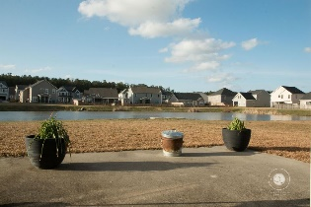
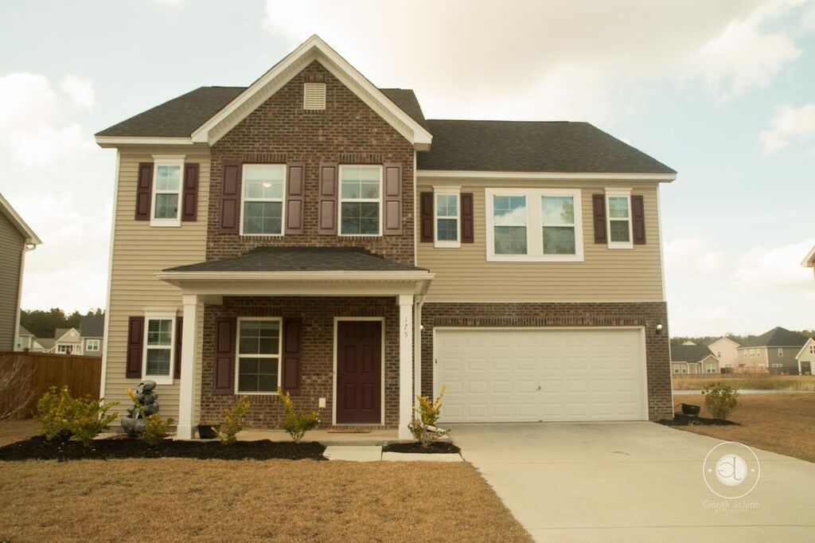
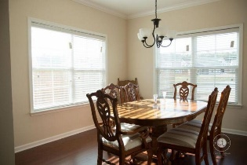
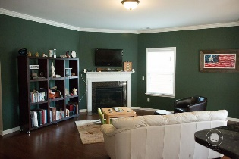
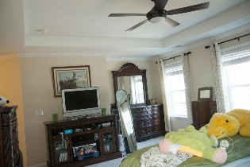
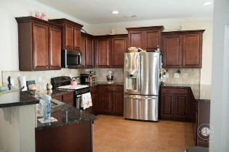
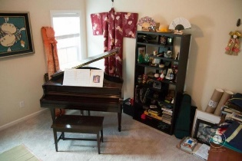
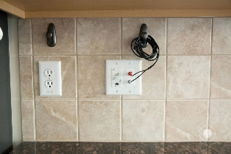
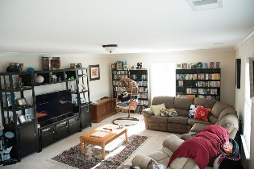

Executive Rental Home in Moncks Corner Available May 1st
Over 3000 Sq.Ft on Pond Lot!
175 Charlesfort Way
Spring Grove Plantation · Moncks Corner · MLS# 16007667 · $1,950
Executive Rental Home in Moncks Corner with Over 3000 Sq. Ft. to Enjoy! Enjoy an immaculate home nestled on a gorgeous pond lot conveniently located to Boeing, and everything the Lowcountry has to offer! All the upgrades one can imagine with 4 Bedrooms,Designer Kitchen with Beautiful Cabinetry and Pull-Out Drawers, Enormous Bonus Room overlooking the Pond, Study with French Doors, Organization Room, Jack & Jill Bath Upstairs, Oil Rubbed Bronze Fixtures throughout the home for an added touch of elegance. Enjoy a gorgeous Lowcountry day via the Sunroom or outside as you feed the geese in the abundant back yard. The neighborhood amenities include boat storage, pool, and an open air pavilion with community fun activities including movie night!
Mattie Nesmith, ABR
Broker-in-Charge
Mobile - (843) 452-3779 | mattie@ergroupofsc.com
The Elite Realty Group of SC, LLC · 8310-A Rivers Ave · North Charleston, SC 29406

