Slide 1
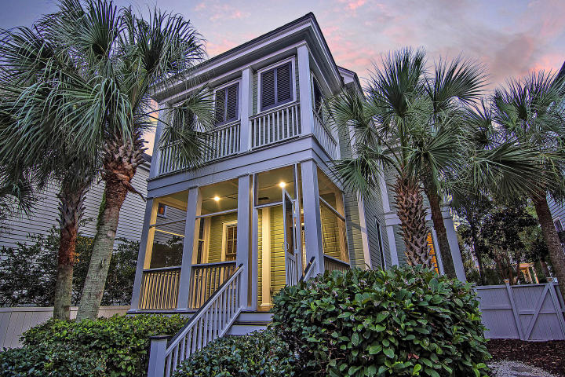



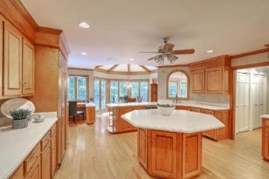
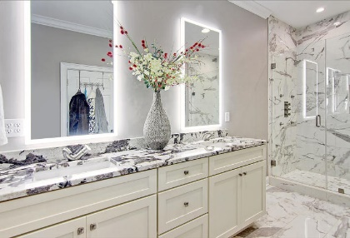



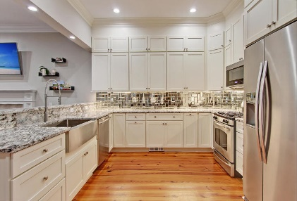

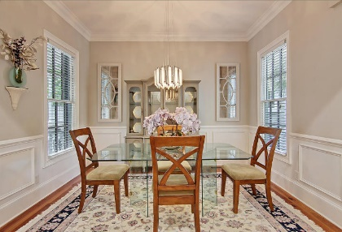
Just Reduced!
Parkshore Marshfront
Secure the I'ON lifestyle
for your client
at this reduced price.
Book your showing today!
175 Civitas Street
I'On ~ Mount Pleasant, SC 29464 ~ MLS# 20023030 ~ $885,900
Peacefully set in Mount Pleasant's prestigious community of Ion, this stunning home shows like a model and has an incredible location. In 2019 this home underwent a nine-month renovation. High end finishes throughout this home include gleaming hardwood floors, wainscoting in the dining room, columns that lead into the kitchen, a fire place in the living room and a master bathroom to die for! This floorplan boasts an office or bedroom on the 1st floor with an en-suite bath as well a front and back porch. The patio and fenced-in yard creates another great outdoor living space. Just walking distance to the shopping and dining in Ion, you can easily get in and out of the community and access its amenities. Behind the home is direct access to nature walking trail along The Rookery which is a gorgeous pond and preserved area.
Additional features include:
Crown molding
Baseboard molding
Kitchen has SS appliances, a gas range and a mirror backsplash
Laundry room is gorgeous with tons of cabinets, counter space and a sink
Entire home repainted
Master bedroom has two closets, one is a fabulous shoe closet and the other is a custom walk-in closet
Master bath has a dual vanity with illuminated mirrors and a rainfall walk-in shower with upgrades all around
New Rinnai tankless water heater
Book your showing today!
Nate Gainey 843-513-2038
nate@mattoneillteam.com
Atlas Fathalla 646-552-2421
atlas@mattoneillteam.com

