Slide 1
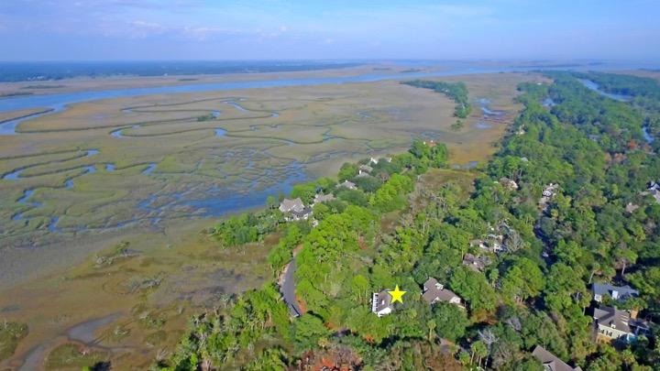
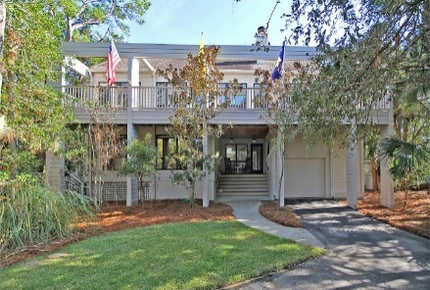
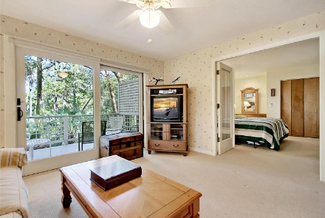
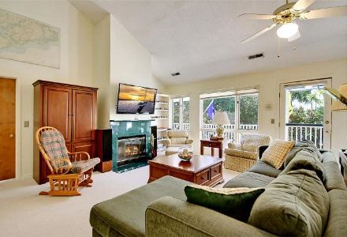
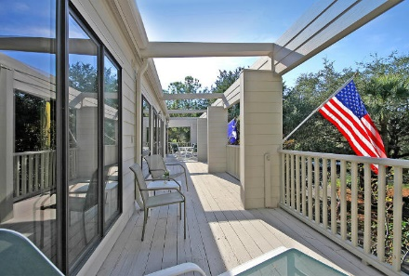
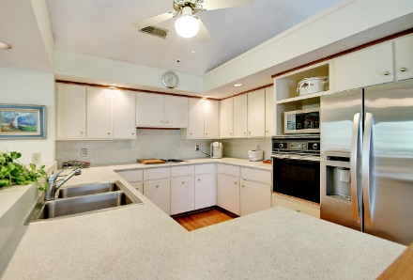
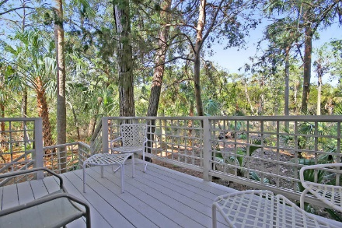
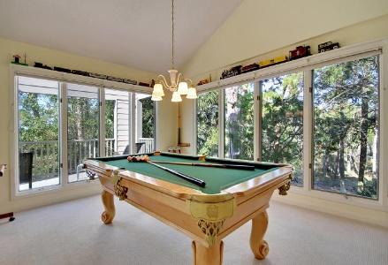
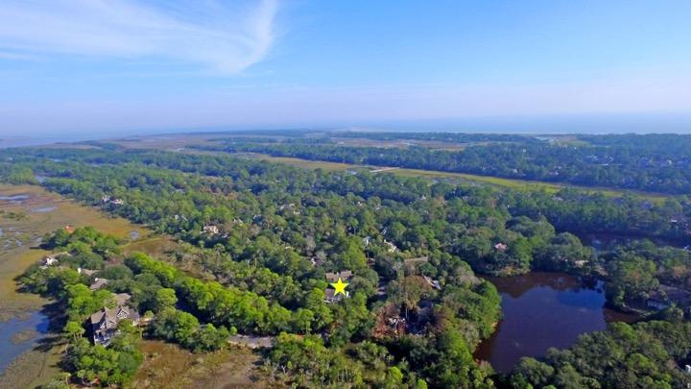

Open House Sunday, May 27 from 1-3
175 Marsh Island Drive
Kiawah Island, SC 29455 ~ MLS# 17030435 ~ $695,000
Privately situated amongst tall, mature landscaping with the marsh and river just steps away, this Kiawah Island getaway is the perfect place to call your home, vacation, investment or simply your very own slice of paradise! The main level of the reverse, open concept floor plan boasts soaring cathedral ceilings and amazing natural light from the huge picture windows and sliders that also reveal the beautiful views. A wrap-around deck makes for the perfect place to enjoy a meal or drink while feeling the breeze and listening to the palm trees blowing in the wind. A private deck on the lowered level has been fortified and is wired and ready for a relaxing hot tub. A car lift in the garage turns this one car into a two! The Kiawah Island lifestyle is calling your name.
Additional features include:
Lots of windows throughout the first and second level of the home for tons of natural lighting
Private setting
Hardy plank siding
New carpet on both levels
Lower level porch is fortified and electrified for a spa
Car lift in the garage
Third bedroom can also be used as an office
Book your showing soon!
Ben Laaper ben@mattoneillteam.com 843-642-3546

