Slide 1
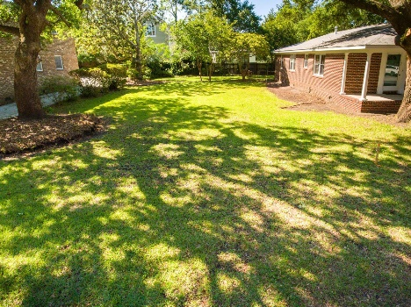
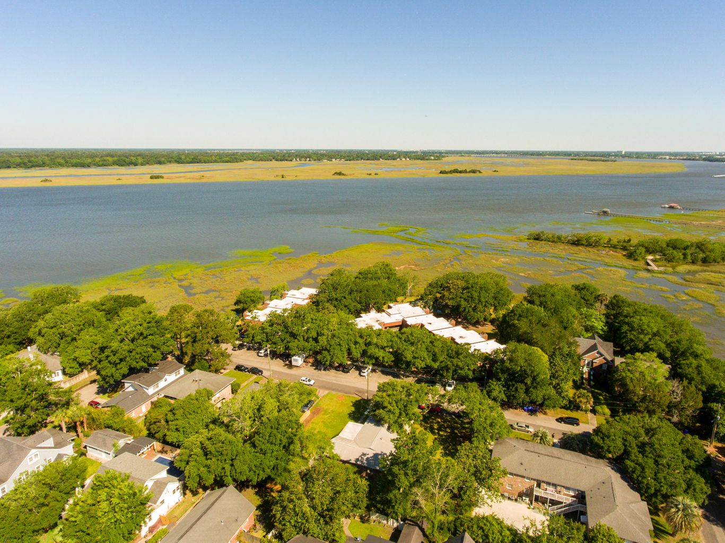
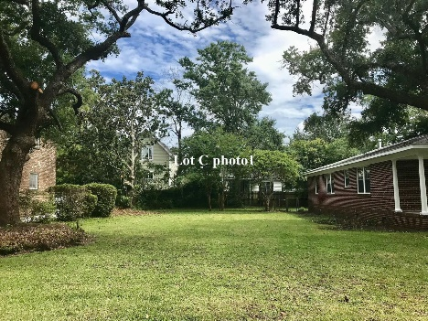
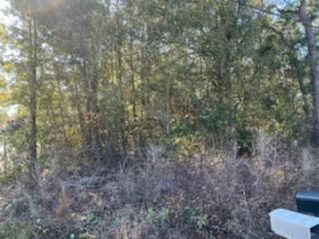
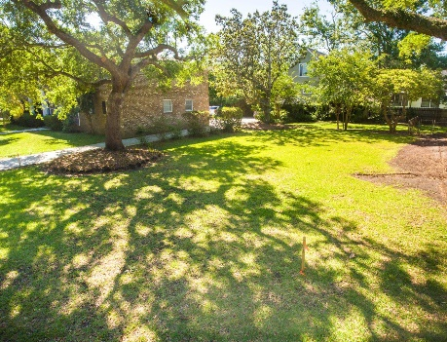
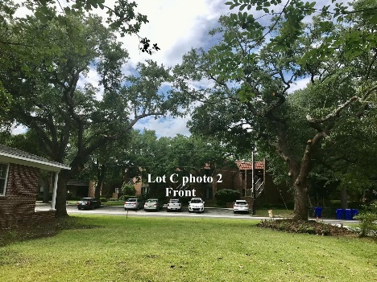


Downtown Vacant Lot with River Views
Reduced!
175 3rd Avenue
Wagener Terrace · Charleston, SC 29403
MLS# 21018861 · $399,000
Michael Dew
O 843-769-5100
M 843-870-7000
michaeledew@gmail.com
www.michaeldewrealestate.com
Gorgeous views of the marsh and Ashley River with mind blowing sunsets surrounded by 100+ year Live Oaks. This exclusive SFH lot is adjacent to Lowndes Grove Plantation (current Netflix Hit TV series Outer Banks filmed) and the only one available in the highly sought after downtown area of Historic Wagener Terrace. The lot is nestled in the most peaceful and private area of downtown Charleston. A once and last in lifetime opportunity to build your Southern Charmed Dream Home in the Heart of America's #1 City and live in this private, prestigious, and historic location. Walking distance to Hampton Park and the Citadel. Easy bike to upper peninsula shops and restaurants. Won't last long in this market! Plat and house plans in documents.
AgentOwned Charleston Group
902 Savannah Hwy
Charleston, SC 29407
Real Estate ● Mortgage
Insurance ● Business Brokerage

