Slide 1

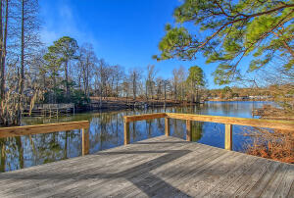
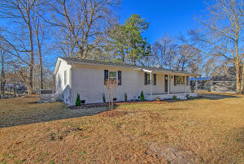
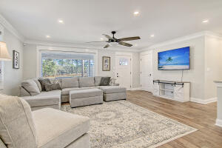
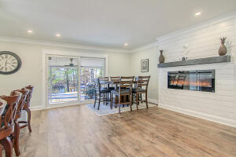
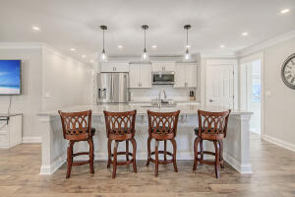
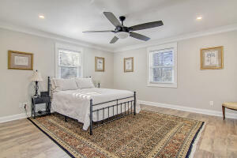
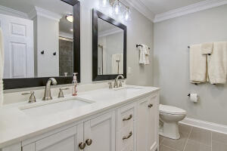

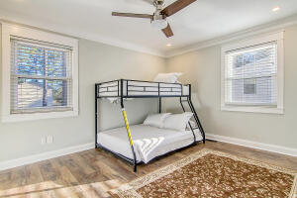
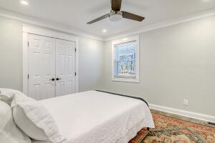
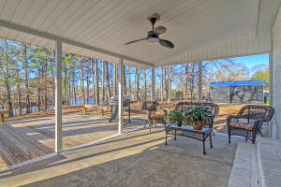
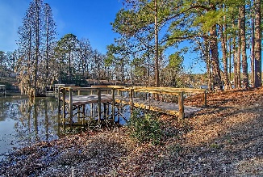

Renovated Lake House
With Private Dock
Debbie Cromer
ABR, RSPS, REALTOR, CRS
(843) 437-6342
debbie@debbiecromer.com
www.debbiecromer.com/
1762 James Loop Road
Manning, SC 29102 | MLS# 23000458 | $575,000
Stunningly renovated lake house w/ private dock. This home comes fully loaded and move in ready. Perfect for short term rental, second home or live the lake life full time. Open floor plan w/ amazing lake views from the living areas as well as the master bedroom. Living & Dining areas flow into the spacious Kitchen that features white shaker cabinets, new upgraded appliances & beautiful granite countertops including a 10' island. The large master bedroom is in the back of the house & features a renovated bathroom w/ double sinks & beautifully tiled shower. Two additional bedrooms, an additional renovated bath & laundry room complete the inside. Off the dining area is the new deck that leads to your private dock. Don't' forget the new 20'x30' garage to house cars, boats & toys. Sold fully furnished including 65 in tvs, towels, sheets, dishes, glasses & silverware. Nest Thermostat and Ring security system. Private dock, large lot, less than 1/8th mile from boat landing. Lakefront is a Santee Cooper lease that was just renewed for 40 years.
Video Tour: https://vimeo.com/787243324
Century 21 Properties Plus | 1090 Park West Blvd; Ste 103 | Mount Pleasant, SC 29466

