Slide 1
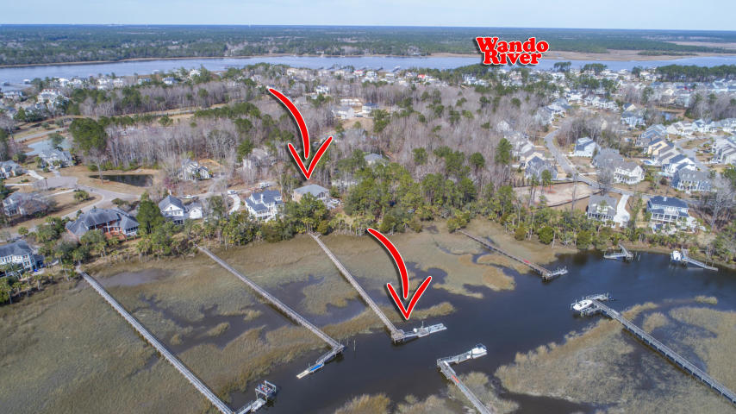
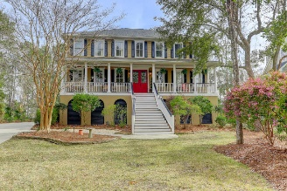
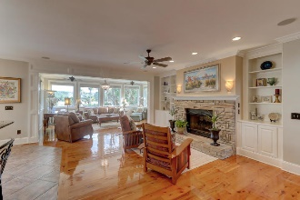
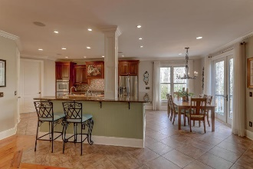
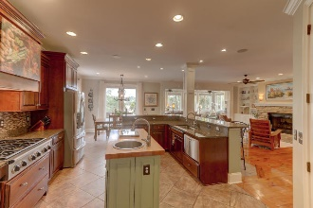
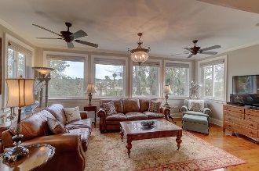
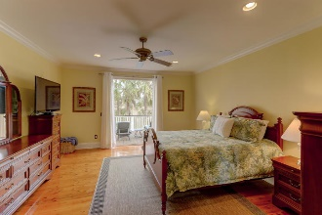
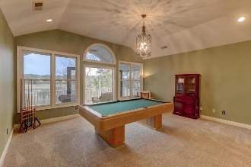
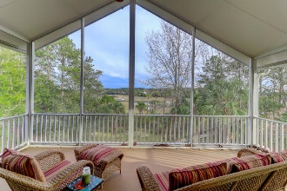
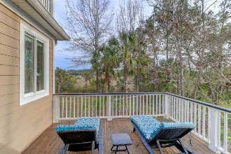
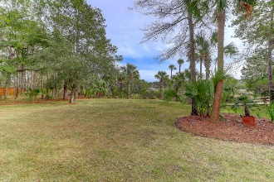
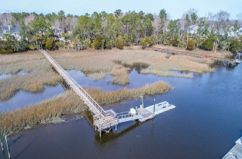


1764 Greenspoint Court Dunes West :: Mount Pleasant, SC 29466 MLS# 19004540 :: $1,049,000
New Price!
First Time On The Market!
Incredible waterfront property in Dunes West with a shared dock on Wagner Creek just minutes to the Wando River. There are water views from almost every room in the house. This home has 5 BR plus an additional finished mother in law suite on lower level . Open floor plan with large chef's kitchen with custom cherry cabinets, center island with prep sink, a 6 burner Dacor gas cooktop, 2 dishwasher dish drawers and double ovens all by Fisher Paykel. Formal dining room, living area with gas fireplace and a large sunroom area that easily extends the entertaining area completes the main floor living space. Spacious main floor master suite with newly updated spa like bath plus access to a private deck overlooking the marsh and creek.
Upstairs by way of the beautiful staircase or the 3 stop elevator has a media/game room with large screened porch again with great water views and 4 nice sized bedrooms that each share jack and jill style baths. House has been recently painted inside and out, new HVAC systems , all Australian Cypress floors recently refinished just to name a few things. This is truly a must see for any water enthusiast.
Clay Cunningham
O (843) 886-8110
M (843) 345-4647
clay@carolinaone.com
www.claysre.com
Carolina One Real Estate
1503 Palm Blvd Ste
Isle of Palms, SC 29451

