Slide 1
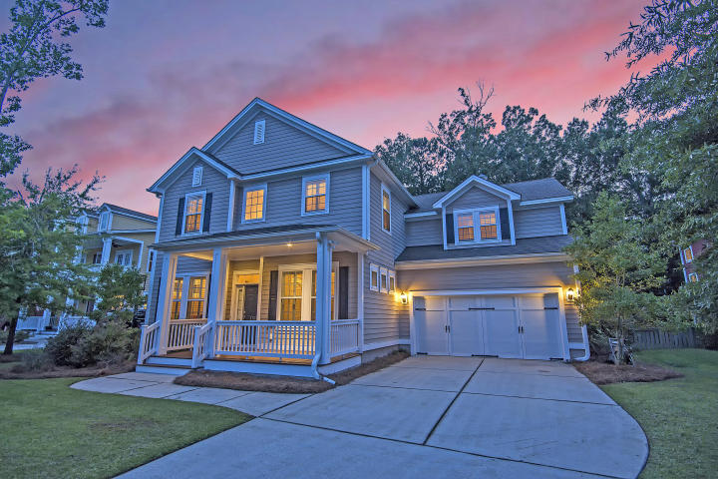
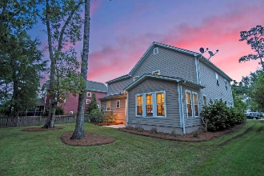
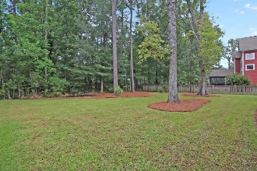
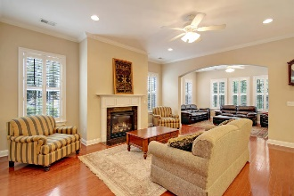
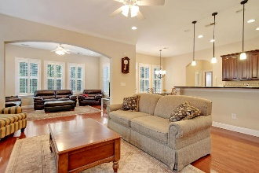
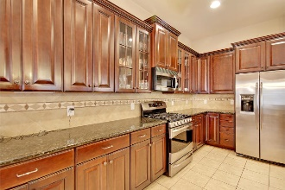
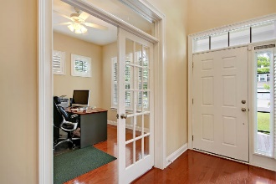
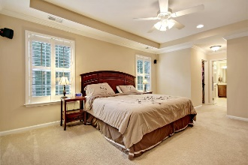
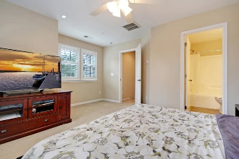
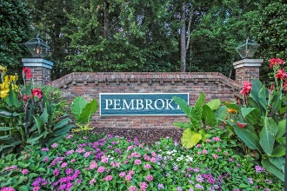
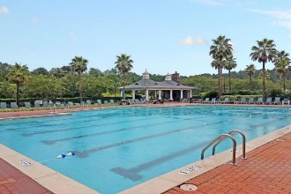
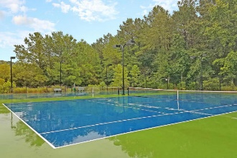
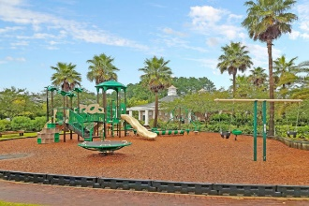
Drop by and enter to win a gift certificate to Duck Donuts!
Major Price DROP!
Now Less Than $600k
1768 Wellstead Street
Park West ~ Mount Pleasant, SC 29466 ~ MLS# 18022651 ~ $599,999
Looking for an open floor plan, space for everyone, & a large private backyard in Mt. Pleasant? This well-appointed Park West home is full of upgrades & has a custom layout that includes both formal & flex spaces & offers an unusual amount of versatility & flexibility. Formal living & dining, a formal office, keeping & family rooms, a large breakfast area & huge pantry off the kitchen, & a bedroom w/ an ensuite bath round out the 1st floor, while the upstairs includes the master suite, 3 additional spacious bedrooms (2 with ensuite baths), another full bath, & a loft area/flex space. Cherry wood flooring & cabinetry, plantation shutters throughout, granite counters, stainless appliances, crown molding, high ceilings, & arched doorways are just a few details that make this home shine.
Additional details include:
Highly-functional and flexible floor plan offers a number of spaces that could be used as playrooms, additional office spaces, game rooms, sun rooms, media rooms, craft rooms, studies, libraries, etc. along with 5 spacious bedrooms (one downstairs) and 5 full bathrooms (one downstairs).
Open kitchen features upgraded cherry cabinetry; granite counters; stainless steel appliances; tile backsplash & flooring; gas cooking; recessed lighting; a huge walk-in pantry; and a large island with a breakfast bar, a wine storage rack, and extra storage cabinets overhung by pendant lighting.
Master suite features a tray ceiling, plantation shutters, surround sound pre-wiring, his and her closets, and a large ensuite bath, which offers a large shower with a handheld sprayer and tile surround, his and her sinks, tile flooring, brushed nickel fixtures, a separate water closet, and a linen/storage closet.
Guest suite (FROG) features an ensuite bath, plantation shutters, surround sound pre-wiring, and a walk-in closet.
Freshly-painted and stained front porch with freshened paint inside.
Transferable termite bond in place with Terminex.
Economical home with energy-efficient insulation.
With some of the best neighborhood amenities Mt. Pleasant has to offer, Park West features two swimming pools, six tennis courts, a Summer kitchen, a clubhouse, a play park, a sand volleyball court, a crabbing dock, and miles of walking trails.
Park West community also features several commercial areas with restaurants, grocery shopping, banking, healthcare, veterinary care, and lots more all conveniently-located within the neighborhood. A recreation complex including a variety of sports fields, a track, and a dog park maintained by the Mt. Pleasant Recreation Department is also conveniently-located within the neighborhood.
No matter what stage of life you are in, this home is a must see! Book your showing today!!
Julie Nims julie@mattoneillteam.com 843-580-6310

