Slide 1

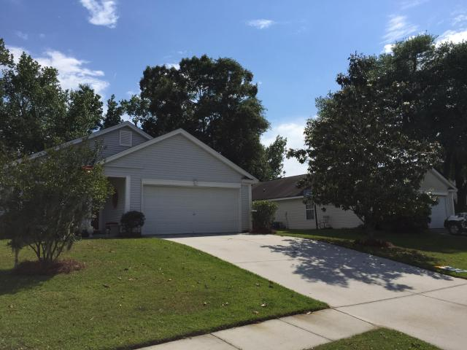
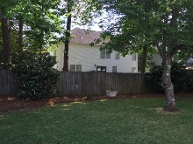
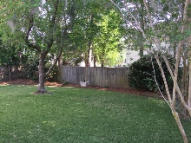

4 Bedroom in Shadowmoss
176 Droos Way
Charleston, SC 29414 - MLS# 16009429 - $225,000
Great one level open floor plan. Home consist of 4 bedrooms, 2 full bath, vaulted living/dinning room combo, and open foyer that could be used as an office space. Hardwood floors through out the main living space and carpet in the bedrooms. Vaulted ceilings provide open atmosphere in the family room leading into fenced in back yard and patio. Master bedroom located in the rear of the house for extra privacy. Extra amenities include pool membership and discounted golf at Shadowmoss. Easy to walk/bike to Elementary school.
Andrew Tackitt
843-437-8726 cell
andrew@radekopf.com
1205 Two Island Court, Suite 201 | Mount Pleasant, SC 29466
Phone: (843) 579.2217 | Fax: (843) 971-0281

