Slide 1
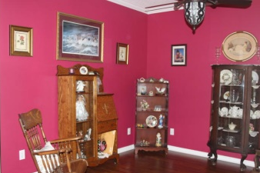
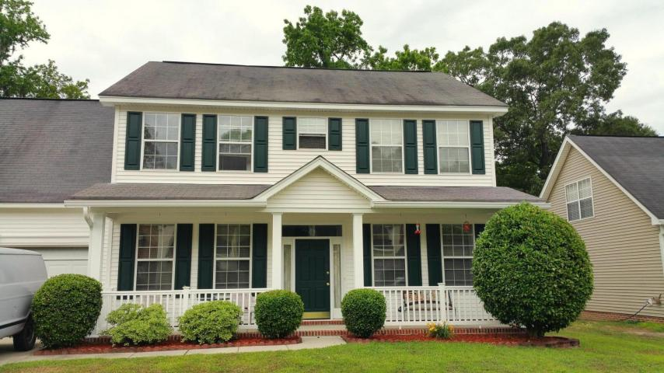
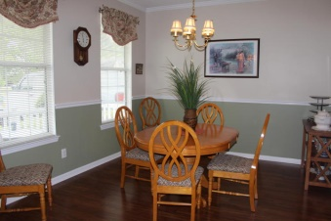
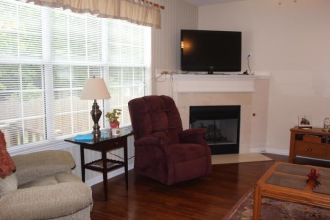
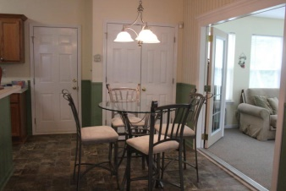
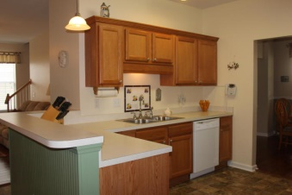
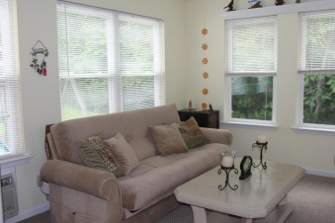
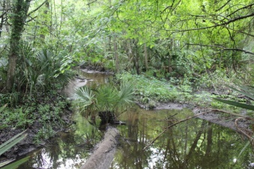
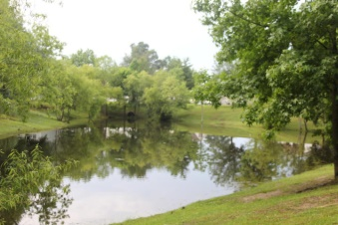


176 Hainsworth Drive
Marsh Hall ~ North Charleston
MLS# 15012745 ~ $263,000
Creekfront in Dorchester County
Situated on protected wetlands/creek & wooded buffer off the Ashley River this turn-key 4 bedroom, 2½ bath home won't last long (Frog is 4th).
Recently updated with custom crown moldings & vanities, Corian & granite countertops in baths; wainscot in kitchen; new pre-engineered flooring; premium stone look vinyl in kitchen; new HVAC; new dishwasher & microwave; new faucets and most light fixtures; new marble surround for fireplace; new French doors at sunroom; new garage door opener; gutters in 2006.
Owners have done it all! Including removal of artwork & patching holes to create smooth unblemished walls & freshly painting. This quiet Dorchester County neighborhood has lots of green space & ponds creating a peaceful environment while only 7 miles to airport; 1m to Bosch & minutes to schools & shops.
Margaux L Kilgallen, REALTOR
Cell - (843) 670-4035
mak@beresfordrealty.com
Beresford Realty, LLC
672 Marina Dr Ste 206B| Charleston, SC 29492
www.beresfordrealty.com

