Slide 1
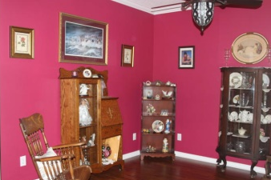
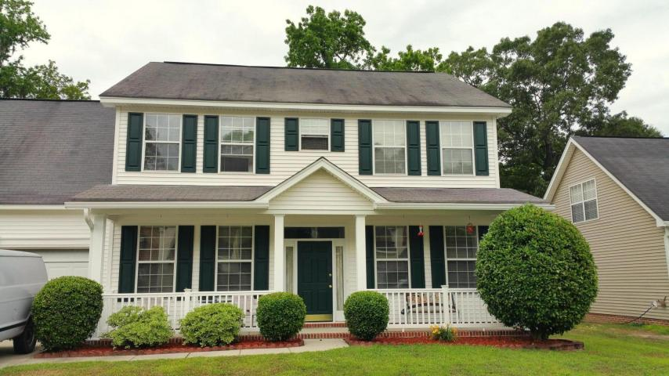
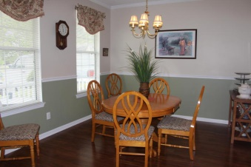
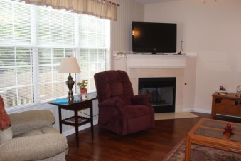
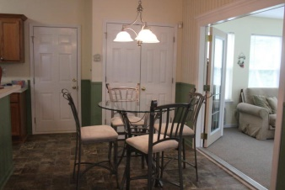
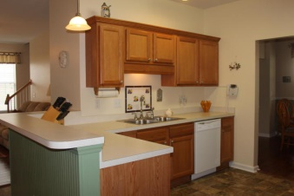
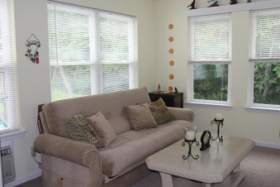
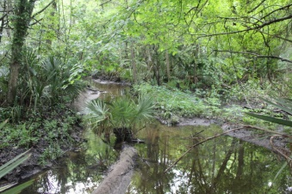
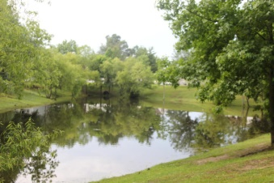
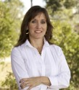

Bring all Offers for this Dorchester II District Home Owners Offering $3000 Closing Costs $245,000
176 Hainsworth Drive – Marsh Hall/Coosaw Pointe
4br/2.5b 2600sf home on creek
Rarely does a home along the creek
come on the market in this neighborhood.
NEW HVAC
NEW Dishwasher
NEW Microwave
NEW Faucets
NEW Custom Crown Molding
NEW Corian kitchen counters
NEW Granite on bath vanities
NEW Wainscot in Kitchen
NEW French doors
NEW Handscraped Laminate flooring
NEW Marble fireplace surround
NEW Garage Door Opener
NEW Premium Stone-look vinyl in kitchen
Freshly Painted throughout
Gutters Installed in 2006
Owners have done it all!
7 miles to Airport & Boeing; 2m to Palmetto Parkway; 1m to Bosch, walking distance to Newspring, New primary school and shops. Enjoy living close to work and shops without the hassle of long commute.
Margaux L Kilgallen, REALTOR
Cell - (843) 670-4035 mak@beresfordrealty.com
Beresford Realty, LLC 672 Marina Dr Ste 206B| Charleston, SC 29492
www.beresfordrealty.com

