Slide 1
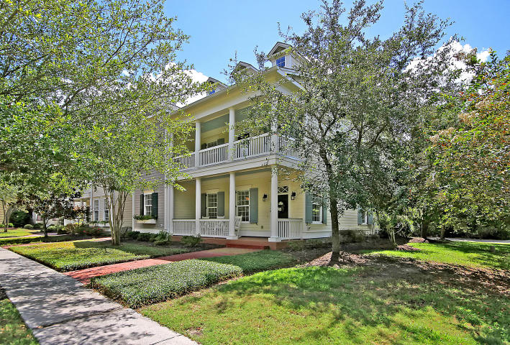
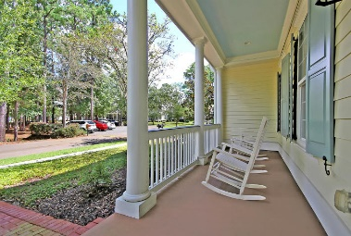
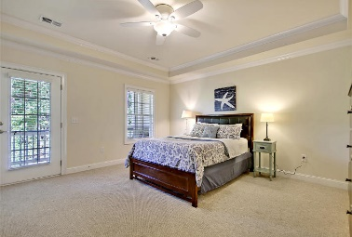
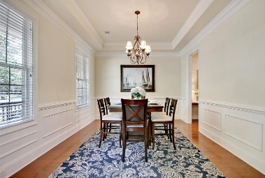
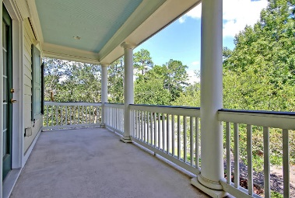
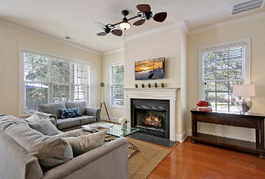
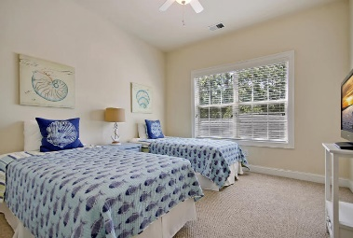
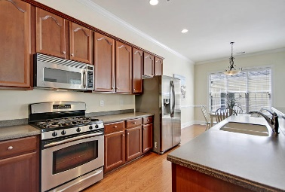
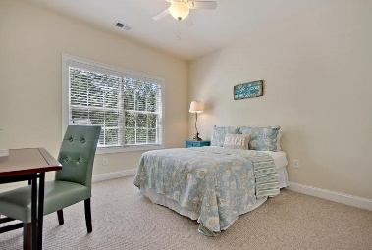
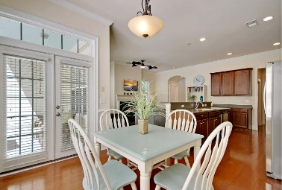
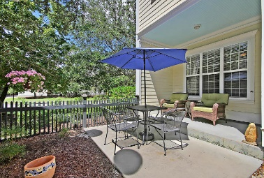
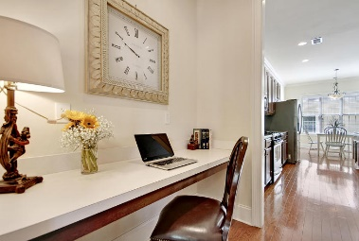
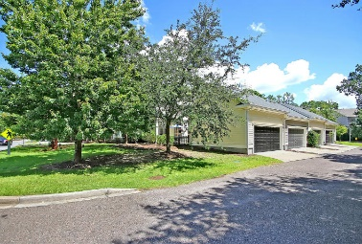
Great Downtown Investment Opportunity
Park West Open House Saturday 12 - 3!
Price Reduced!
1770 Tennyson Row Mount Pleasant, SC 29466 ~ MLS# 18024578 ~ $369,000
You'll feel like you hit the jackpot with this stunning end unit townhouse with 2-car garage in Park West.
Not only is this layout extremely inviting & comfortable, but there are 3 outdoor living spaces to enjoy as well - a full front porch, balcony off master & fenced in backyard with patio.
The natural light pours into this home onto the beautiful hardwood floors, causing the granite counters to sparkle & the stainless steel appliances to shine.
A Butler's pantry (also great for a work/study nook) leads to the eat in kitchen which provides a view of the cozy fireplace in the living room.
The master bedroom has a huge walk in closet & ensuite bath w/dual vanity, soaking tub & walk-in shower.
This home is conveniently located near the amenity center w/tennis courts, two pools, playground & volley ball court. There are miles of walking and biking trails in this family friendly neighborhood.
Book your viewing today!
Paige Rhodes 843-830-3281 paige@mattoneillteam.com
Ben Laaper 843-642-3546
ben@mattoneillteam.com

