Slide 1
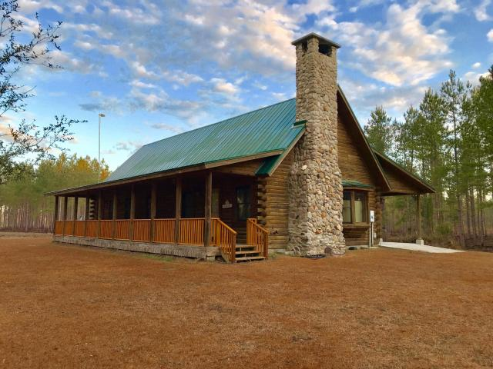
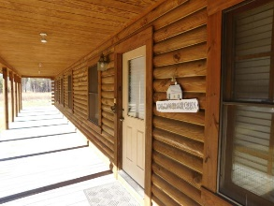
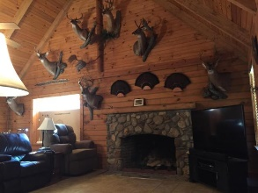
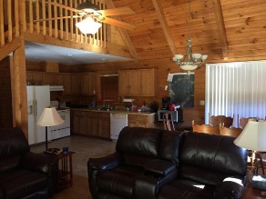
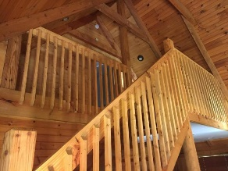
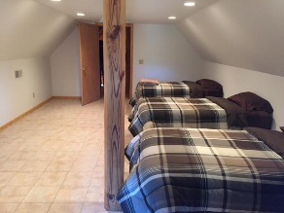
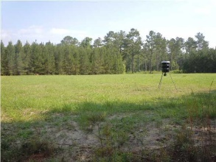
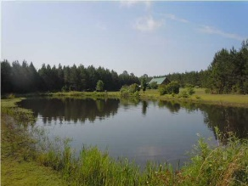
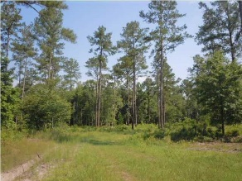
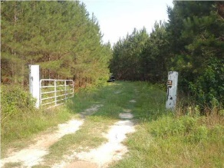
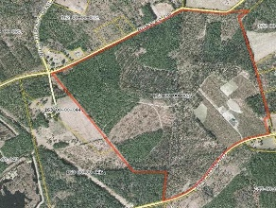


1775 Ram Horn Road Varnville, SC 29944 ~ MLS# 15030527 ~ $834,500
Price Reduced
in the Old Village!
240 Acres + Log Cabin
Owner Financing Available At 5.5%
Price Reduced
Well Below Appraisal
Open House Sunday 1-3
Beautiful log cabin with metal roof overlooking a large stocked pond. Cabin sleeps 10+ people. 240 acres with pine plantation, oak hardwood bottoms, food plots, deer stands. Property borders 2000 acre Cypress Bay plantation. Quality Deer managed for 20+ years, abundant Turkey population, duck ponds ready for flooding. This property is a turn key recreational property ready for someone serious about being ready to hunt and fish now. Owner will finance with little down.
Billy Shuman
Broker In Charge
Residential & Land Sales
coastalpointsc.com
843.906.1159 Cell
COASTAL POINT REAL ESTATE
886 Johnnie Dodds Blvd,
Suite 102
Mt. Pleasant, SC, 294
Office 843.256.2237

