Slide 1
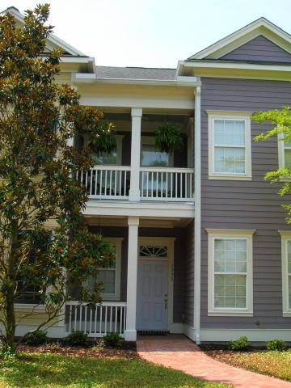
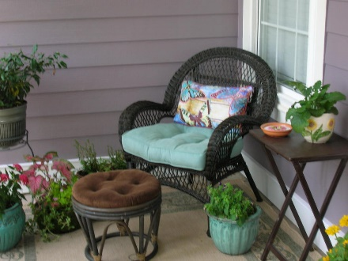
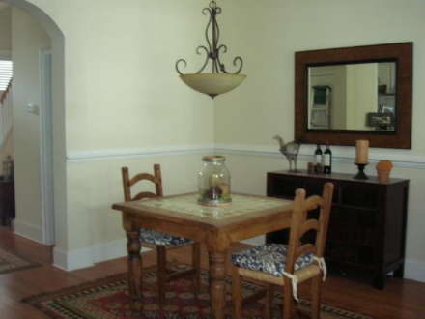
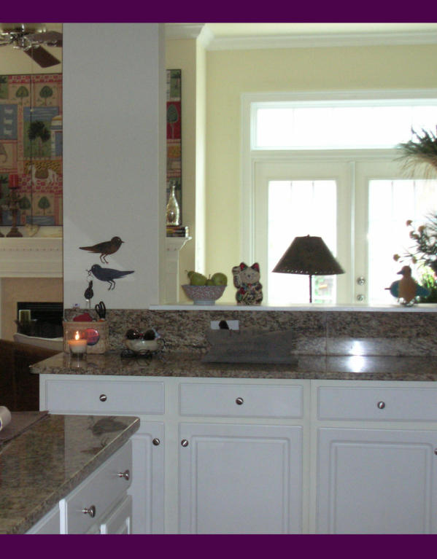
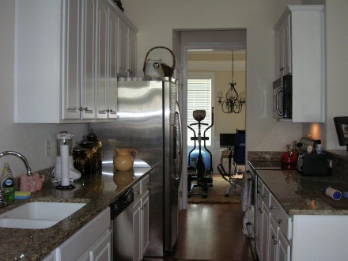
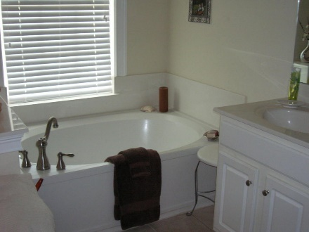

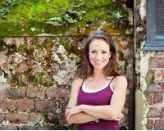

Welcome home! This custom townhome with 3 br and 2.5 baths has so much to offer. Double piazzas, beautiful private brick patio with French drains and an extra large garage. Upstairs is the master suite that has his and hers closets, double vanity, separate shower, garden tub and tile floors. You will love the gourmet kitchen with beautiful granite countertops, stainless steel appliances and a nook that can be used as a butlers pantry. Come take a peak, you won't be disappointed. If square footage is important please measure. All of the information in this listing is to the best of the agents knowledge. Buyer to verify schools and square footage.
$1,000 AGENT BONUS with ratified contract by February 14, 2016 * Seller is offering $2000 towards closing costs!!!
(*with BIC approval)
1775 Tennyson Row
Park West ~ Mount Pleasant ~ MLS# 15017437 ~ $342,000
Joy Lance
C 843-216-1631 | O 843-606-5251
1joylance@gmail.com
LifeTree Real Estate, LLC | 3094 Hwy 17 North | Mt. Pleasant, SC 29466 | 843-216-1631 | www.lifetreerealestate.com

