Slide 1
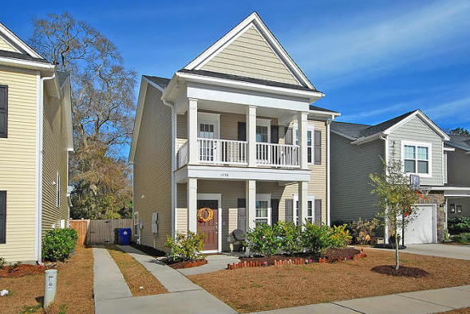
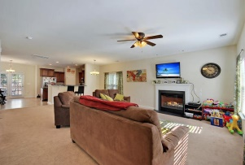
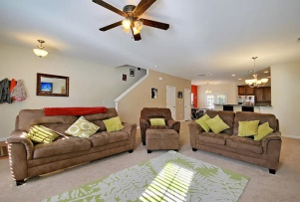
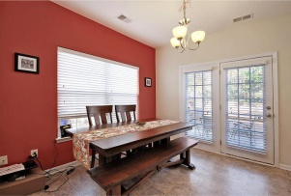
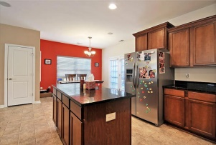
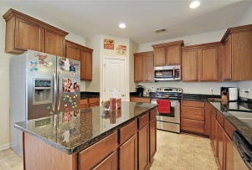
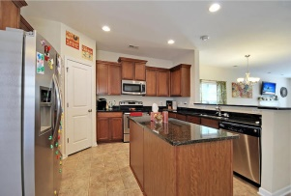
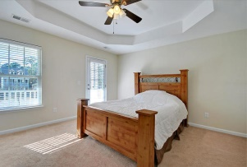
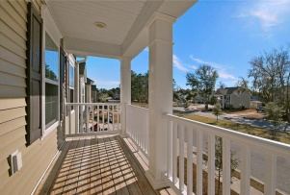
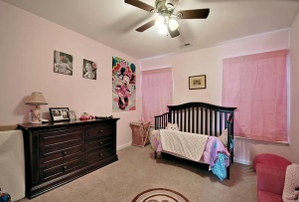
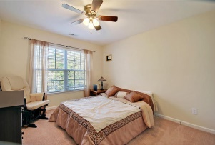
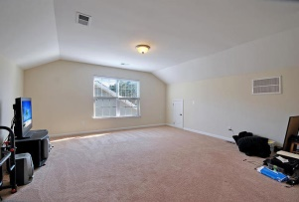
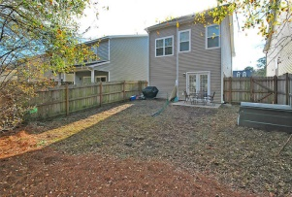


Move-in Ready Johns Island Beauty!
1776 Towne Street
The Cottages at Johns Island
Johns Island, SC 29455
MLS# 15002541
$265,000
4 Bedrooms | 2½ Baths | 2,141 sf
Welcome home to the Cottages at Johns Island! This lovely Charleston single style home is move in ready! You'll immediately notice the great double porches which offers wonderful curb appeal. Upon entering you see a very large, living room/ dining room combo with a gas fireplace. The kitchen overlooks the living and dining rooms and has stainless steel appliances, pantry, island and large eat in kitchen area. Upstairs, on the second floor, you have two bedrooms with a full bath, and the master bedroom. The master bedroom has access to the upstairs porch. The master bathroom offers dual vanities, a shower and garden tub and large walk in closet. Keep climbing to the great room on the third floor that can be your 4th bedroom or wonderful bonus space! Out in the backyard, you have a very nice private completely fenced in yard. The neighborhood offers a playground and walking trails are coming soon! The location of this home is amazing! Close to downtown Charleston, the beaches, James Island County Park, golf and some of the best restaurants in the Lowcountry! Come see this home today! You won't be disappointed!
Larry & Kathy Mazalatis
Larry Cell 843-693-0529
Kathy Cell 843-693-0159
Office 843-871-9133
AGENTOWNED PREMIERE GROUP | 1800 TROLLEY RD | SUMMERVILLE, SC 29485

