Slide 1
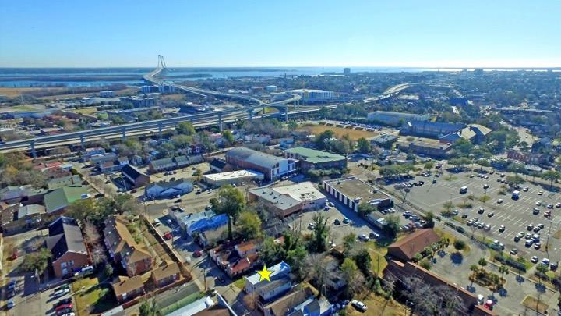
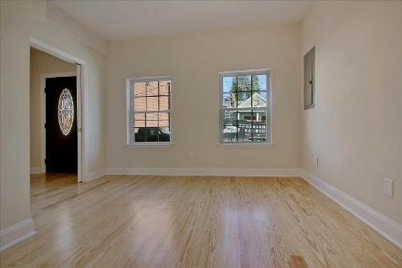
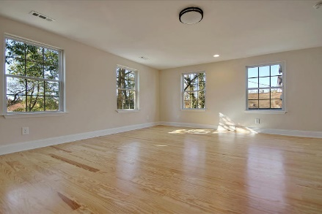
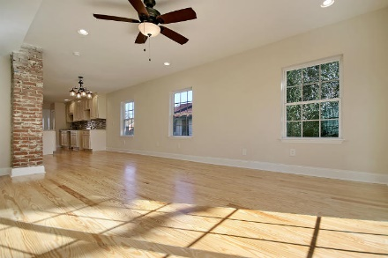
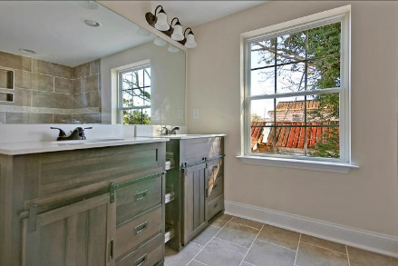
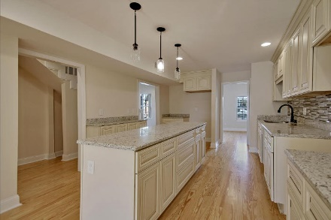
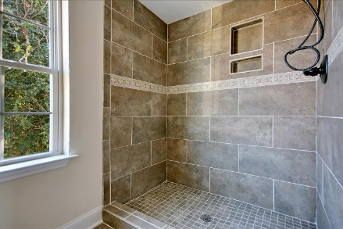
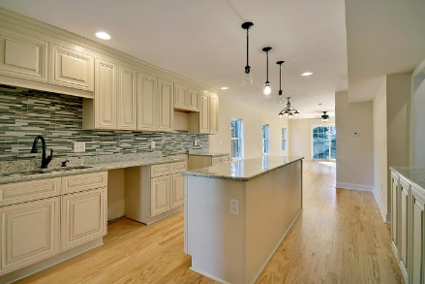
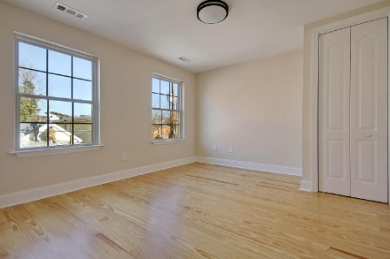
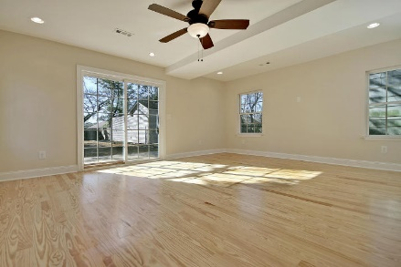
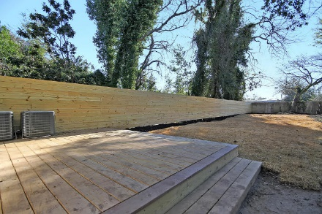
Price Reduced!
Downtown Dream House! Super Low Price!!
177 Romney Street Charleston, SC 29403 ~ MLS# 18002079 ~ $449,900
Don’t miss out on the chance to live in this amazing downtown Charleston location that’s walking distance to Hampton Park and the Citadel. Stunning flowers decorate the walking paths around the ponds, water fountain and bridge at this gorgeous park that’s just a few blocks away.
This historic home has been completely renovated from top to bottom and has a deck looking over the unusually large, fenced-in backyard for a location like this. There are hardwood floors throughout, beautifully updated baths with custom tile work, a balcony on the second floor and a sun drenched main living area with a granite kitchen, center island, tile backsplash and exposed brick in the eat-in area.
If you've been looking for move-in ready with not a thing to do AND a killer location, this is it!
Book your showing today!
Chip Walsh chip@mattoneillteam.com 843-822-4663

