Slide 1
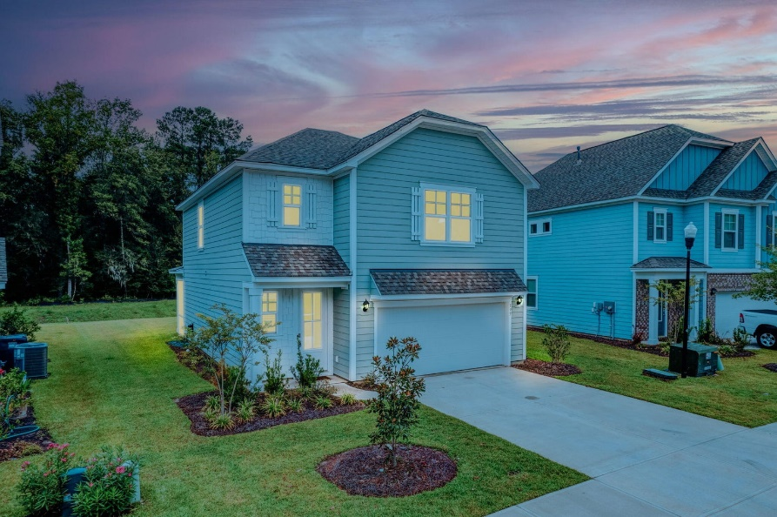
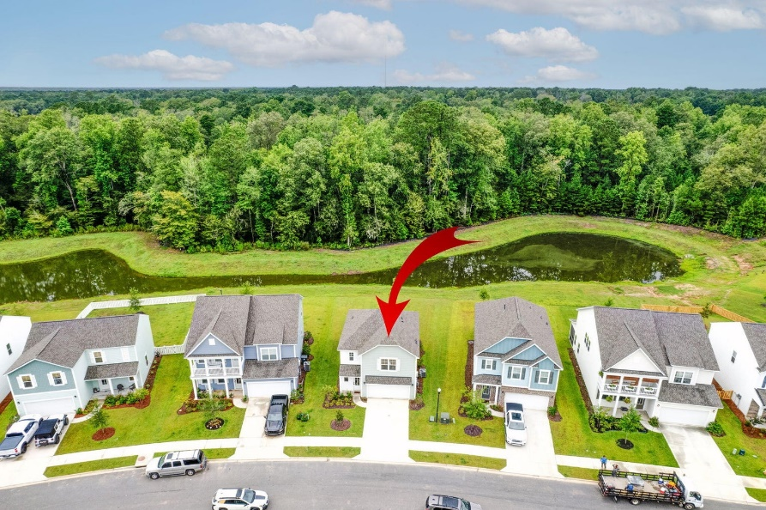
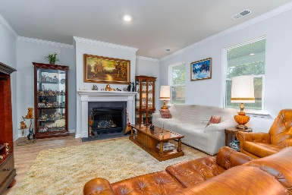
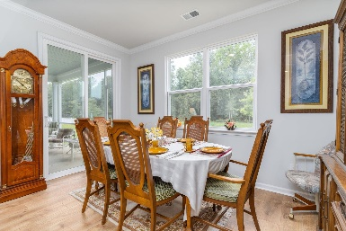
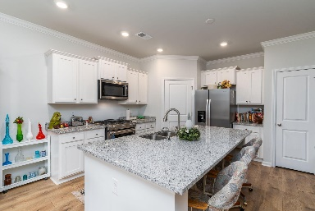
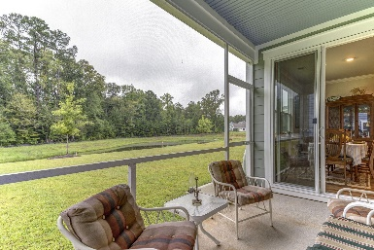
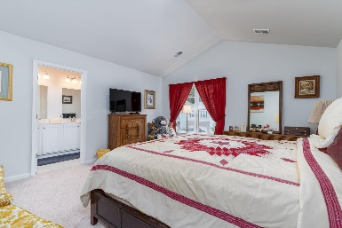
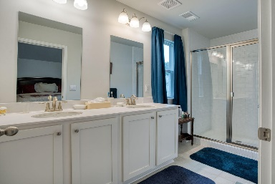
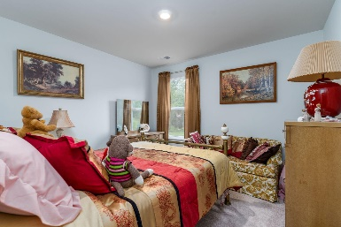
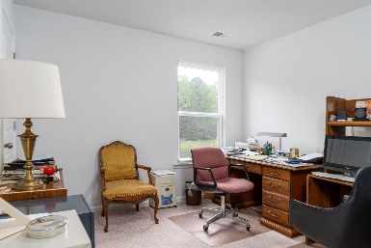


177 Cherry Grove Drive The Ponds | Summerville, SC 29483 | MLS# 23016962 | $399,900
Motivated Seller will Entertain a RATE BUY DOWN!
Welcome to the Ponds! An incredible, award-winning community! It features a play park, 20-acre lake, outdoor picnic pavilion with a fireplace, Amphitheater, 1100-acre nature preserve, multi-purpose sports fields, historic farmhouse amenity center, YMCA and 21 miles of trails! This DR Horton Dawson plan, Elevation B is almost brand new without the wait time to build! It features a large kitchen island, with granite, overlooking a breakfast nook and Great Room with a gas fireplace! Upstairs you will find a nice sized Master Bedroom with a walk-in closet and full bath! Bedrooms 2 & 3 are good sized also! 2.5 baths with cultured marble, Low E windows, Mohawk floorings throughout, Laminate, carpet and ceramic tiled baths. 9 ft ceilings down. LED lighting, SS Appliances and Smart Home Technology.
Christopher McCormick
Office - 843-871-9133
Cell - 843-224-3204
cj.mccormick@agentownedrealty.com
AgentOwned Premiere Group
1800 Trolley Rd
Summerville, SC 29485

