Slide 1
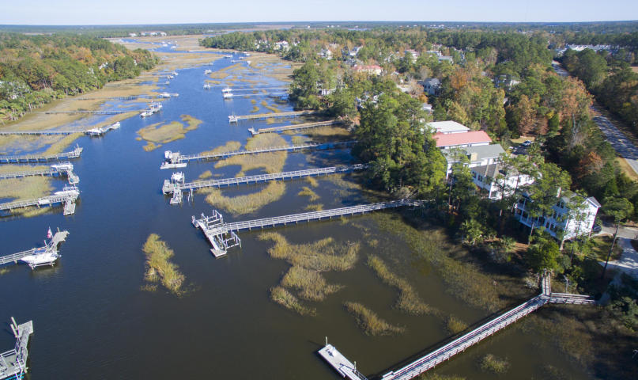
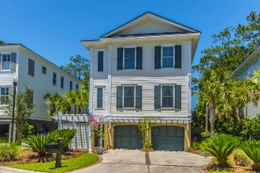
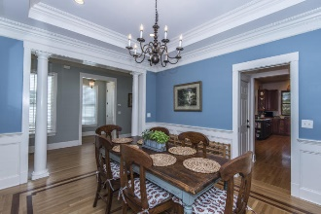
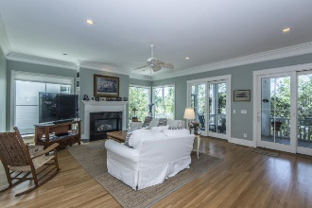
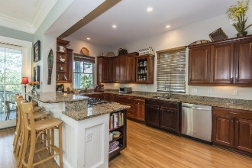
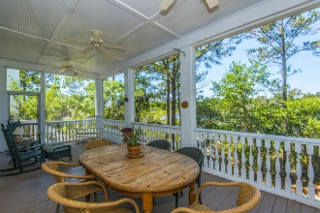
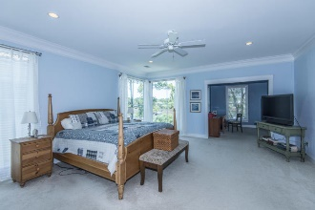
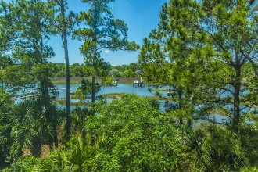
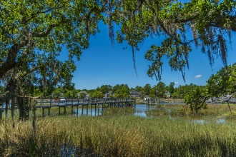
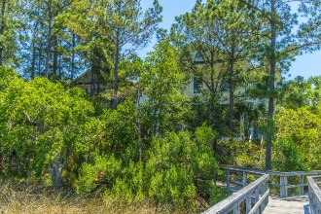
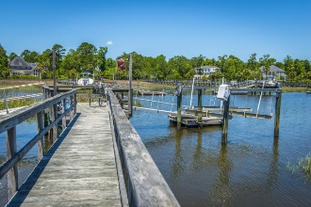


1782 Bergenfield Road
Mount Pleasant :: MLS# 17014167 :: $899,000
Beautiful Waterfront Listing in Park West
Beautiful Waterfront home on Toomer Creek including boat lift and floater on shared dock. Incredible waterfront and sunset views from both floors. Main floor has great room with large windows and doors to take advantage of the views. Huge screened in porch extends the entertaining space even closer to the water. Dream kitchen with stainless appliances including gas cook top, custom cherry cabinets and granite counters . There is a guest bedroom suite with full bath on this level as well as separate dining room . The second floor is where you will find the master retreat with more gorgeous water views and a separate space that can be used as office/sitting room in the bedroom area. There is a large dressing room and walk in closet steps away from bath with claw foot tub and large shower with rain head shower system. Two bedrooms that share a jack and jill bath plus a large media/ playroom with built in desks and bookcases.
There is a elevator shaft in place. 10 ft ceilings main floor, oak floors throughout downstairs. Large 2 car garage with plenty of extra storage for all your boating and fishing needs.
Clay Cunningham
O (843) 886-8110
M (843) 345-4647
clay@carolinaone.com
www.claysre.com
Carolina One Real Estate
1503 Palm Blvd Ste
Isle of Palms, SC 29451

