Slide 1
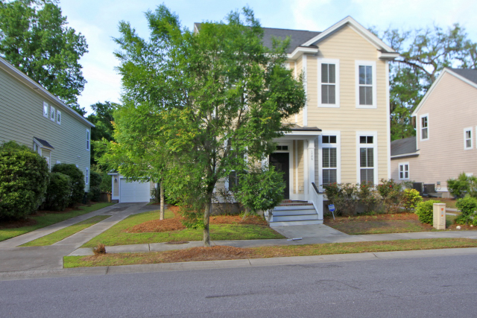
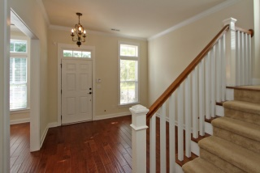
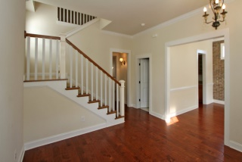
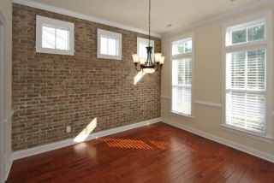
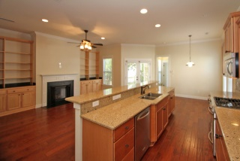
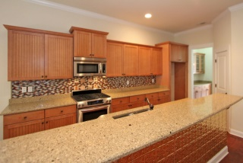
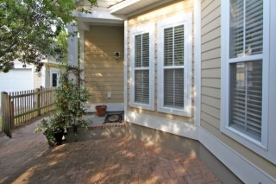
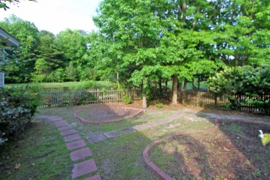
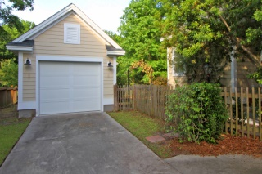


1786 Cornsilk Drive
Charleston, SC 29414 - MLS# 15012476 - $319,000
Just Listed in Carolina Bay
Great opportunity to own in the Salt Grass subsection of Carolina Bay. Nice mature lot located on a pond. The home has some nice upgrades from the original owner such as high ceilings, an exposed brick wall in the dining area, butler's pantry from the kitchen to dining area, a gourmet kitchen with granite countertops, gas cooktop, electric oven with warming drawer and built in bar to enjoy this family space. Enjoy the nice fireplace in the family room. Master is located downstairs with high ceilings and outdoor access to the patio. The upstairs is host to the three other bedrooms and two more full baths. The property has been freshly power washed, some fresh painting in the master bedroom. It is move in ready for you to enjoy!
Charla McDonald
Office - (843) 884-1622
Cell - (843) 343-1456
Fax - (843) 746-4845
cmcdonald@carolinaone.com
charlamcdonaldproperties.com
Carolina One Real Estate
628 Long Point Rd
Mt Pleasant, SC 29464

