Slide 1
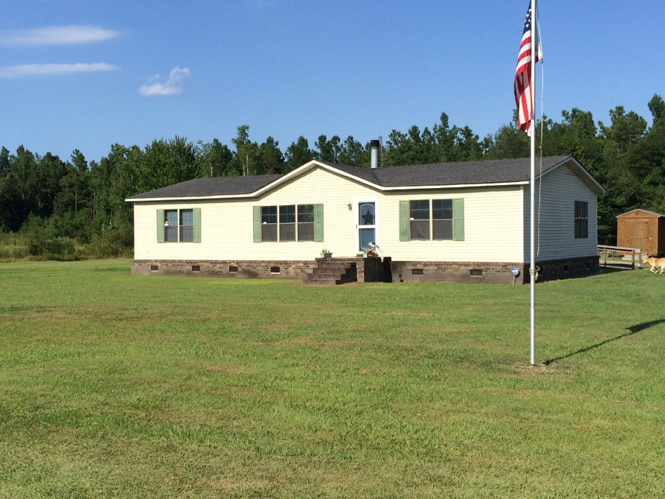
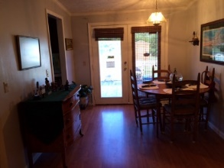
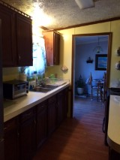
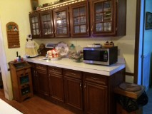
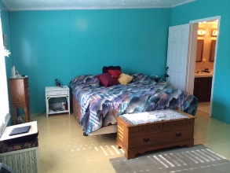
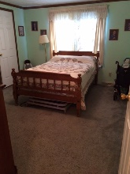
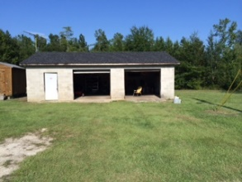

1787 County Line Road
Cross, SC 29436 | MLS# 15021159 | $119,900
3 Bed | 2 Bath | 1,568 Square Feet
Get out of the city and relocate to this 2.4 acre property in Cross!
This 3/2 mobile home sits of plenty of land to do whatever you heart desires, and there is also a 2 car workshop that conveys with the property!
Come take a look!
Carla C Davis
Mobile - (843) 437-4873
gaweber@tds.net
AgentOwned Premiere Group
141 A N. Main Street
Summerville, SC 29483

