Slide 1
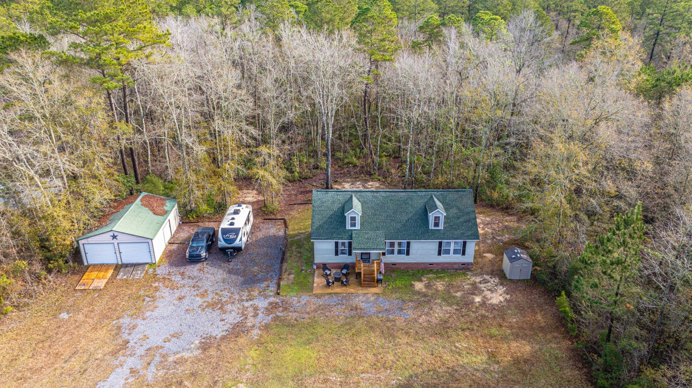
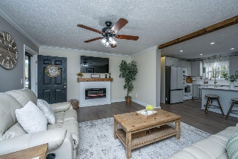
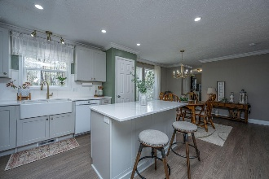

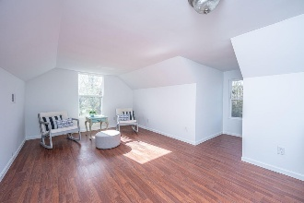
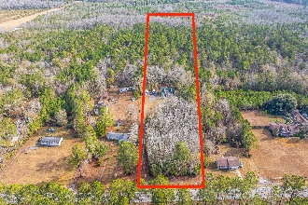

1788 Poplar Hill Drive Cross, SC 29436 · MLS# 25000057 · $475,000
5.9 Acres · NO HOA
2,157sf Home and a 30ftX24ft Detached Garage/Workshop
Welcome to 1788 Poplar Hill Drive! Located on 5.9 Acres, NO HOA, 2157sqft Home and a 30ftX24ft Detached Garage/Workshop. Yes, all of this and the seller is offering $5K in FLEX money that your buyer can use at their discretion (either towards closing costs OR off the purchase price). We can't make any more land so you need to acquire property while you can. Berkeley County is booming and it's COMING! That is one thing we know for sure here in the low country. A few local destinations near this home worth mentioning are both the Volvo plant and the Walmart Distribution Center are both is 15 minutes and many more industry giants. If you are a boating enthusiast, you are conveniently located only 10 miles to the Hatchery Boat Ramp at Lake Moultrie Or just 13 miles to the Cathead Landing for Lake Marion Access. Or, you can hunt on your own property as there are (3) two man deer hunting stands, one rotary feeder and two drop feeders in the woods behind the house. The home itself is fantastic and turn-key with 3 bedrooms downstairs, 2 Full Baths, a Completely renovated Kitchen, new Laminate Flooring downstairs, two 2024 HVAC units, a newly Installed Electric Fireplace, an amazing 703sqft bonus room upstairs and the Stackable Washer/Dryer convey. The current owners completely renovated the kitchen with New Cabinets (doors and drawers are both soft-close), new Farmhouse Sink, Quartz Countertops and a New Samsung Bespoke Refrigerator with a Beverage Center. The garage is a 24x30 metal frame building. The ceiling and walls are insulated, there is a deep sink with hot and cold water that drains out back. The garage has a 220-volt 100AMP sub panel that is fed from the main panel in the house. Located near the garage is a 50AMP RV receptacle and the septic tank is located directly next to the concrete patio out front. Lastly, the Well Shed is worth mentioning as it contains the well head, a deep water well pump, a pressure tank, a water softener and a Scale Blaster. There is also a dedicated GFCI outlet fed from the house panel to power the lights and all the equipment plus the shed itself is insulated. The Current Global Home Warranty can be transferred to the New Owner as well. Don't delay! Schedule your viewing today.
Nickole Samios
(843) 330-4136
nickole@carolinaone.com
Carolina One Real Estate
900 N Main St
Summerville, SC 29483
www.summervillesouthcarolinahomes.com

