Slide 1
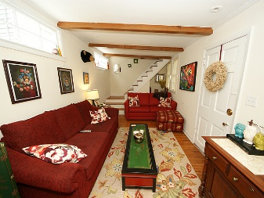
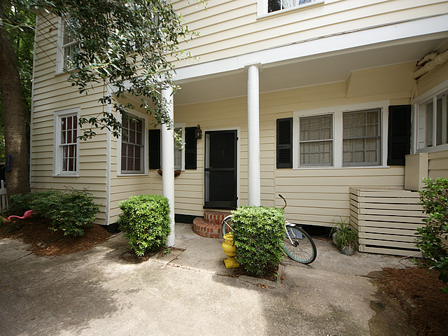
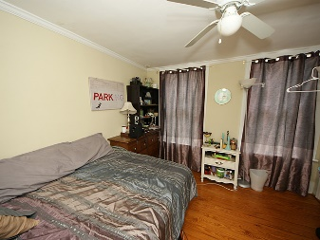
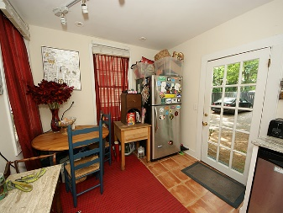
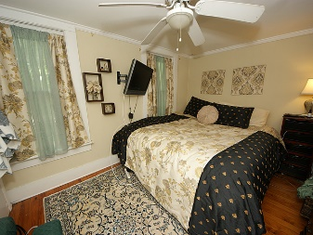
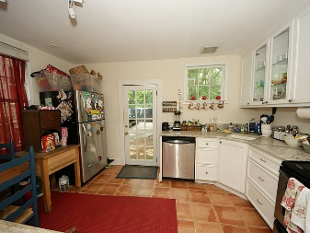
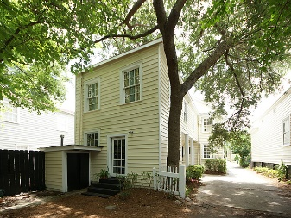
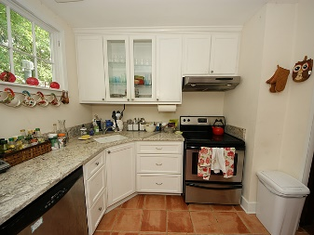
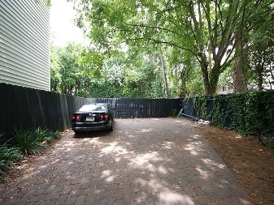


$500 Agent Bonus & Motivated Seller!
178.5 Wentworth Street
Harleston Village ~ Charleston
MLS# 16020300 ~ $404,900
Adorable two bedroom carriage house with off street parking! Charming 1830s home, 178 1/2 Wentworth is the perfect Charleston abode in the center of downtown. Beautiful hardwoods throughout and renovated kitchen. Both bedrooms are upstairs with a full bathroom and washer and dryer. Walk to King Street, the Battery, steps from Charleston Marina and College of Charleston! Don't miss this opportunity to own a piece of the #1 City in the World!!
Lara Harpe
Co-Owner, Broker/ Realtor
Mobile 843-298-6669
Lara@thepulsecharleston.com thepulsecharleston.com

