Slide 1

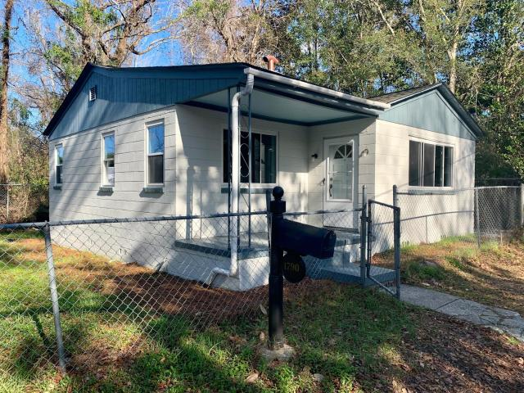
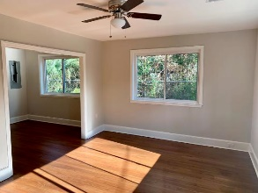
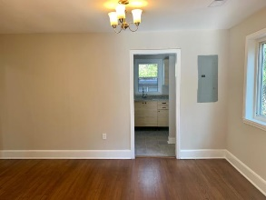
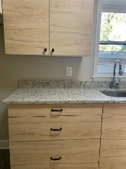
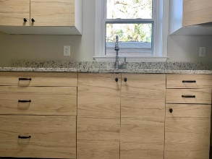
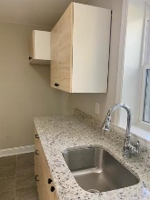
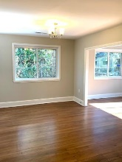
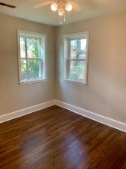
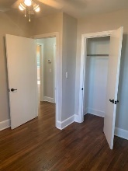
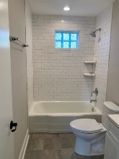
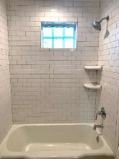
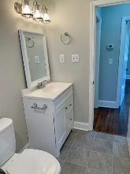
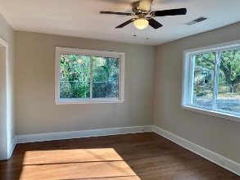
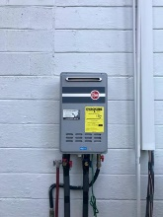
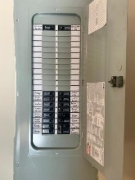
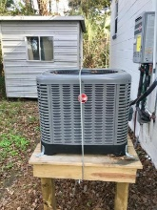
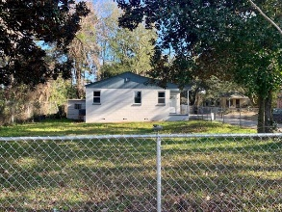



Total Reno Of Office/Residential Property
1790 Brockington Avenue
Charleston, SC 29407
MLS# 19001578 | $185,000
2 Bedrooms :: 1 Bath :: 888 sf
Fully Renovated 2 bed 1 bath house. NEW Upgrades include: NEW ELECTRIC (panel and wiring), new FIXTURES, new ROOF, new kitchen CABINETS, GRANITE counter tops, PAINT inside & out, HVAC, TANKLESS Water Heater, WINDOWS, wood floors refinished, new bathroom with TILE shower. New 2'' faux wood blinds to be installed. Will convey. Fenced in yard and off street parking area. Save thousands with no flood insurance required. Ample side yard to play in. Property is in the Ashley River Rd. Overlay District. Could make a great space for a horticulture business, day care, medical office, etc. Large side yard for laydown or equipment storage.
Eric Draper
(843) 442-7118
eric.draper@gmail.com
Reid Adams
(919) 638-5618
reid@charlestonrealestategroup.com
www.charlestonrealestategroup.com
Charleston Real Estate Group | 443 Folly Rd | Charleston, SC 29412

