Slide 1
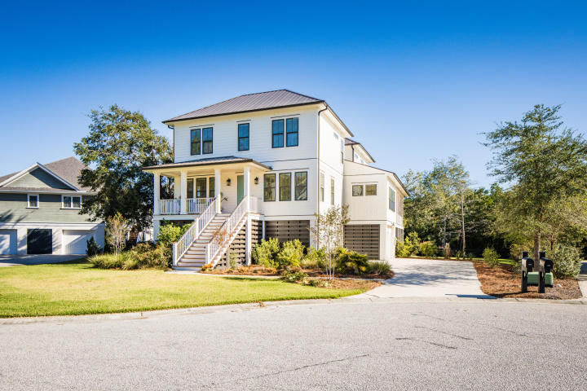
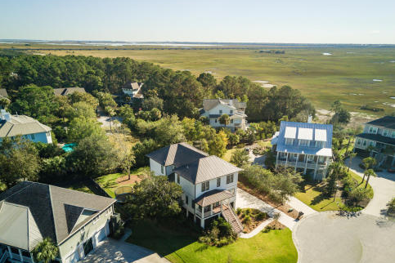
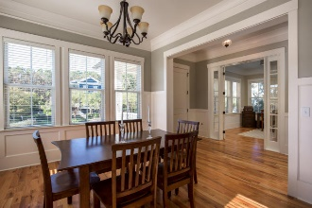
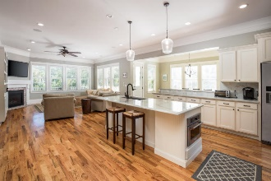
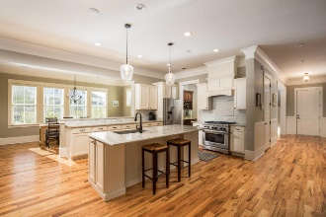
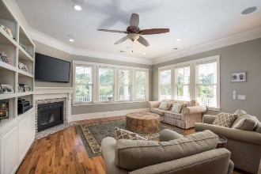
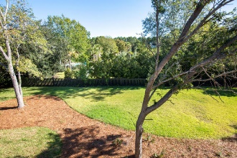
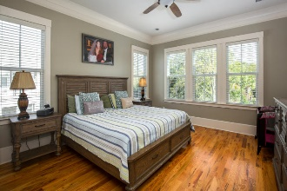
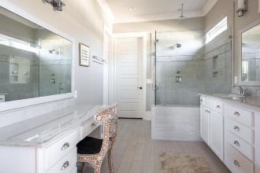
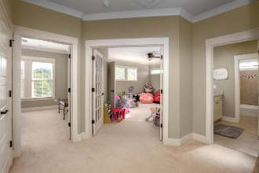
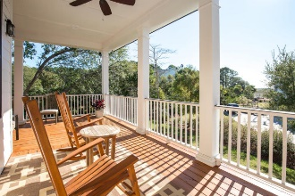
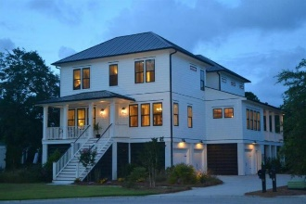
1790 Canyon Oaks Drive
Mount Pleasant · MLS# 17029399 · $1,199,000
Darrell Creek Elevated Home With Elevator & Salt Pool
Recently Reduced in Seaside Farms!
This stunning 5 BR, 3.5 BA home is nestled in the highly desired Cathedral Oaks section of Seaside Farms. This is the builders personal home, newly built in 2015. This fabulous home boasts a large open floorplan, is great for entertaining and has an abundance of natural light. It has custom lighting and plumbing fixtures and cabinets; 10ft ceilings, large crown molding, and beautiful site-finished oak wood floors throughout the downstairs; master down; upstairs game room/bonus room; and elevator shaft from ground level garage to all levels for convenience. Walk up to the rocking chair front porch and enter the home through the gracious foyer with glass French doors to the office on the left and a double opening leads to the dining room on the right. Enter the home through the gracious foyer with glass French doors to the private office/library on the left and a double opening leads to the generous dining room on the right. The family room has a gas fireplace with brick accents and built-in surround sound and a ton of natural light. The chefs kitchen includes, granite countertops with a tile backsplash; island with a bar top; butler's pantry with wine cooler; and premium Kitchenaid appliances, including a dual gas range for the true culinary experience. Upstairs has multiple bedrooms and baths with a large multi purpose room that can be used as a playroom, hobby room, media room, etc. This home is also equipped with a ground level to top floor elevator for convenience. The ground level, 3-bay, drive under garage has ample space for parking, storage, workshop, and golf cart for a ride to the commercial district. The neighborhood includes a community pool, play park, and is very walking/biking/golf cart friendly. One of the best parts about the location is the proximity to the commercial section of Seaside Farms. Shops and dining include-- Target, Harris Teeter, Crave, Deroma's, Tasi Juice Bar, Crafty Draught, Calder's, OPAL, Saveurs du Monde Cafe, Basil, Massage Envy and so much more!! Everything you need right in your neighborhood. 5 minutes to the beach, 20 minutes to downtown, easy access to 526. This is the best location in Mt. Pleasant! Home is in an AE flood zone. Approx. $800/year.
Andrea Rogers
(843) 532-3010 | andrearogers1@gmail.com | www.andrearogersrealtor.com
AgentOwned Preferred Group | 1400-G Palm Blvd | Isle Of Palms, SC 29451

