Slide 1
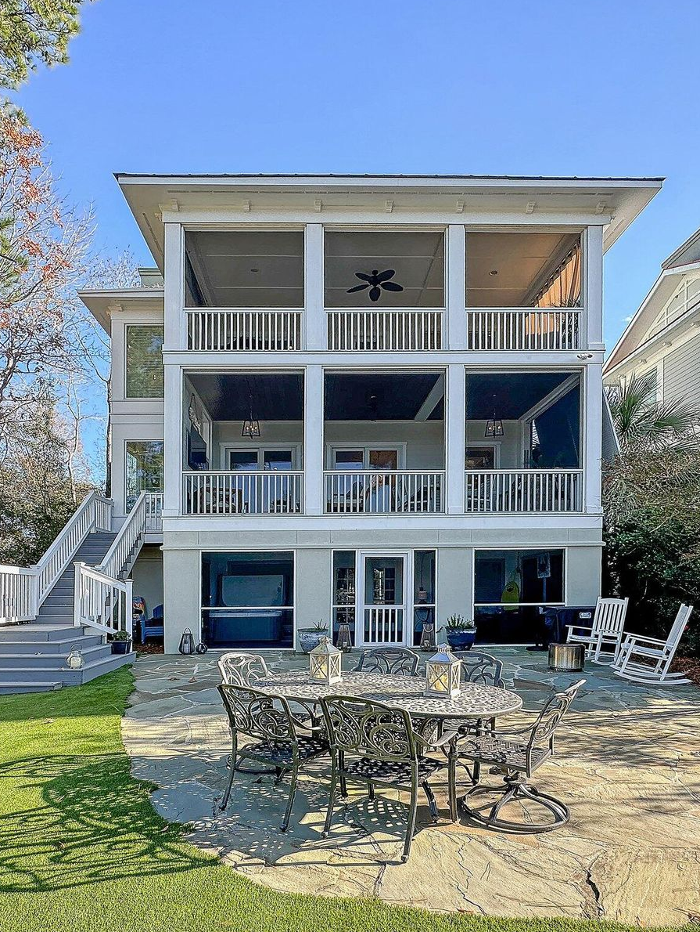
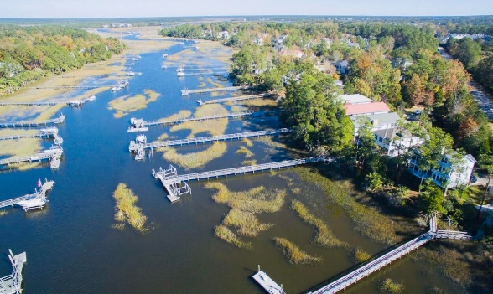
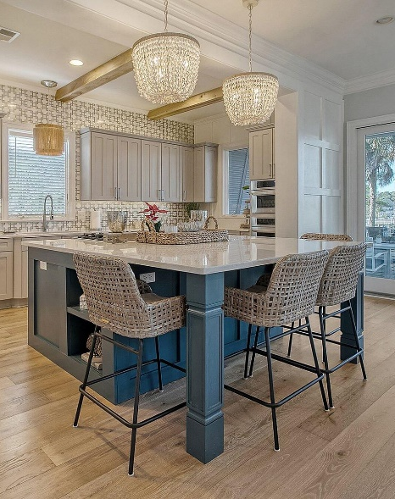
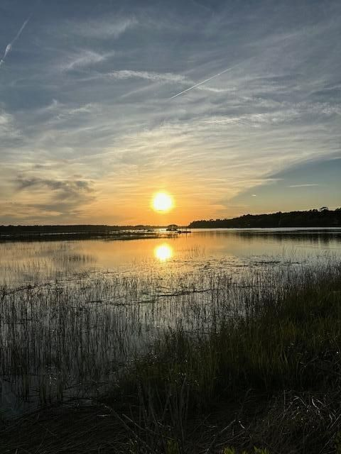
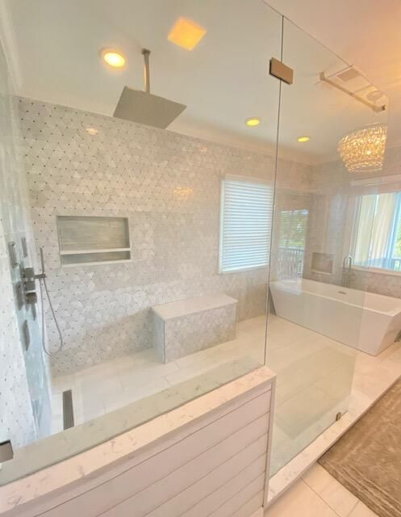
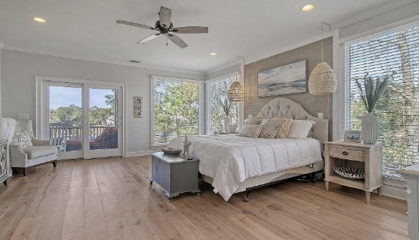


Waterfront Dream
IMPROVED PRICE ~ MOTIVATED SELLER!!
DON'T MISS THIS WATERFRONT, FULLY RENOVATED, TURN-KEY PROPERTY!
1790 Bergenfield Road
Park West | Mount Pleasant, SC 29466
MLS# 24004477 | $2,095,000
Chrissy Strickland
843-906-5553
chrissychsrealtor@gmail.com
Visit My Website
WATERFRONT, FULLY RENOVATED & STUNNING SUNSETS! Welcome to 1790 Bergenfield Rd., a subdivision that is a hidden gem in Park West and WATERFRONT! With amazing water views and gorgeous Lowcountry sunsets this house is the perfect place to live a relaxing vacation type lifestyle. It's never been easier to jump on your boat right from your own dock to head out on a short or day long excursion! Experience the joy of no more trailing or pulling your boat out of the water each time! Watch the tide and boats soar by daily from one of the three screened porches all with a different flair! This bright and airy costal vibe property was completely and tastefully renovated from top to bottom in 2021-2022! From the new gorgeous light wide plank wood floors to the expanded kitchen with oversized island, new quartz countertops, and a truly phenomenal master suite this home is one that you don't want to miss!! With exceptional detail and design this property will wow you at every turn. Downstairs this home features heavy moldings and shiplap, designer tile, beamed kitchen ceilings, coffee bar, upgraded light fixtures, custom walk-in closets, 10 ft ceilings, newly designed fireplace, an added wet bar, lower-level bedroom or dual master, newly wallpapered formal dining room, new staircase with cable details, designer punch walls, a Built-in Murphy bed for guests, bookcases and much more!
Enjoy this video tour!
EXP Realty LLC
170 Meeting Street Ste 304
Charleston, SC 29401

