Slide 1
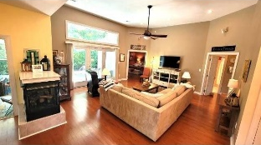
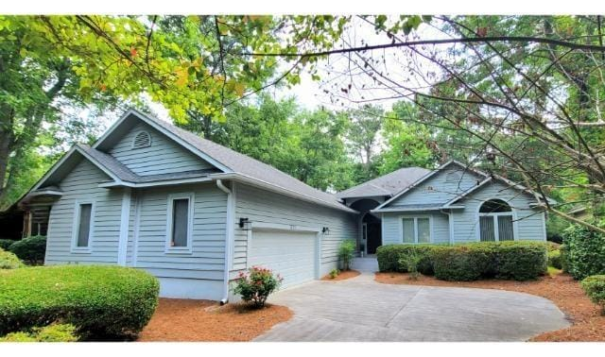
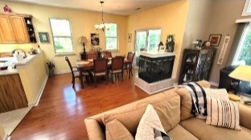
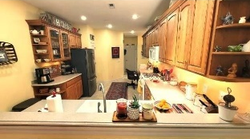
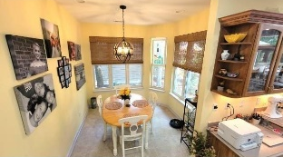
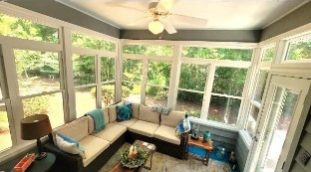
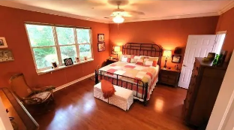
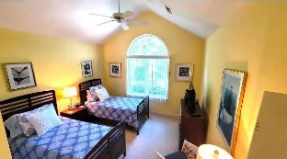
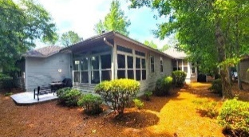

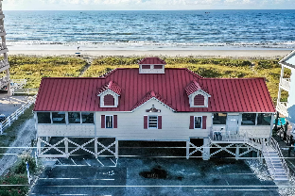



TURNKEY FULLY FURNISHED 3/2 TIDEWATER HOME
1793 Spinnaker Drive
Tidewater Plantation | North Myrtle Beach, SC 29582 | MLS# 2416011 | $649,000
Wonderfully maintained 3 bed/2 full bath, big 2 car garage home with popular list of highly desired features. Plus, it is being sold beautifully, turnkey furnished. Enter from the drive into the garage or foyer with closet and ease of access to the entire home; enjoy the comfortable, inviting living, entertainment area and the Carolina Room back porch (owner will install splitter, heating/cooling unit with acceptable offer) with side golf course/tee views, yet with privacy. The pretty landscaped yard will delight any gardener, too. The irrigation is metered on a separate water usage-only meter. Even the oversized garage has a potting shelf, storage cabinets, and a workbench. A tankless on-demand Rinnai water heater assists with low electric usage. Calling all chefs, there's a gas range in the kitchen, along with gas dryer (wired for electric or gas), water heater, and the HVAC system, as well as the gas logs in the cozy three- sided fireplace. The laundry/utility is oh-so user-friendly, with built-in sink and storage cabinets galore! The rear yard has a limited golf-course view of the tee and the 16 fairways of world-class Tidewater Golf Course. So no danger of errant golf balls. The living room and porch are wired with Bose speakers which convey with the house. The outdoor patio has a central gathering, propane fire pit, couch and table and chairs, as well as a free-standing barbecue - great for relaxation and get togethers any season. The kitchen is just right for cooking, walk-in pantry, prep and clean up, everything from the prep sink, stove and big stainless-steel refrigerator nearby and with views of the heart of the house as well. There is even a work desk! Dining can be formal for eight or informal in the breakfast nook. Bedrooms can be lock-out separate en suites in this split bedroom plan, with the two guest rooms sharing one fully equipped bath with tub and shower. The master is spacious, with plenty of room for a sitting area and large, beautiful furniture, yes, included. The master en suite features a whirlpool-tub and separate shower. Tidewater amenities include two pools, a fitness center, tennis/pickleball courts, reduced golf rates and the jewel in the crown of a gated ocean front beach cabana for owner's use. Tidewater also has an overflow parking lot to accommodate owners. Tidewater Golf Course was named the best golf course in the nation in 2022! Perfect! In addition to golf & being in an ICW community near the beach, Tidewater boasts many other rich, upscale amenities, including that owners' beach cabana on the Cherry Grove Beach, named the 11th best in the nation, featuring driving range and putting green. There's more: 24-hour gated, manned, roving security, and a clubhouse with bar & restaurants. There is even a complimentary gated storage yard for boats, campers, recreational vehicles and the like. The on-site, convenient HOA building has rooms for business and other meetings and events and a lending library. There are many clubs and activities year-round. In Tidewater, you can do it all, or just relax in the Tidewater lifestyle. On the Plantation side, the Intracoastal Waterway backs up to and meanders along the golf course, stunning. Bluffs of Tidewater is contiguous along the Cherry Grove Inlet where the Atlantic Ocean rolls into the marsh. This home, therefore, is highly sought after by the investor or primary or vacation homeowner who desires to acquire an extraordinary golf/ICW/beach property. Tidewater itself is on a tree-lined road to oceanfront Anne Tilghman Boyce Coastal Reserve, a nature conservancy, including Waties Island, with access for managed recreational use. Tidewater, a historic plantation, is on an elevated peninsula of live oaks and southern pines between the Intracoatal Waterway and the Cherry Grove Inlet to the Atlantic Ocean. The Plantation also preserves the unique look of its own origins. It is close to the beach, entertainment, and medical services.
Enjoy a Video Tour
Connie Ross-Karl
Realtor Broker SC/NC
702-306-2643
conniesross@aol.com
Ronnie Nichols
Realtor / BIC
ronnienichols8@aol.com
Helen Ashby
Realtor Agent
804-426-7758
hhashby@gmail.com
NEW WAY PROPERTIES MYRTLE BEACH

