Slide 1
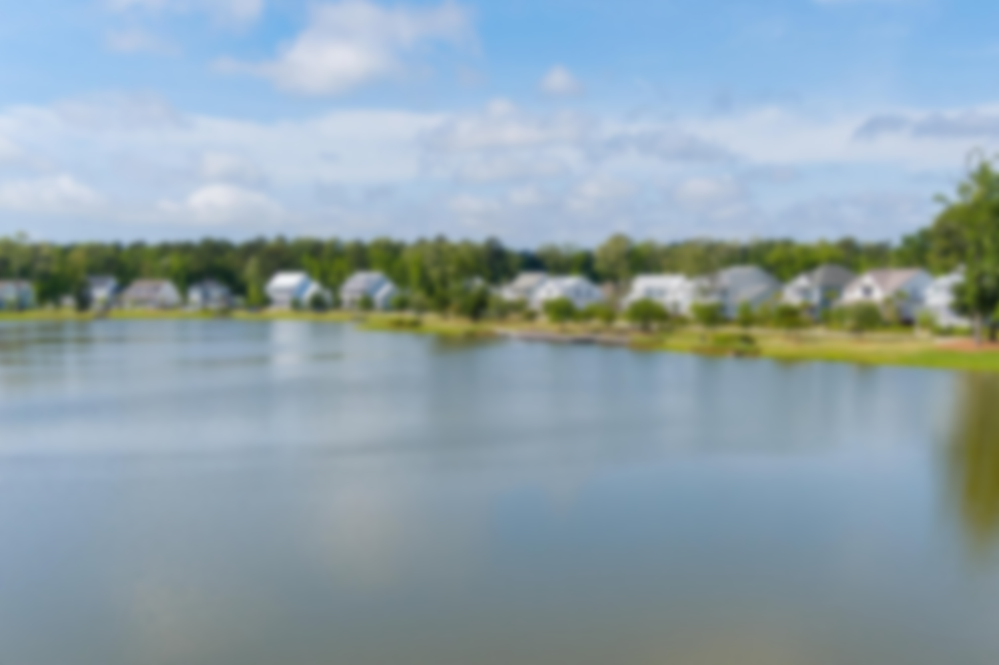
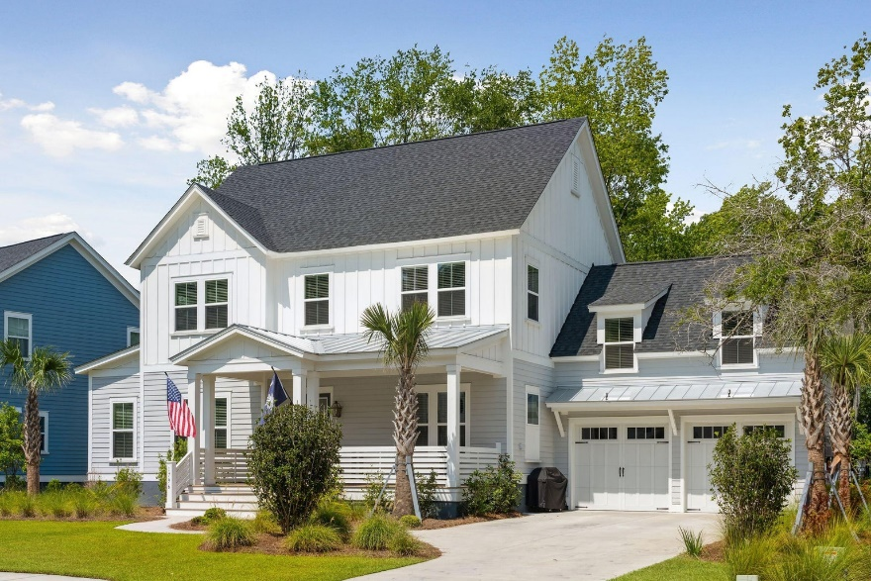
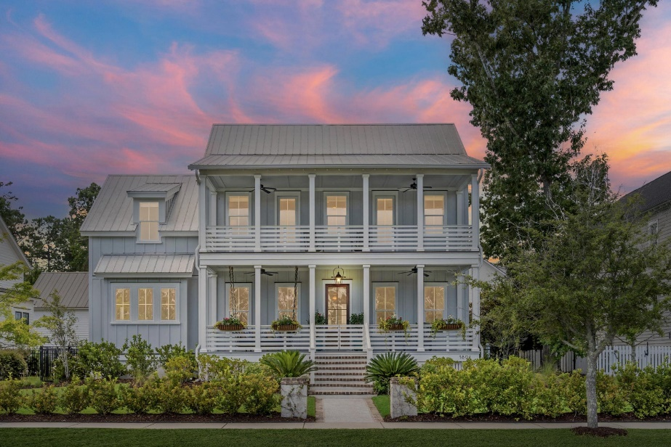
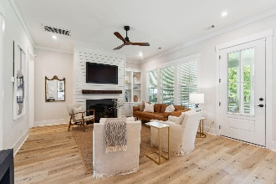
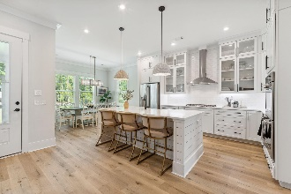
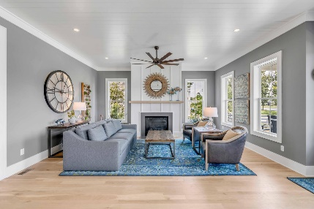
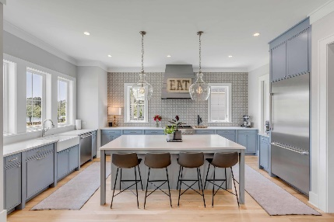
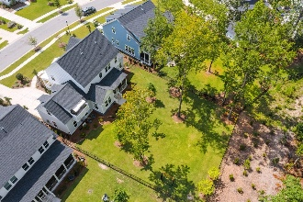
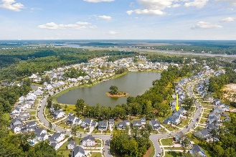
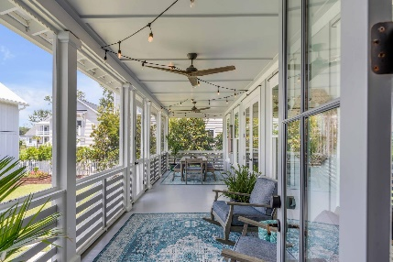
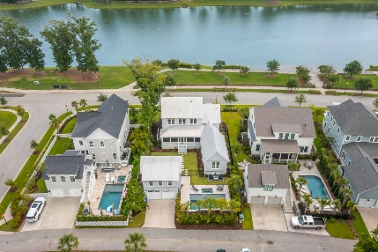


Dual Open Houses Sunday July 30th
1796 Bolden Drive
MLS# 23015945 | $1,575,000
Stop by between 11a-2p
1891 Bolden Drive
MLS# 23016449 | $2,189,000
Stop by between 2p-5p
Nestled in the highly desirable master planned community, Riverside at Carolina Park, this exquisite lakefront 4 bedroom, 4 and a half bath home is located in the exclusive enclave steps away from Riverside's most significant amenity - Bolden Park. The extensive backyard offers some of the best lake views of this neighborhood's center piece, majestic Bolden Lake. Meticulously designed and upgraded throughout, this home offers a perfect blend of space and style. A few updates to this home include high-end white oak luxury vinyl plank flooring throughout, accent walls, custom lighting, custom closet systems, and landscape lighting in front and back yards.
Welcome to luxury lakefront living at 1891 Bolden Drive in highly sought after Riverside at Carolina Park! Custom built by Structures, one of Charleston's most acclaimed builders, the home was carefully crafted and meticulously executed, both inside and out, to take full advantage of the exceptional panoramic views of stunning Bolden Lake. Featuring over 1,000 square feet of covered porches, start your day soaking in the sunrise over Bolden Lake, while enjoying your morning coffee on one of two oversized front porches featuring a custom swing bed, copper gas lantern and lush, irrigated flower boxes. End your day enjoying a cocktail or mug of tea on the rear screened-in porch, watching stunning Carolina sunsets beyond the beautifully landscaped courtyard and sparkling saltwater pool.
Virginia Landon
803-493-9202
virginialandon@kw.com
Keller Williams Realty | 496 Bramson Ct Ste 200 | Mt. Pleasant, SC 29464

