Slide 1
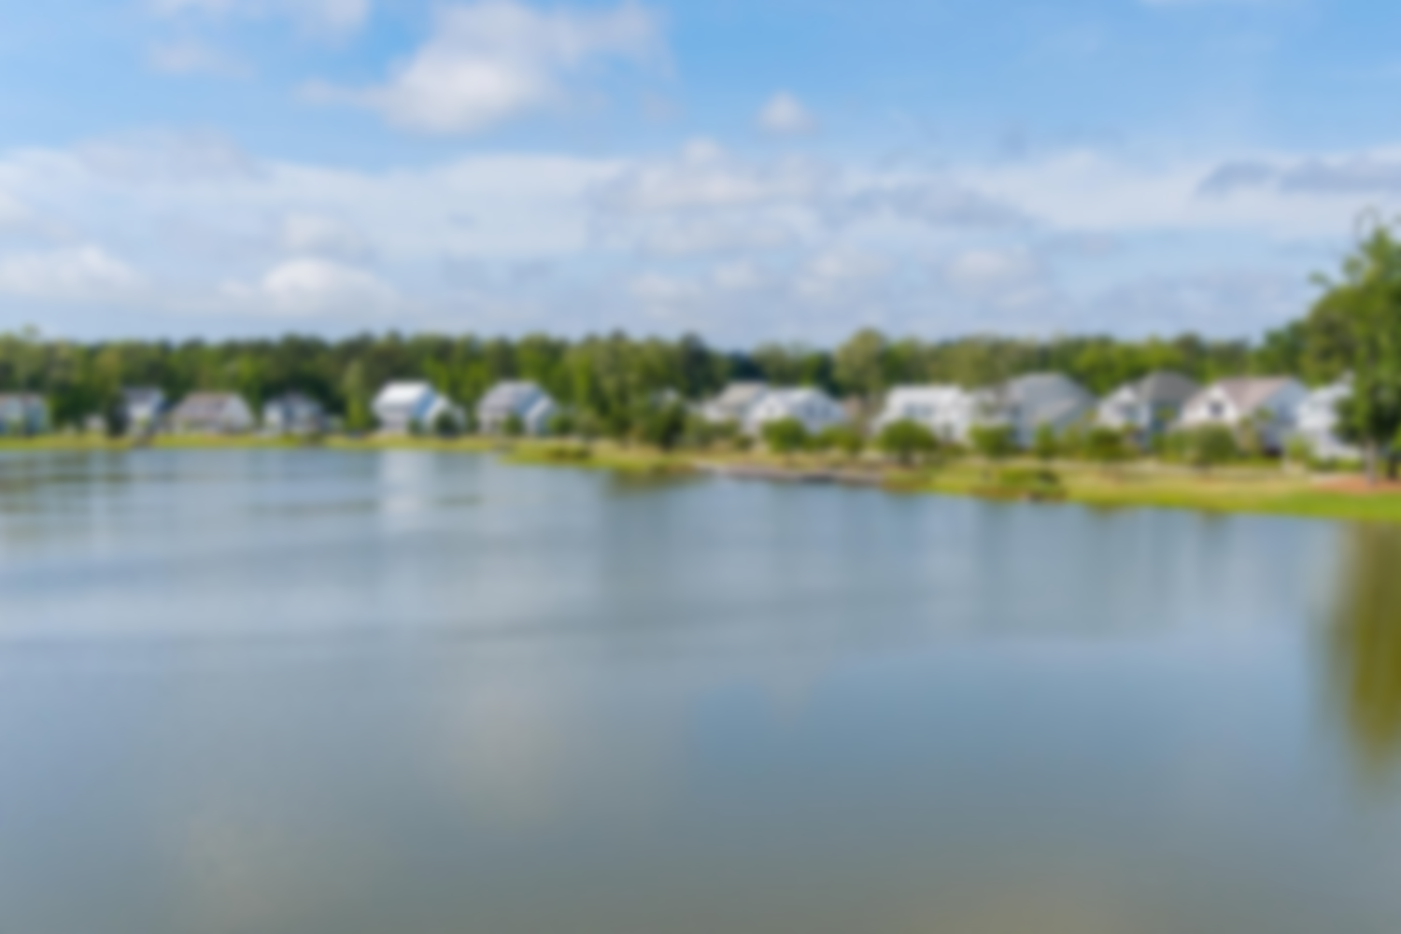
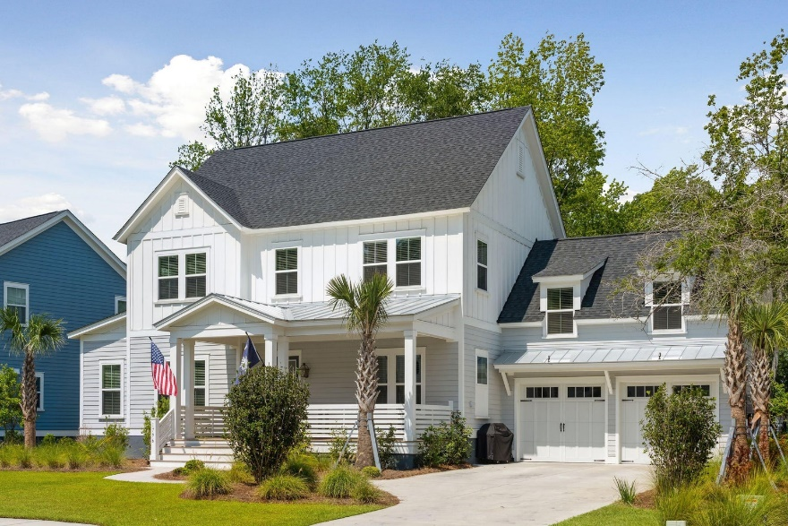
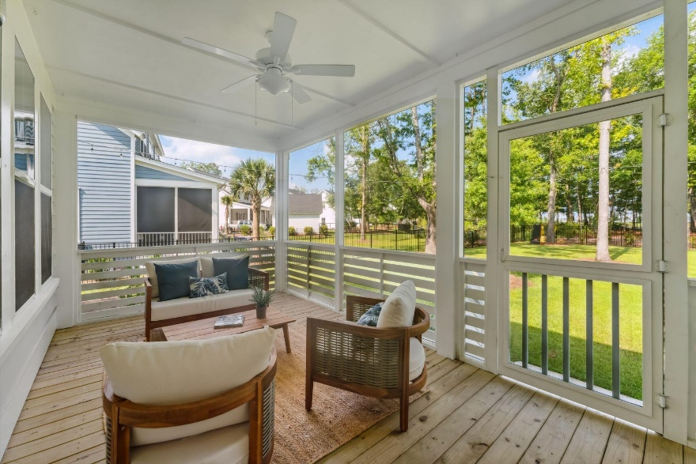
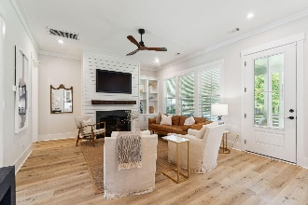
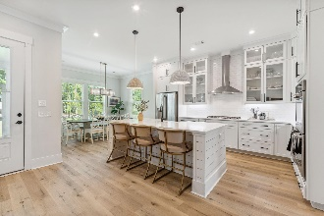
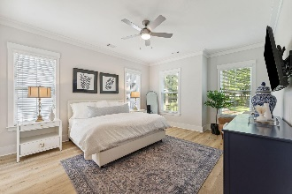
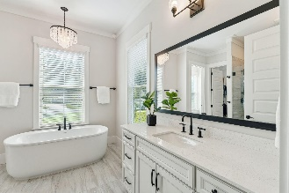
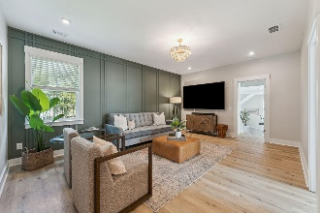
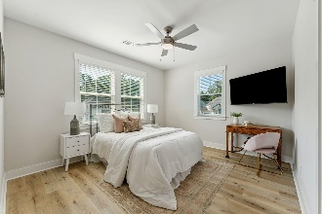
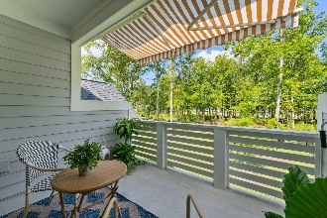
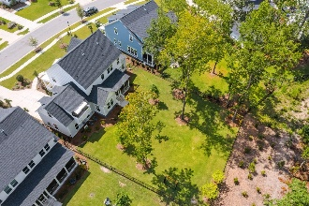
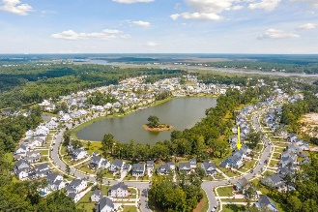
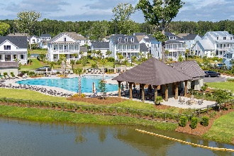


Just Listed! Open House this Sunday July 16, 11-2
1796 Bolden Drive
Carolina Park | Mount Pleasant, SC 29466 | MLS# 23015945 | $1,575,000
Nestled in the highly desirable master planned community, Riverside at Carolina Park, this exquisite lakefront 4 bedroom, 4 and a half bath home is located in the exclusive enclave steps away from Riverside's most significant amenity - Bolden Park. The extensive backyard offers some of the best lake views of this neighborhood's center piece, majestic Bolden Lake. Meticulously designed and upgraded throughout, this home offers a perfect blend of space and style. A few updates to this home include high-end white oak luxury vinyl plank flooring throughout, accent walls, custom lighting, custom closet systems, and landscape lighting in front and back yards.
You are greeted by the generous front porch which is perfect to enjoy a nice Charleston breeze. As you enter the foyer you will be led to open-concept living and dining space. The main living space offers a great area for entertaining, abundant with natural light from all of the windows, and provides direct access to the rear screened in porch. The custom kitchen includes upgraded stainless appliances to include a double wall oven, gas range and cooktop, and built-in microwave. Notice the beautiful 'to-the-ceiling' cabinetry with glass highlights, uniquely crafted tile back splash, and stunning high-end lighting. The family room boasts a cozy gas fireplace to include custom cabinetry and shelving. The laundry room is located near the walk-in pantry and entry to two-car attached garage entry off of the kitchen. There is upgraded shelving in the pantry as well as cabinetry and countertop with sink in the laundry.
The spacious private owner's suite is located on the main level which offers lake views. The master bathroom includes double sinks and countertops, soaking tub, a walk-in tiled shower with frameless glass shower door, and a generous walk-in closet that has been upgraded with a custom closet system.
Arriving upstairs, you will find a roomy loft with an upgraded accent wall perfect for an additional family room or playroom. There are three additional bedrooms upstairs that each have their own walk-in closet and full bathrooms. The FROG (finished room over garage) offers an additional space for a home office or flex space which includes a porch with an awning that overlooking the yard and lake.
The large and beautifully landscaped backyard is fenced in which offers a serene retreat for outdoor activities, perfect for a pool. The home is wired for a generator, heat/chill for pool or hot tub, includes a ring security system and cameras, and gas lines for outdoor grill and exterior fireplace.
This property offers not only a luxurious lifestyle but also the convenience of modern living. The endless array of amenities, including the Lake Club featuring a resort-style pool, wood framed picnic pavilion, and fire pit overlooking scenic Bolden Lake, you will not run out of things to do! Residents also have access to an outdoor kitchen, a second swimming pool located in the Village and available to join, playground, tennis courts, pickleball courts, an open-air pavilion, dog park, the Great Lawn, miles of walking trails and future Riverside crabbing dock. The Bend shopping development includes restaurants, coffee shop, boutiques, wine bar, yoga, hair and nail salon, golf cart shop and other local businesses to include dentistry and doctor offices is just a golf cart ride away. The regional library, top rated Mount Pleasant schools, hospital, fire station, Sweetgrass pharmacy and Costco are also a short bike ride or golf cart distance away. This home is also only 15 minutes to the Isle of Palms and Sullivans Island, 25 minutes to Downtown Charleston and the Charleston International Airport.
Virginia Landon
803-493-9202
virginialandon@kw.com
Keller Williams Realty | 496 Bramson Ct Ste 200 | Mt. Pleasant, SC 29464

