Slide 1
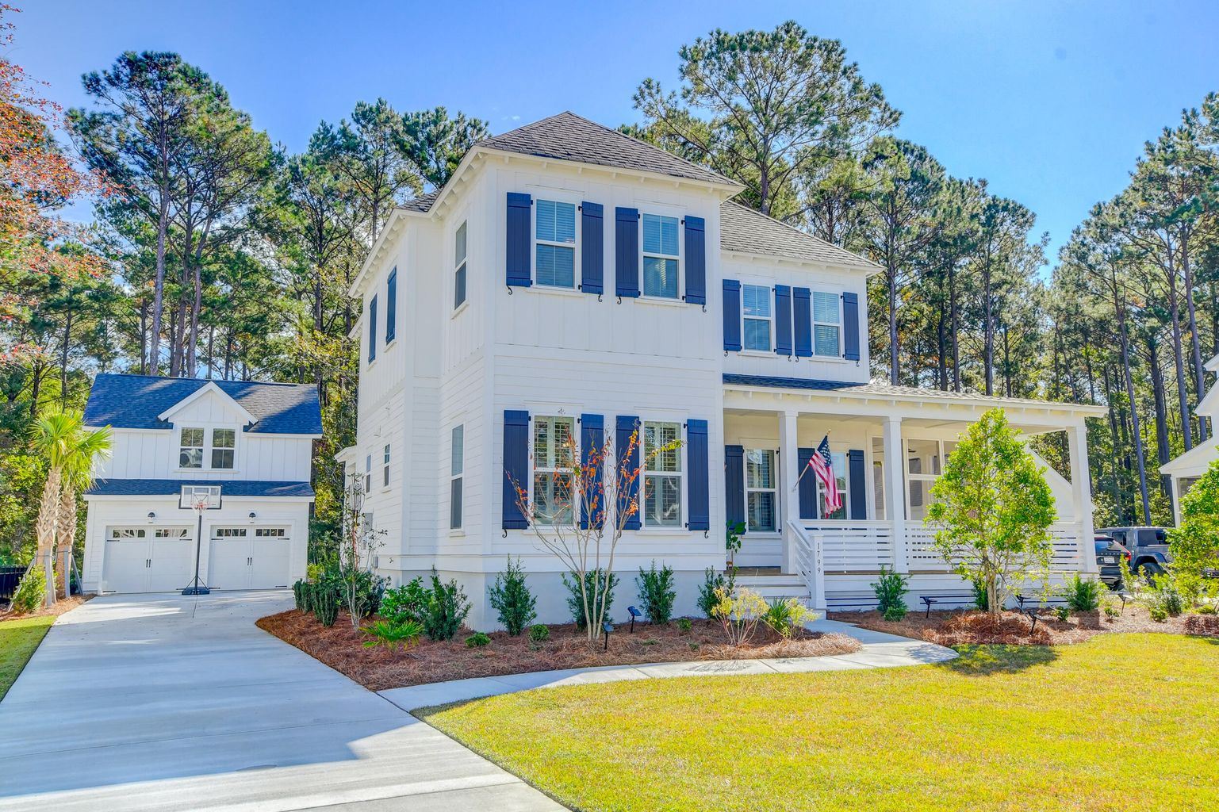

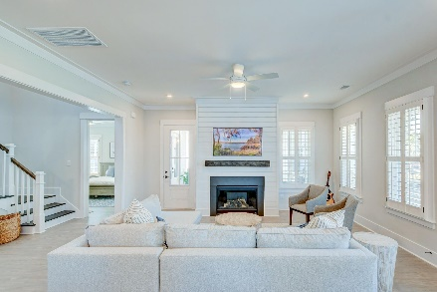
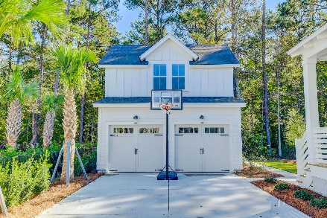
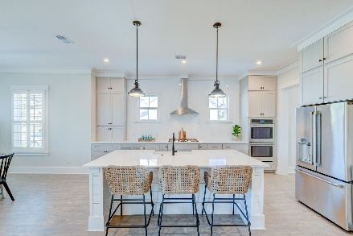
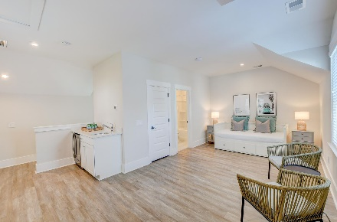
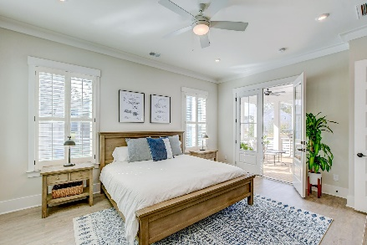
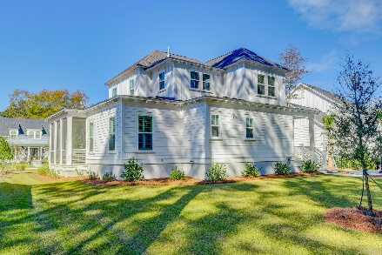
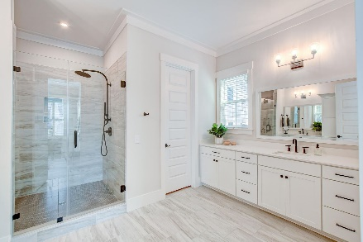
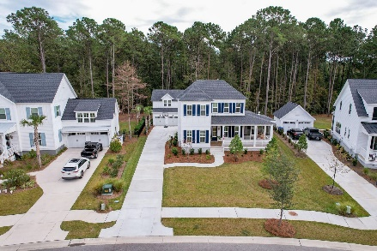
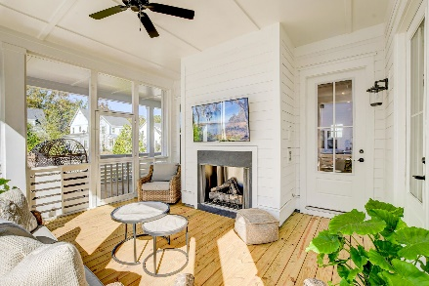
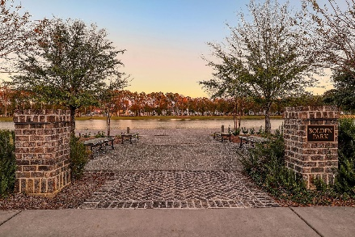
Price Refreshed! Move-in Ready!
NEW PRICE
1799 Bolden Drive
Carolina Park ~ Mount Pleasant, SC 29466 ~ MLS# 22027195 ~ $1,224,000
Just in time for the holiday season! This stunning Riverside floor plan was completed in 2022 and comes with PLENTY OF UPGRADES. It sits on a massive 0.36 acre lot with a detached 2-car garage with a FINISHED ROOM OVER THE GARAGE with a kitchenette, full bathroom and a closet. The main house has a front porch that greets you as you enter the home to wonderful features including an open floor plan, great natural light, crown molding, plantation shutters, shiplap accents, and engineered hardwood flooring throughout. The family room offers a cozy fireplace and access to the roomy screened side porch. The kitchen has everything a chef could ask for; stunning countertops, sleek grey cabinets, a decorative backsplash, an island with a breakfast bar and a farmhous sink, and stainless steel appliances including a gas cooktop with a vent hood, double ovens, a built-in microwave, and a dishwasher. Just off the kitchen, you'll find the dining space with lots of windows to let the light pour in. A convenient mud room offers a built-in drop zone for bags and coasts as well as access to the laundry room and the walk-in pantry. The first floor owner's suite is sure to WOW you with access to the screened porch as well as an exquisite en-suite bath with two separate vanities with lots of built-in storage, a frameless step-in shower, and a walk-in closet with a custom closet system. The main level also has a powder room and storage under the staircase. The screened porch off the family room will be one of your favorite spots in the home with an exterior fireplace and plenty of space to entertain. Head to the second level to find three additional bedrooms, one of which has a private full bathroom while the other two share a Jack n' Jill bathroom. The front bedroom has a view of the beautiful Bolden Lake. The detached 2-car garage has an incredible FROG/bonus space that includes a kitchenette with wine cooler and a full bathroom....perfect as a bedroom, a guest space, a flex space, or whatever suits your needs. The backyard is large and is a lovely spot to enjoy the outdoors. The remarkable community of Carolina Park has a zero-entry swimming pool, a club house, a pavilion, a 20 acre lake, a fenced-in park, and walking trails. This home is 7.9 miles to the shopping and dining at Mt Pleasant Towne Centre, 11.2 miles to Isle of Palms, 14 miles to Sullivan's Island, and 15 miles to downtown Charleston. Book your showing today!
Book your showing today!
Verna Bunao-Weeks verna@mattoneillteam.com (843) 364-2447

