Slide 1
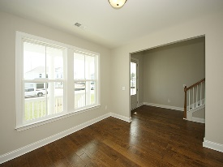
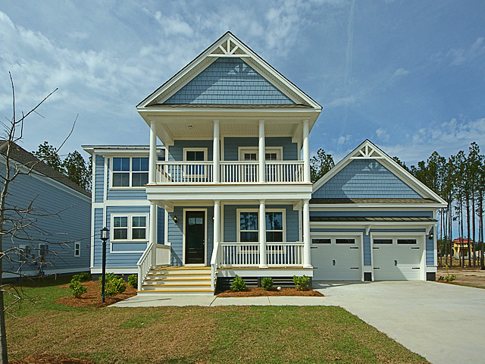
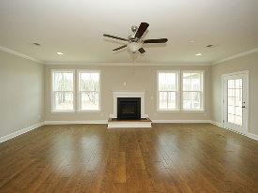
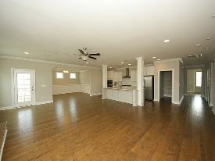
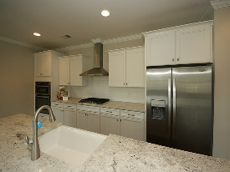
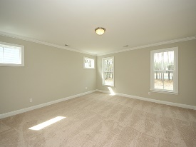
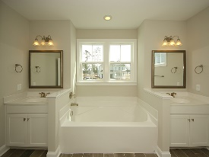
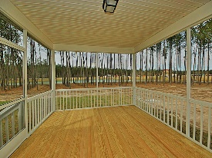


New Construction! New Price!
179 Calm Water Way
Cane Bay Plantation
Summerville, SC 29486
Open House Canceled!
Under Contract In 3 Days!
MLS# 17006110 | $465,000
4 Bed / 3½ Bath
$15k below what it would cost to build same lake front home from builder!
Tons of Upgrades and on the Lake! Gourmet kitchen, fireplace, hard wood flooring, spectacular upgraded master bathroom and over sized rooms and screened porch. This master piece in the Coves at Lakes of Cane Bay, sits on a premium water lot with direct access to a 300 acre lake from your backyard! All builder warranties and one year walk through will convey with the new owner.
$3,000 realtor bonus with ratified contract by 05/31/2017 and BIC approval.
Connie White, Broker
C: 843-532-3356
conniesyouragent@gmail.com
Charleston Homes
597 Old Mt. Holly Road
Suite 301
Goose Creek, SC 29445

