Slide 1
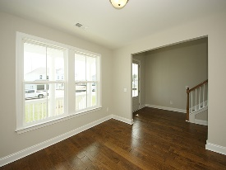
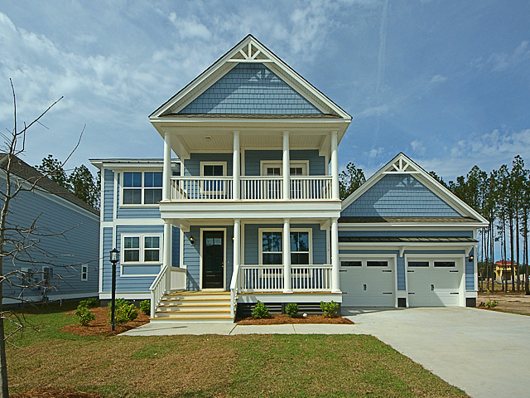
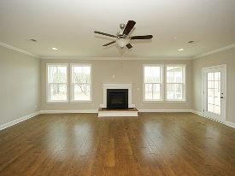
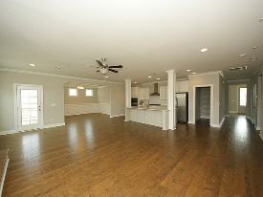
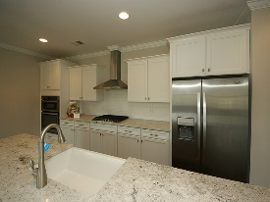
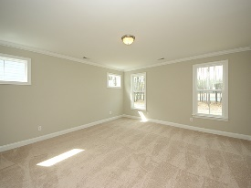
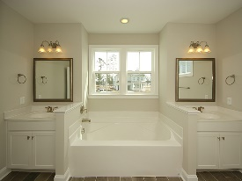
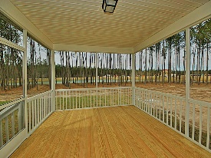

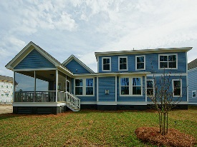

Like New & Move-in Ready!
179 Calm Water Way
Cane Bay Plantation
Summerville, SC 29486
Open House Canceled!
Under Contract In 3 Days!
MLS# 17006110
$449,900
4 Bed / 3½ Bath
Priced $50,000 below what it would cost to build
the same lake front home from the Same builder!
Tons of Upgrades and on the Lake! Gourmet kitchen, fire place, hard wood flooring, spectacular upgraded master bathroom and over sized rooms and screened porch. This master piece in the Coves at Lakes of Cane Bay, sits on a premium water lot with direct access to a 300 acre lake from your backyard! All builder warranties and one year walk through will convey with the new owner.
Connie White, Broker
843-532-3356 · conniesyouragent@gmail.com
Charleston Homes · 597 Old Mt. Holly Road · Suite 301 · Goose Creek, SC 29445

