Slide 1
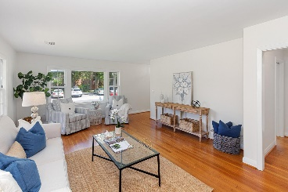
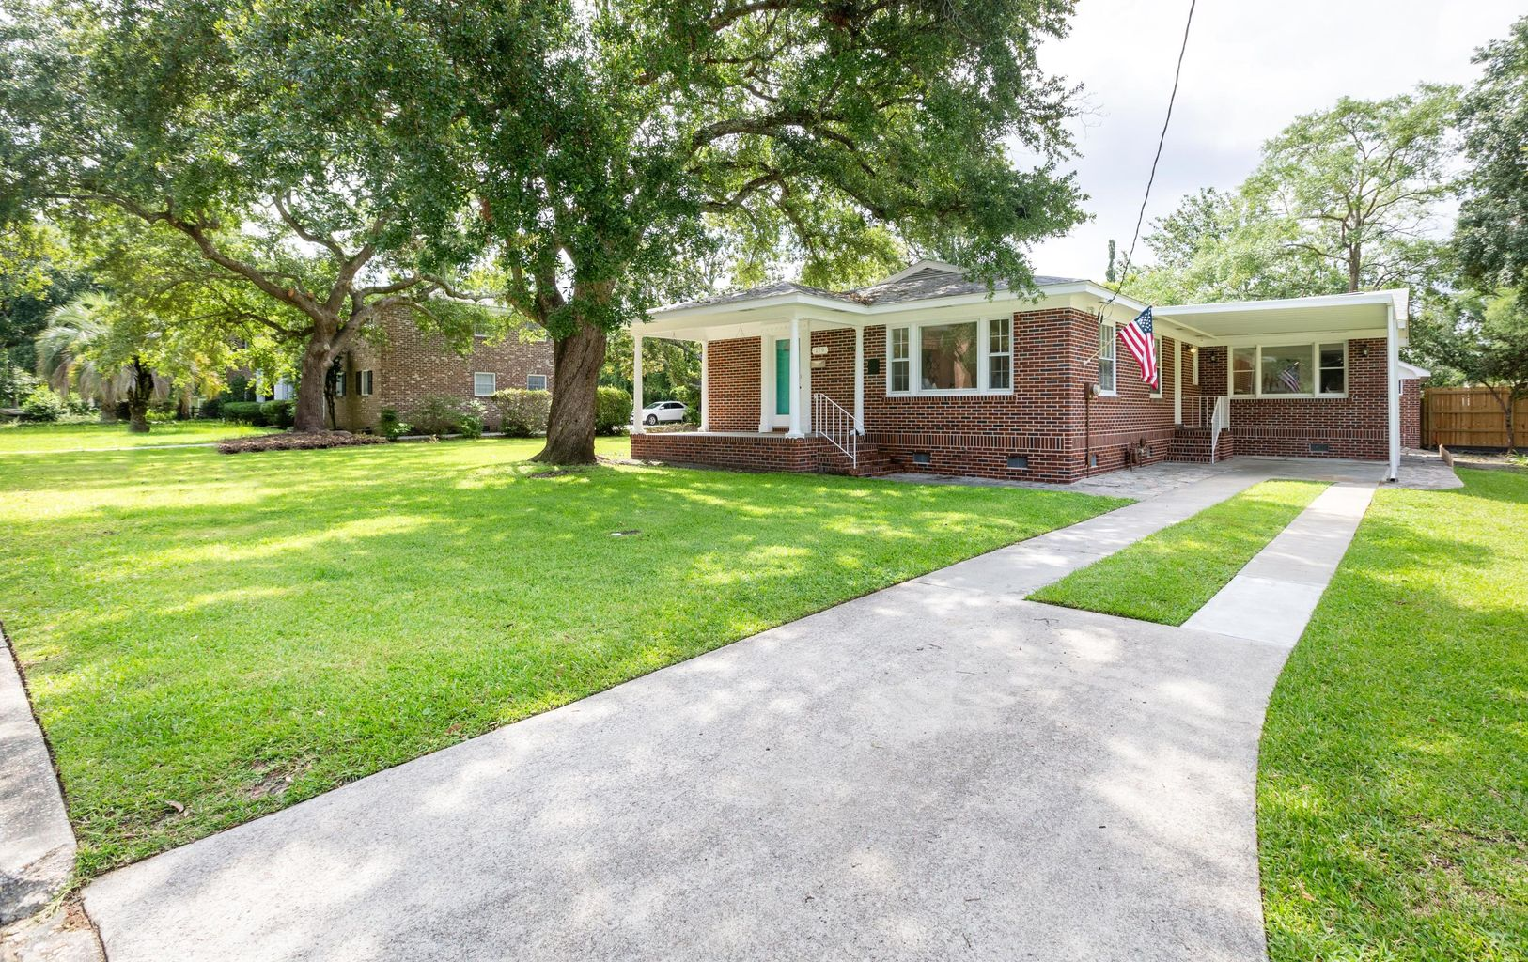
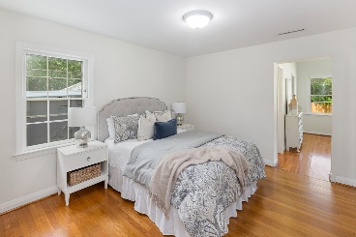
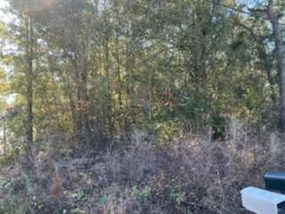
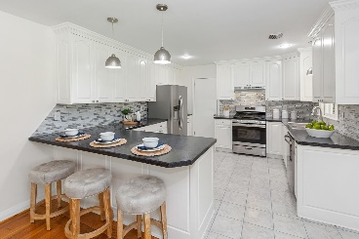
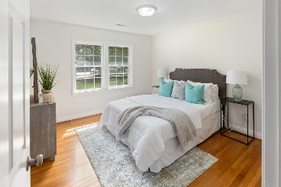
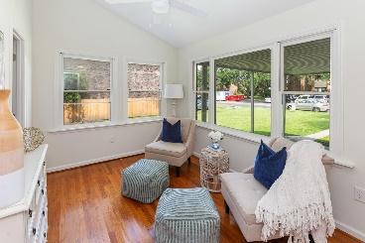
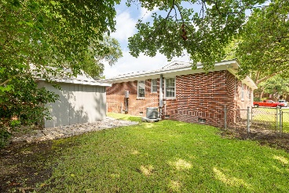


Great Downtown Location ~ River Views!
New Price!
179 3rd Avenue
Wagener Terrace · Charleston, SC 29403
MLS# 21019795 · $695,000
Michael Dew
O 843-769-5100
M 843-870-7000
michaeledew@gmail.com
www.michaeldewrealestate.com
Fantastic opportunity to own in the highly desirable Wagener Terrace neighborhood. Gorgeous views of the marsh and Ashley River with mind blowing sunsets surrounded by 100+ year Live Oaks. This property is adjacent to Lowndes Grove Plantation (current Netflix Hit TV series Outer Banks filmed). Refinished hardwood floors throughout. Interior has been freshly painted. Kitchen with breakfast bar, backsplash, new stainless steel appliances and newly painted cabinets. All light fixtures have been updated and brush nickel hardware installed. Outdoor brick building is zoned to be converted into an office or guest apartment. Property is within walking distance to Hampton Park and the Citadel. Easy bike to upper peninsula shops and restaurants.
Won't last long in this market!
AgentOwned Charleston Group
902 Savannah Hwy
Charleston, SC 29407
Real Estate ● Mortgage
Insurance ● Business Brokerage

