Slide 1
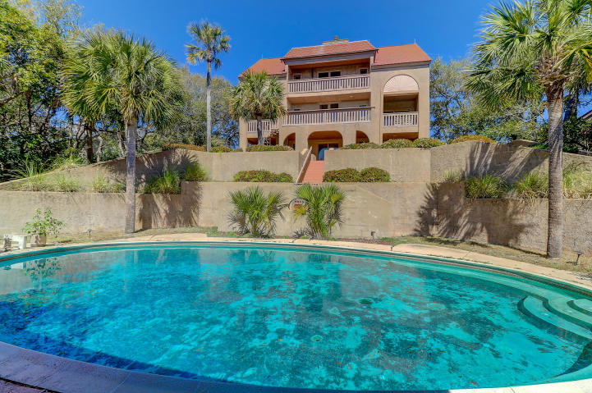
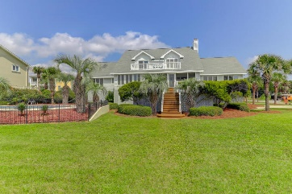
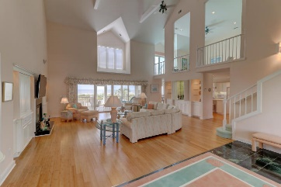
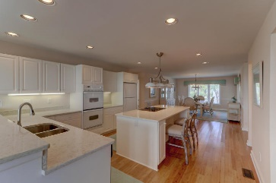
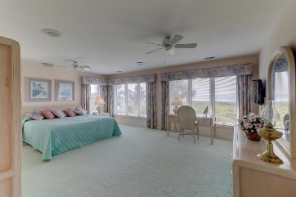
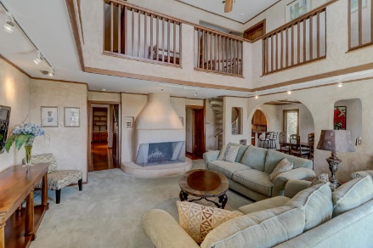
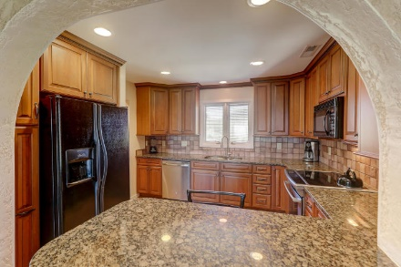
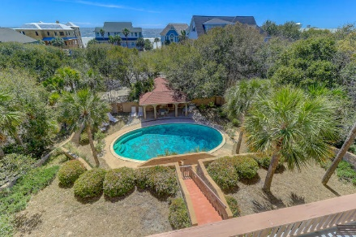
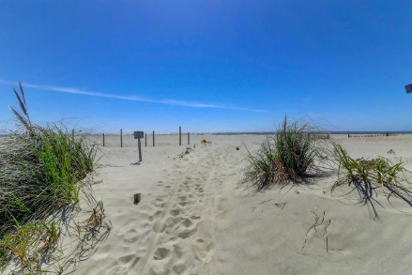
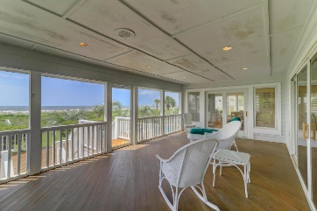


17 W Beachwood West Wild Dunes | Isle of Palms, SC 29451 | MLS# 19009304 | $2,200,000
New Price
Just Listed, Beachwood W/IOP
Ocean Views, Pool and Guest House
Unique home on one of the largest lots in Wild dunes!! This home is situated on a full acre with a main house and a one bedroom guest cottage with a three car garage. The lot is also one of the highest elevations in Wild Dunes and possibly the highest on the Isle of Palms. The main residence has 8 bedrooms, 5 full baths and 3 1/2 baths, a Great Room, dining area off the kitchen with great views of the Atlantic Ocean! Large pool with bathhouse--an ideal setting for entertaining! The impressive main residence with many grand features has approximately 4100 square feet and the guest cottage over 1000 sq. ft. This home features an updated kitchen with granite counter tops and custom cabinetry. Make an appointment to preview this home that offers a desirable location, 1 acre, elevated lot, pool with pool house and an adjacent guest cottage. One of a kind in Wild Dunes!
Darlene Smith Office - (843) 886-8110
Mobile - (843) 696-7824
darlenesmith@carolinaone.com
DarleneSmithTeam.com
Carolina One Real Estate
1503 Palm Blvd Ste
Isle of Palms, SC 29451

