Slide 1
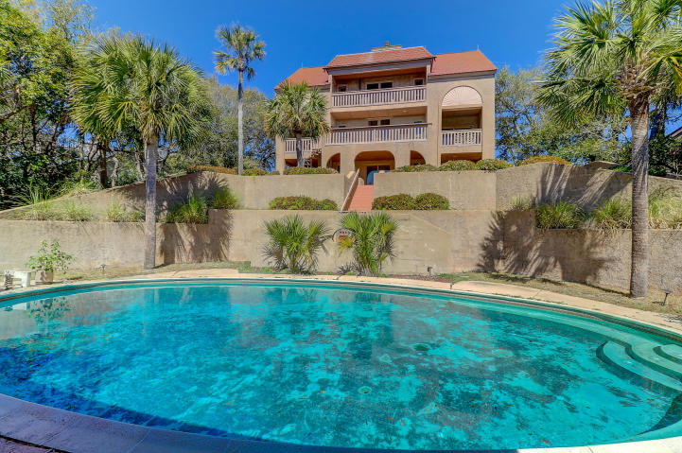
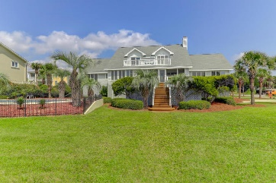
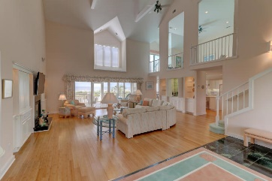
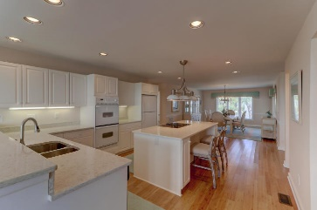
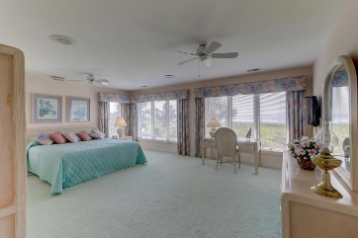
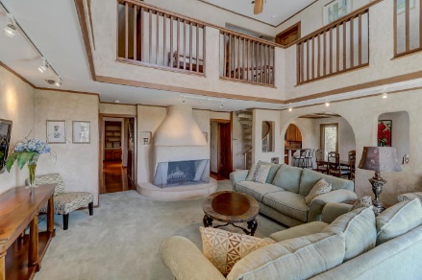
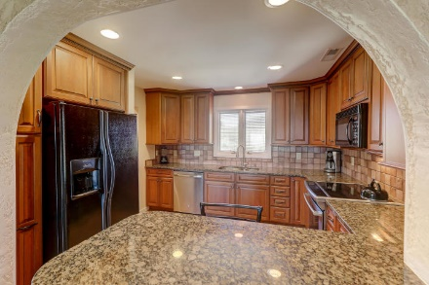
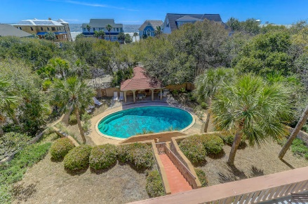
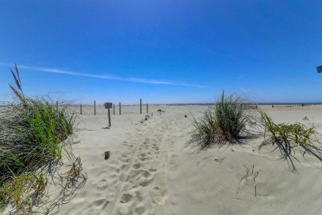
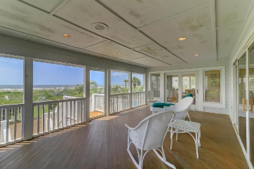


17 W Beachwood West
Wild Dunes | Isle of Palms, SC 29451 | MLS# 19009304 | $1,800,000
New Price
Ocean Views, Pool & Guest House
1 Acre Lot Can Be Subdivided Into 2 Lots With Conditions
Great Opportunity to purchase the "Castle" in Wild Dunes--Ocean Views and short walk to the beach. Unique home on one of the largest lots in Wild Dunes!! Even Better...this property has just been approved for a partition (subdivided) for two lots, with conditions that must be met and each one being approx 1/2 acre. A proposed survey has been completed and can be deeded separately and recorded once the conditions are met. The lot is also one of the highest elevations in Wild Dunes and possibly the highest on the Isle of Palms. This is a unique property with many options and won't last long!
The main residence has 8 bedrooms, 5 full baths and 3 1/2 baths, a Great Room, dining area off the kitchen with great views of the Atlantic Ocean! Large pool with bathhouse--an ideal setting for entertaining! The impressive main residence with many grand features has approximately 4100 square feet and the guest cottage over 1000 sq. ft. This home features an updated kitchen with granite counter tops and custom cabinetry. One of a kind in Wild Dunes!
Darlene Smith
Office - (843) 886-8110
Mobile - (843) 696-7824
darlenesmith@carolinaone.com
DarleneSmithTeam.com
Carolina One Real Estate
1503 Palm Blvd Ste
Isle of Palms, SC 29451

